Slide 1
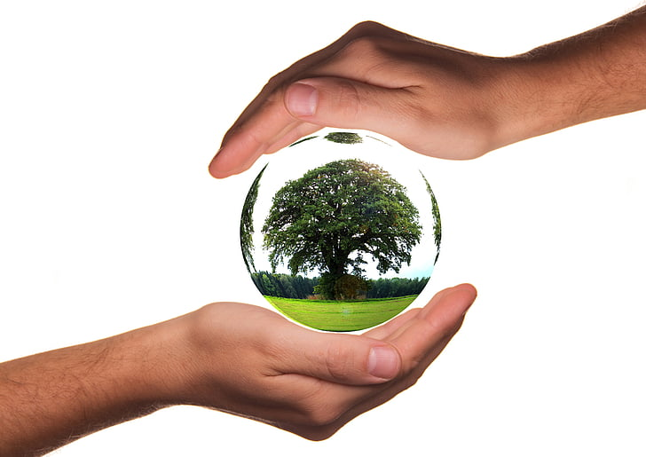






Earth Day 2020: Trees, Please!

Slide 2
University of Redlands is a private institution of higher education here in Redlands
Redlands Unified School District is the school District that your school is in!
The City of Redlands is where you attend school. City staffers work hard to make Redlands a wonderful place to live, work and study!
Esri is an international supplier of geographic information system software. The company is headquartered in Redlands.
IERCD is a local government agency that provides a range of services in habitat conservation, and education to residents in the Inland Empire.

Slide 3


What is Earth Day?
Why do we celebrate?
Notes:
Ask questions to gather students’ current knowledge.

Slide 4
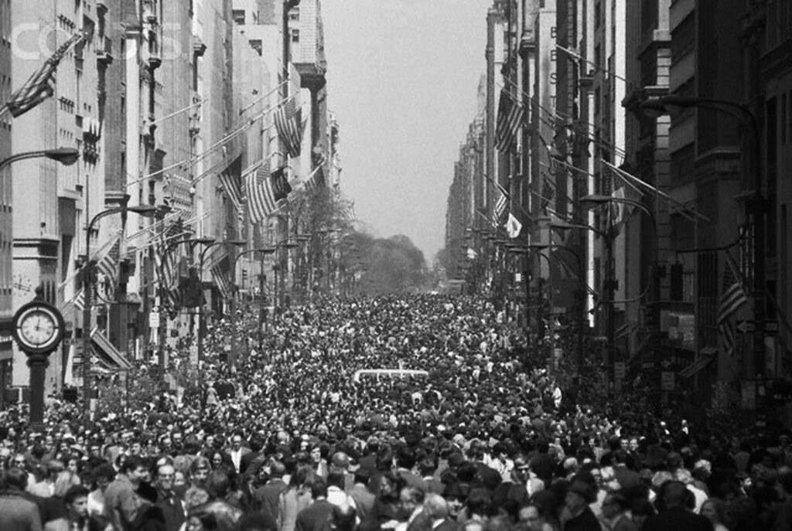
The first Earth Day occurred on April 22nd, 1970. On this day,
20 million Americans organized to demand a healthier, more sustainable environment.

Slide 5

Since 1970, one billion people have celebrated Earth Day in more than 190 countries across the world!

Slide 6

For Earth Day 2020 students in Redlands Unified School District will receive something that...

Slide 7

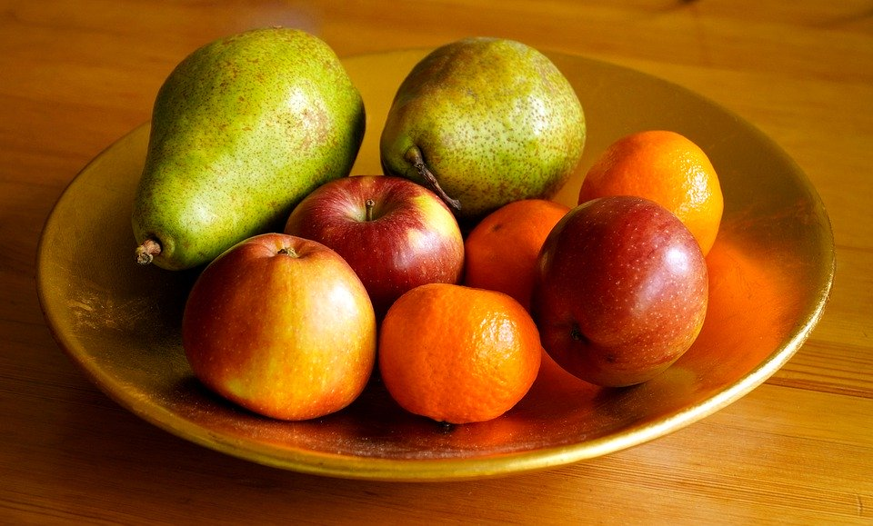

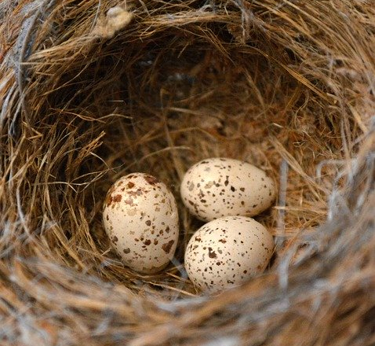
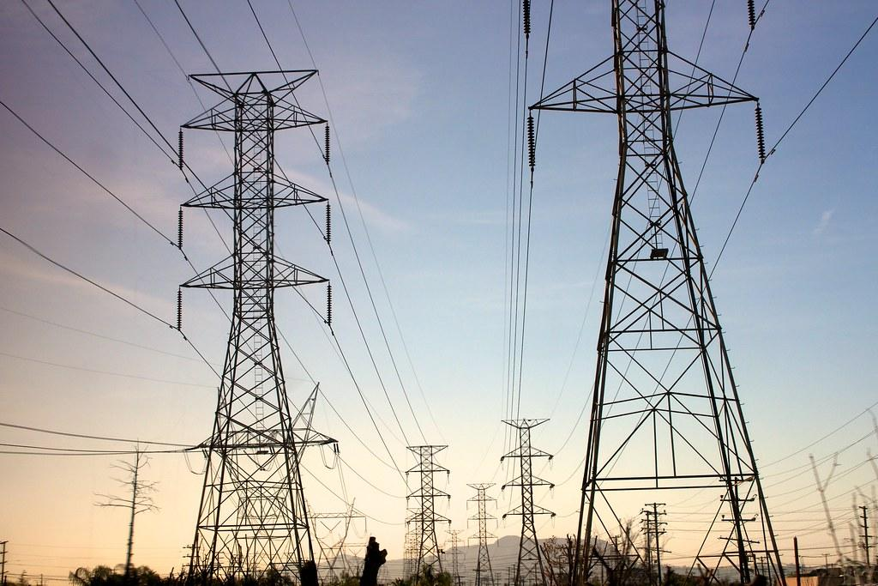

Is used in making medicine
Provides habitat
Gives us food
Produces oxygen and reduces smog
Saves electricity needed for heating and cooling

Slide 8

A tree for every student in RUSD!

Slide 9
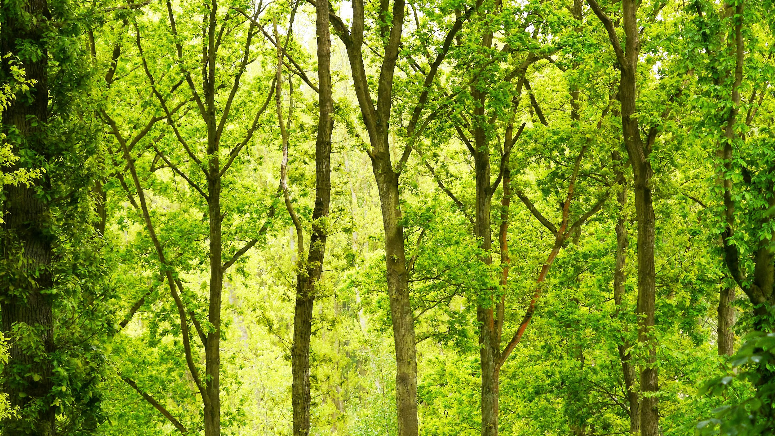
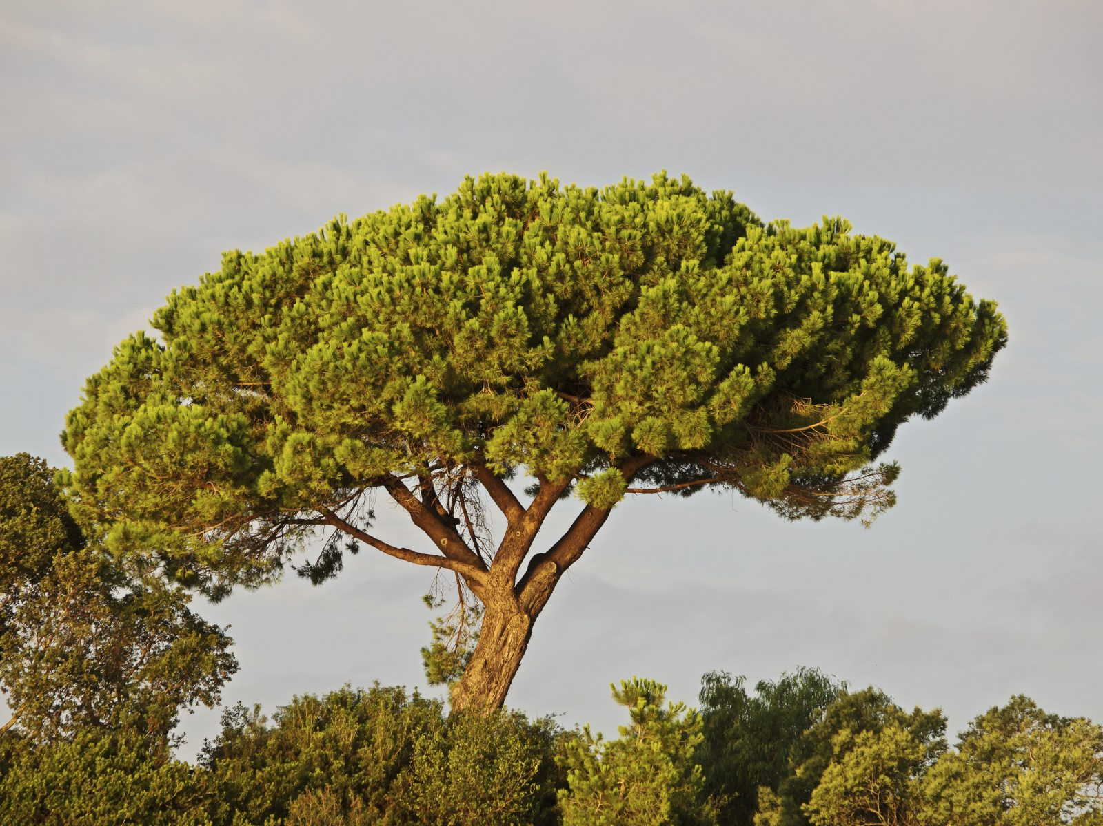
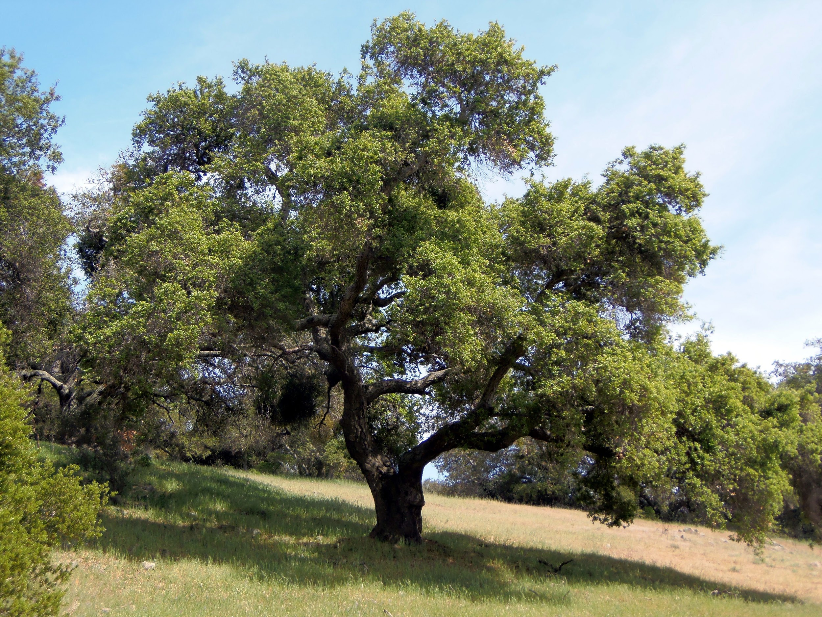
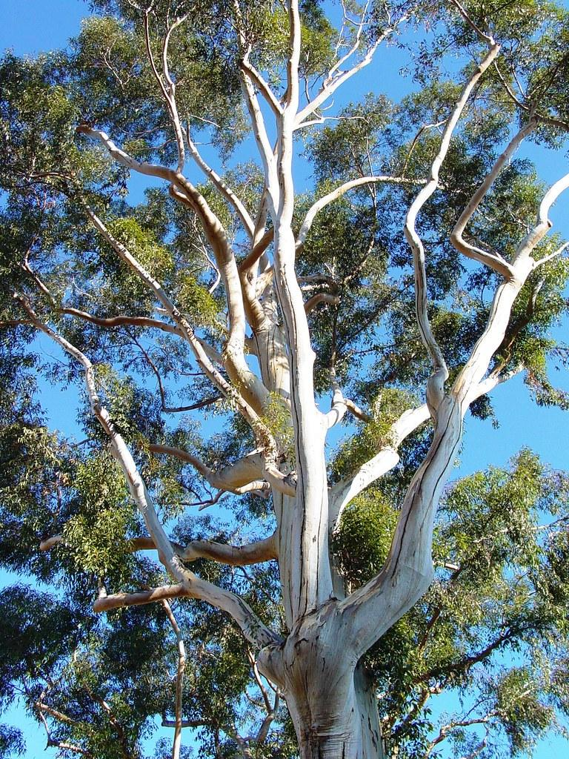
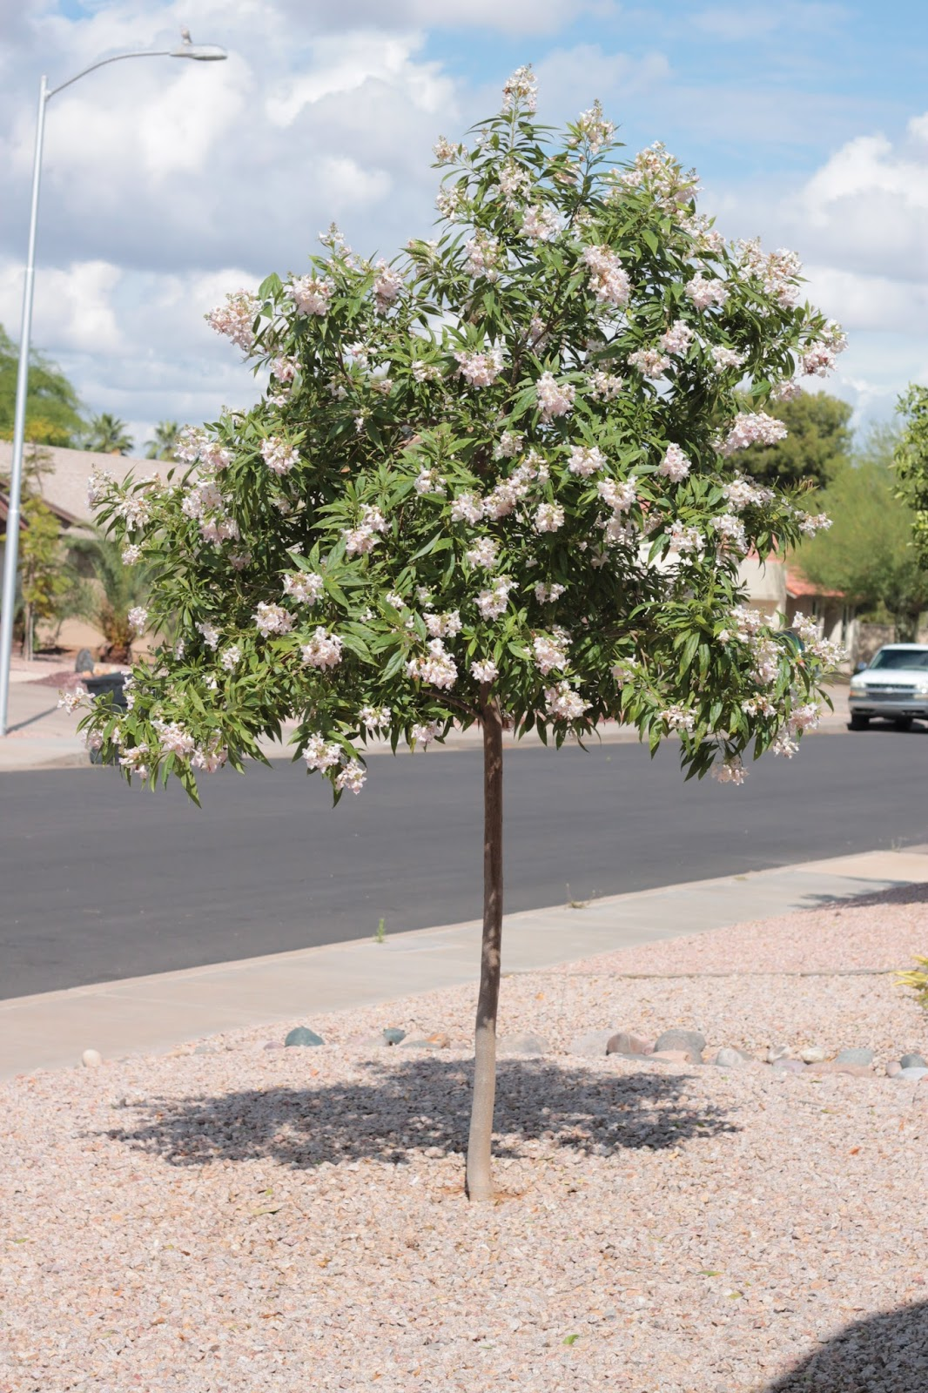
You will receive one of these four trees...
Stone Pine/ Pinus pinea
Coast Live Oak/Quercus agrifolia
Chitalpa/tashkentensis
Eucalyptus/Eucalyptus globulus
Notes:
Show pictures and ask students to guess trees

Slide 10
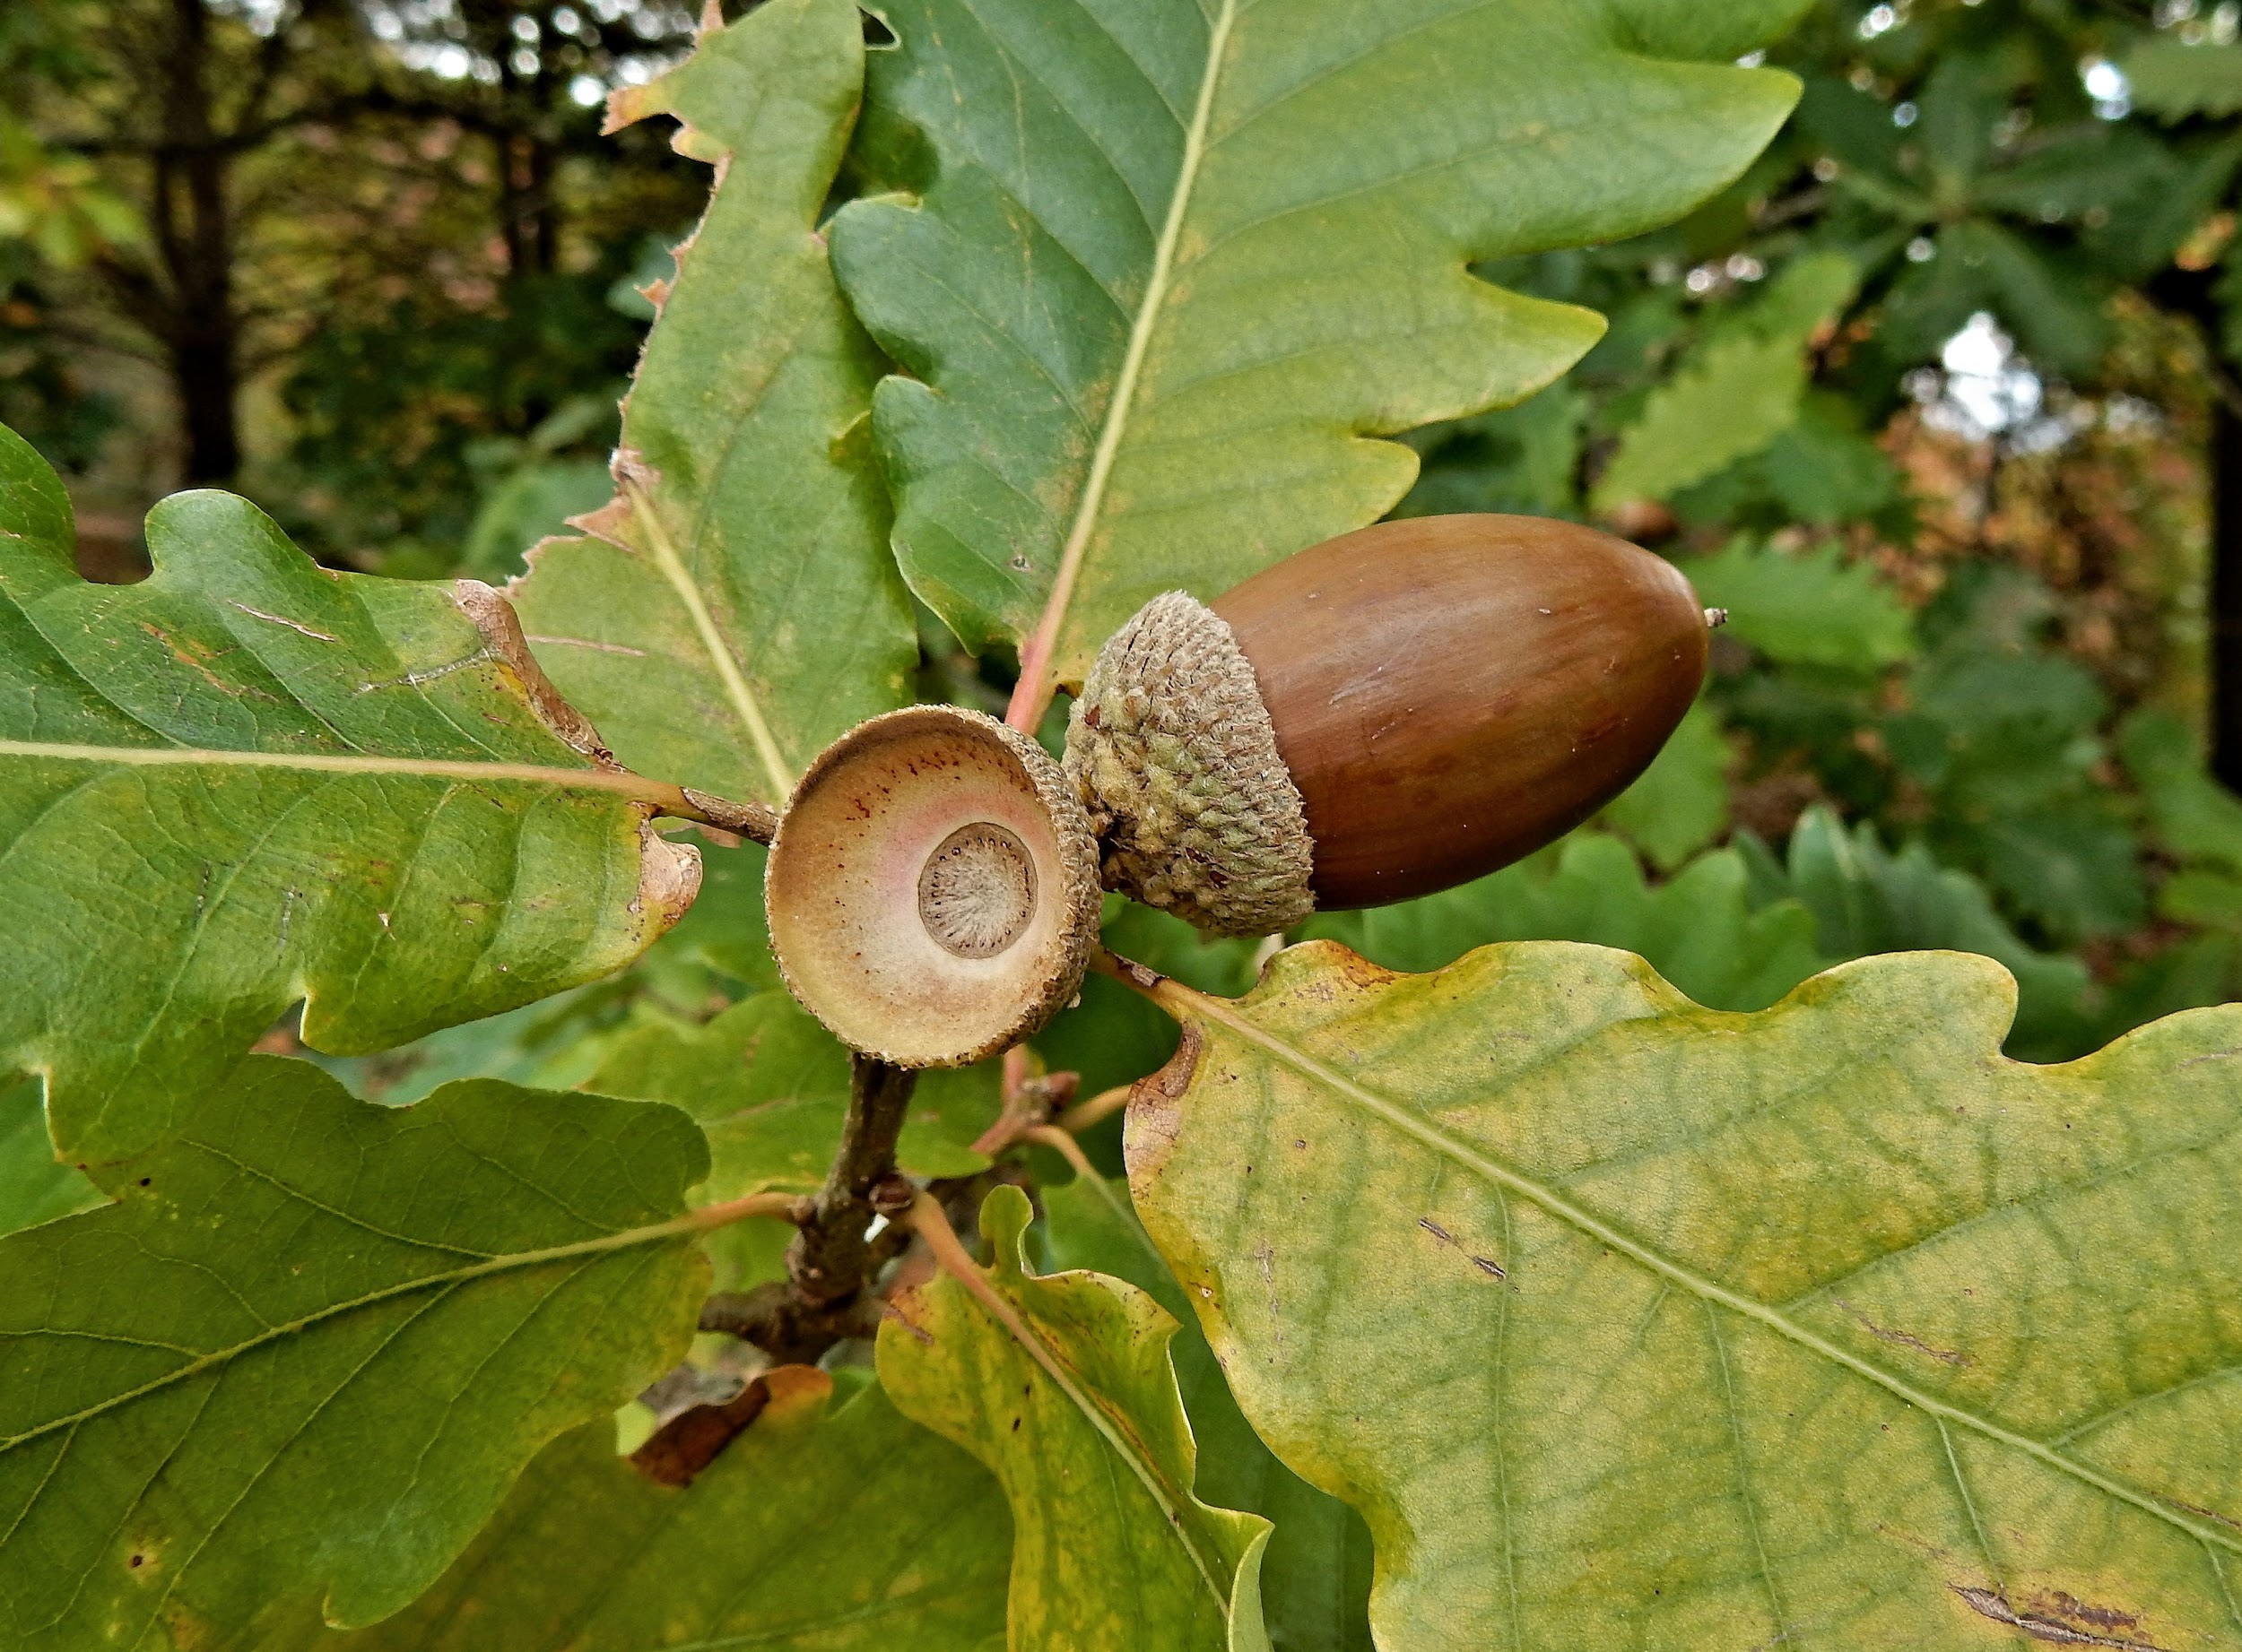
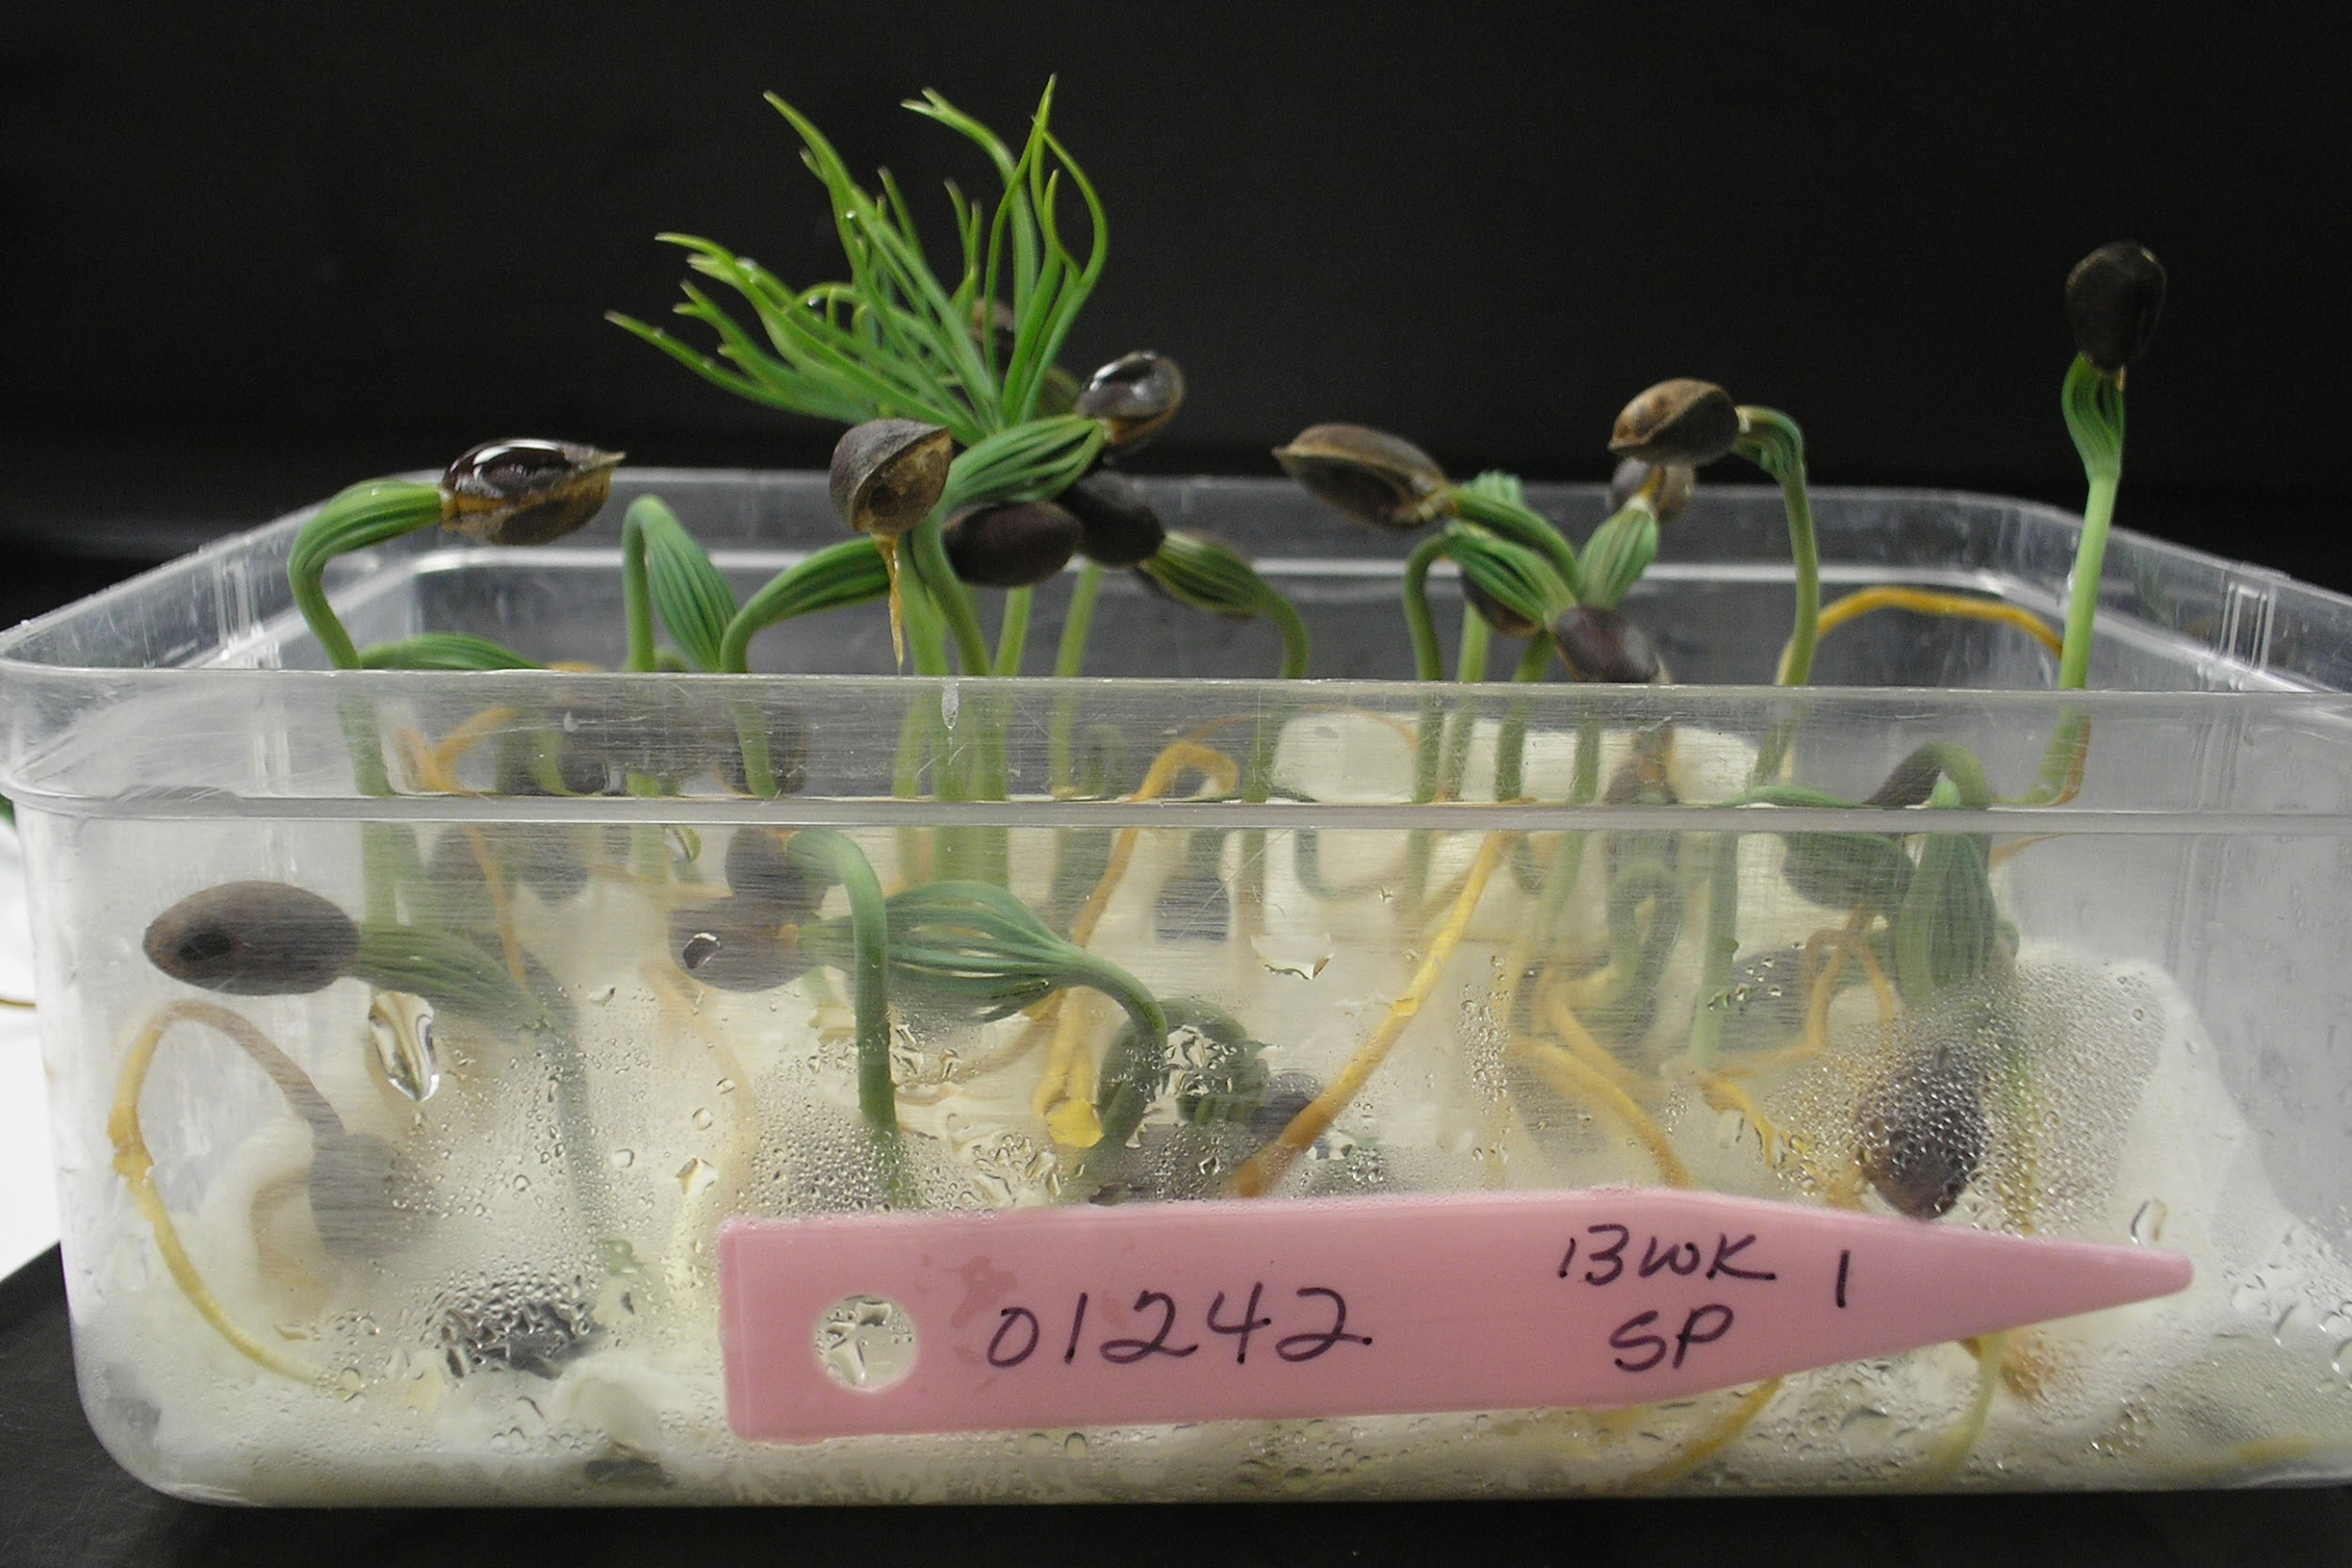

Support an argument that plants get the materials they need for growth chiefly from air and water.
Notes:
Phenomena: What do you think is happening in this video? What do you notice?

Slide 11
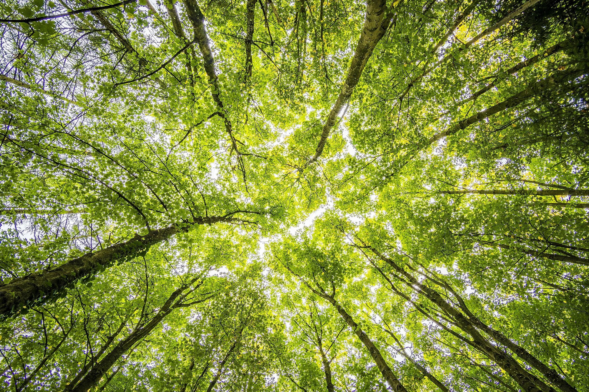

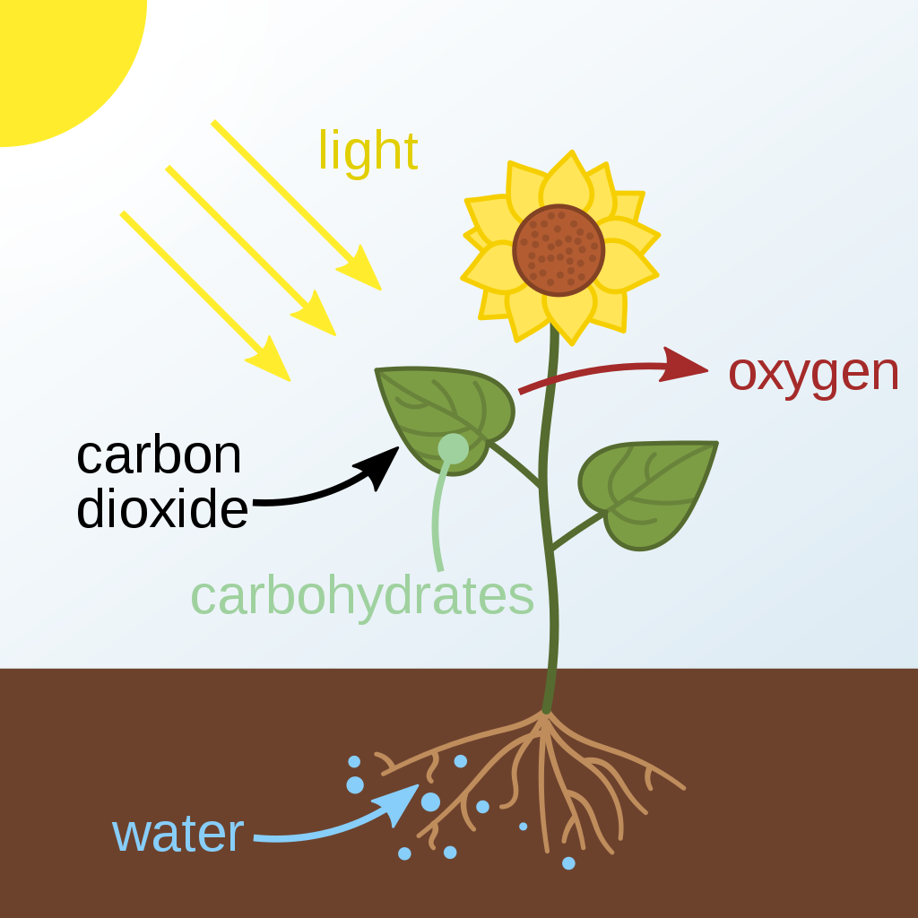


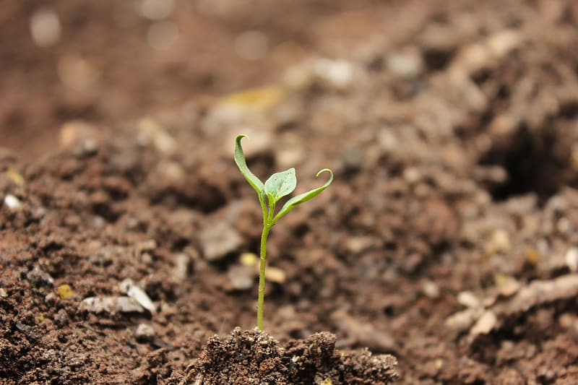
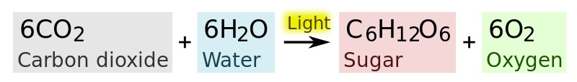
What does a tree need to survive?
Photosynthesis
4-LS1-1 Construct an argument that plants and animals have internal and external structures that function to support survival, growth, behavior, and reproduction.
Notes:
Ask question, then populate as students provide answers.

Slide 12
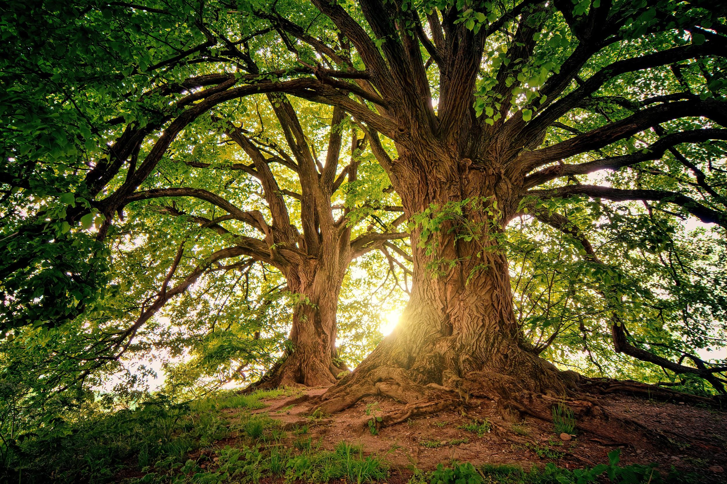
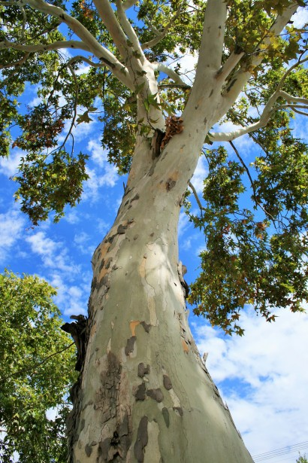
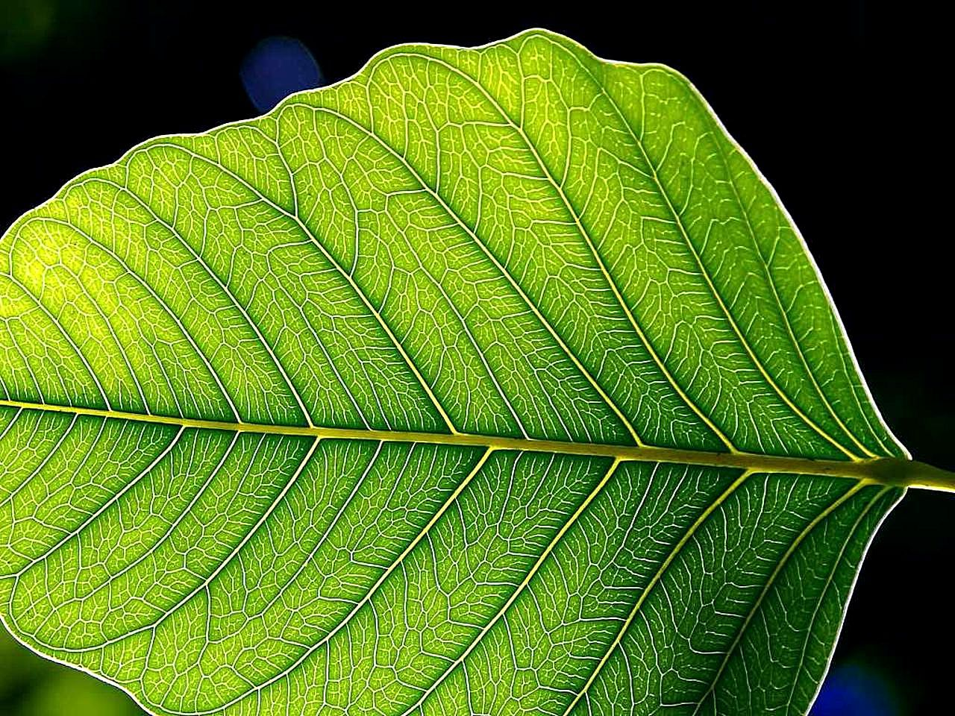
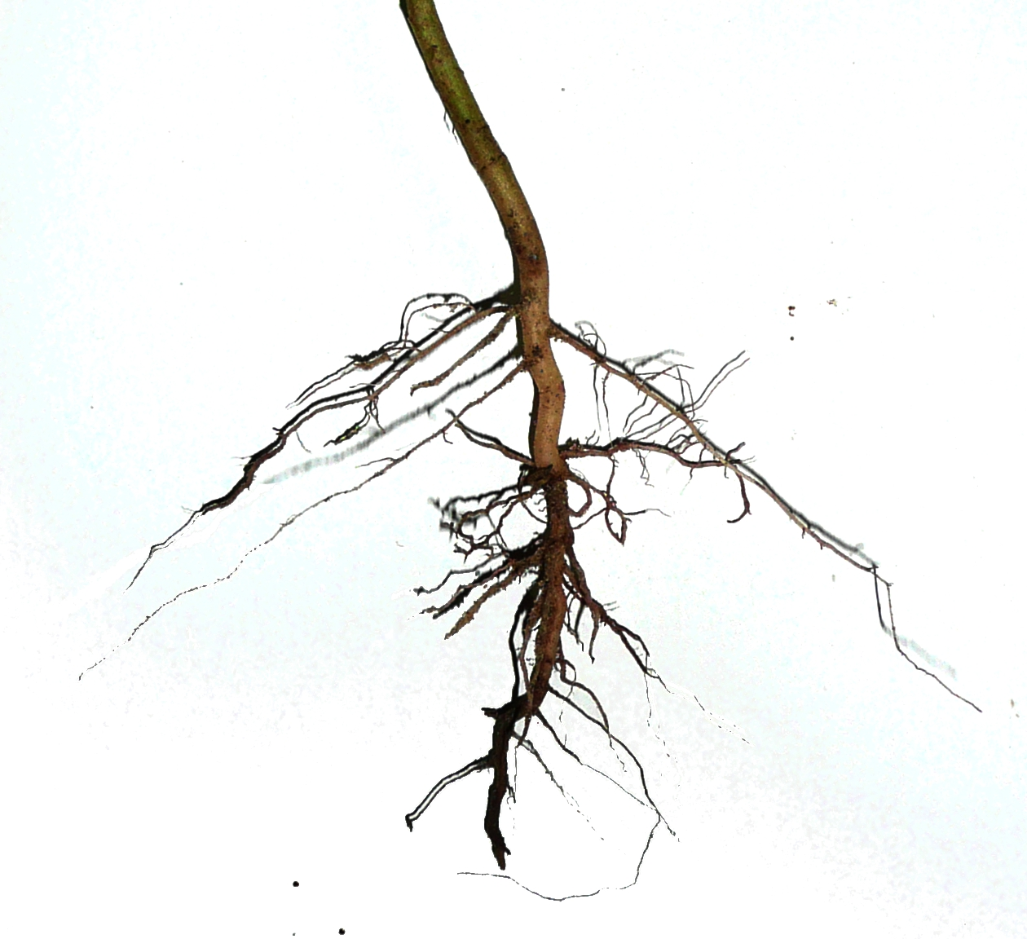
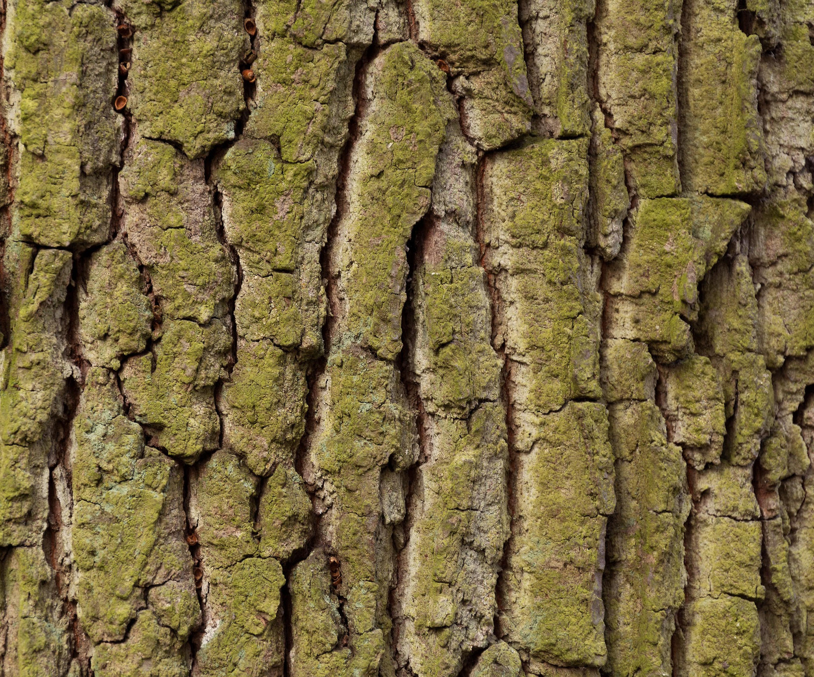
Do you know the different parts of a tree and what they do to help the tree?
The trunk provides structure. It carries water and minerals up from the roots to the leaves and carries sugar down to the roots.
Leaves use sun to make food for the tree
Roots absorb water and nutrients from the soil, store sugar, and anchor the tree.
Bark protects the tree from insects, disease, weather, and fire.
Notes:
Start with questions and images. Ask individual students to name an item and then explain how it helps the tree. Once all have been covered, then show purposes and review.

Slide 13
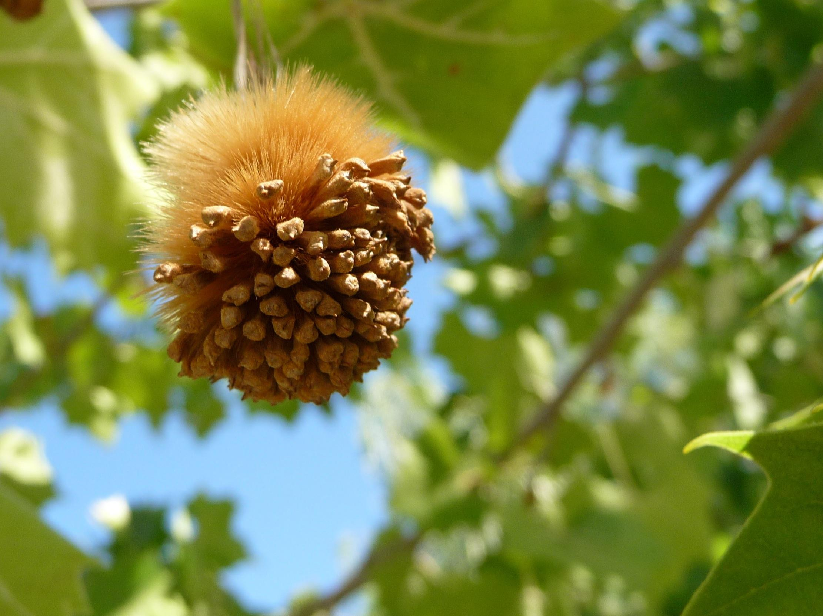
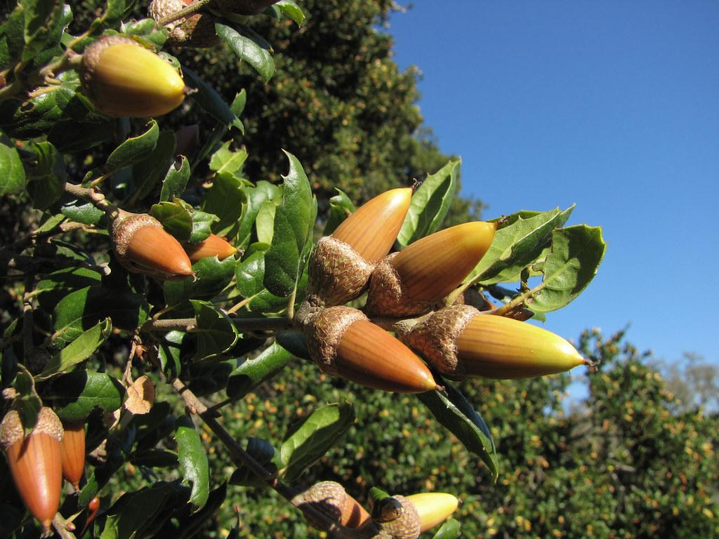
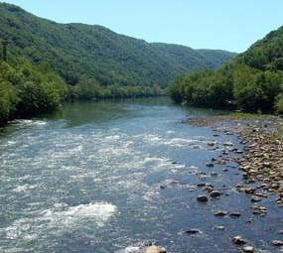
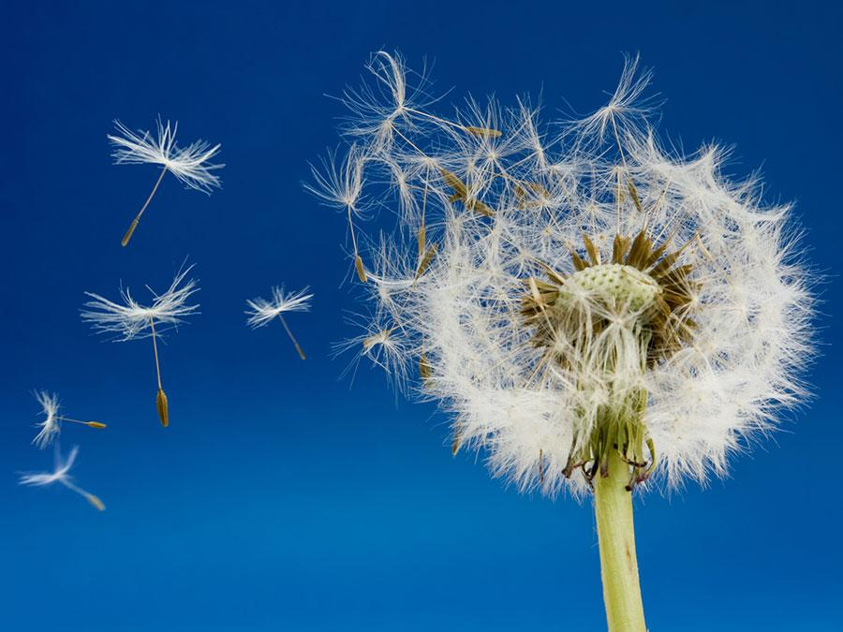
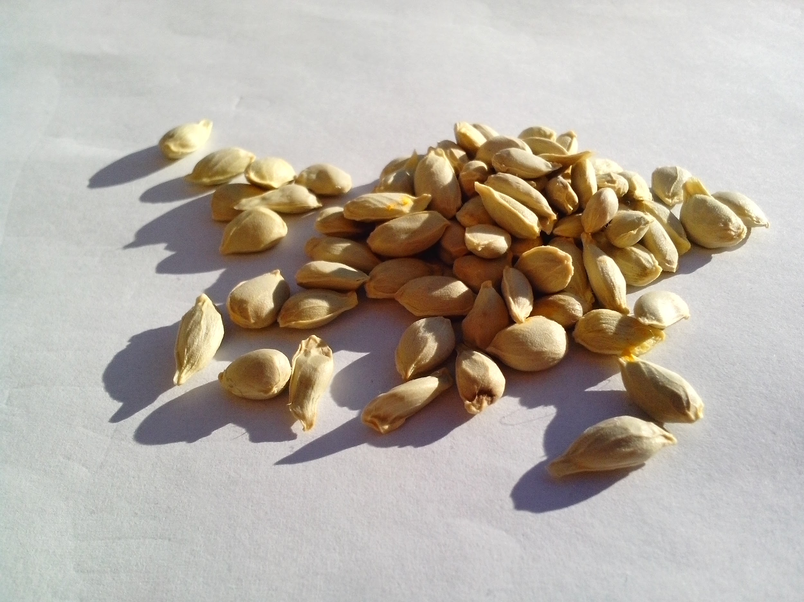
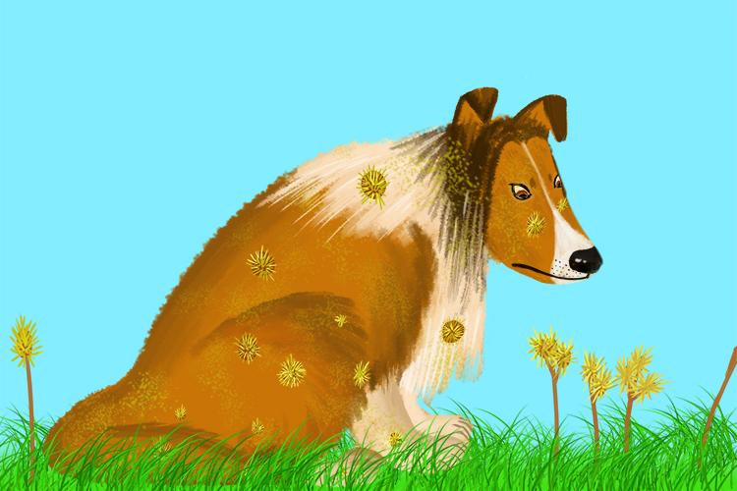
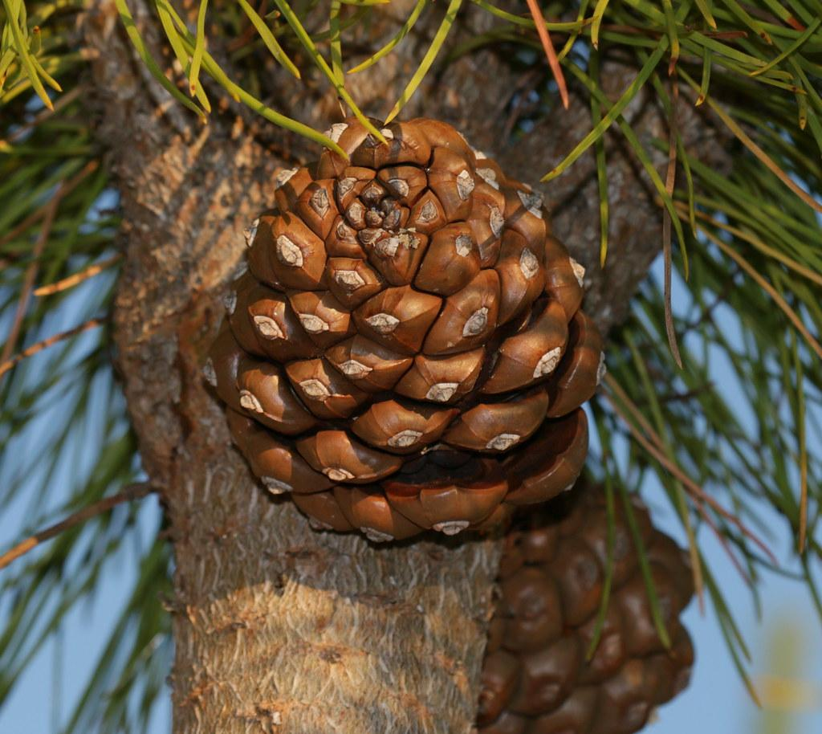
Let’s see what you know!
Water
Wind
Animals
Notes:
Seed observation and what it tells us about the way it might be dispersed:
Wind
Water
Animals - consumption, exterior transport
Gravity

Slide 14
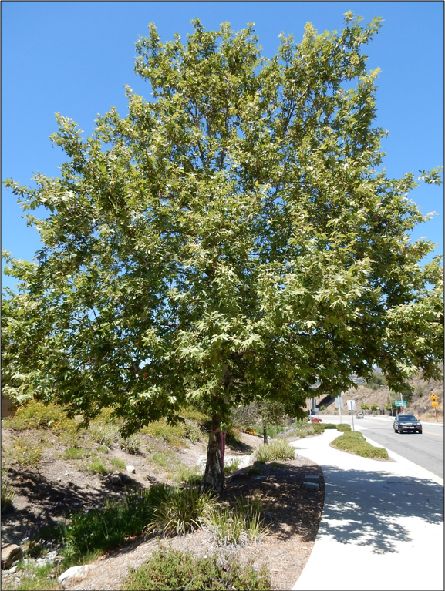
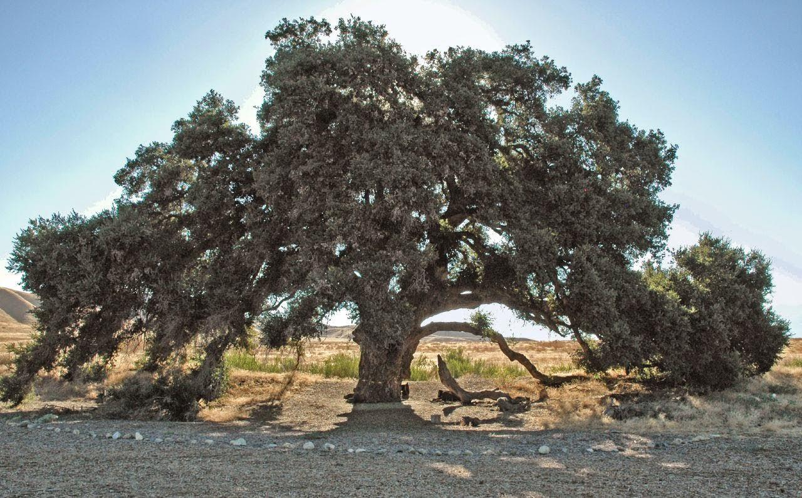
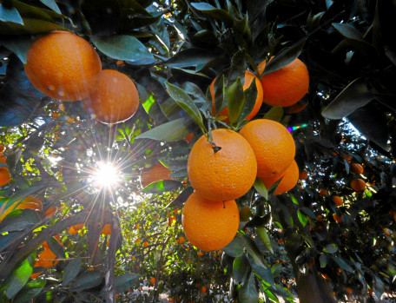
Let’s see what you know!
Orange
Sycamore
Coast live oak
Stone Pine
Notes:
Seed guessing/ID as trees appear

Slide 15
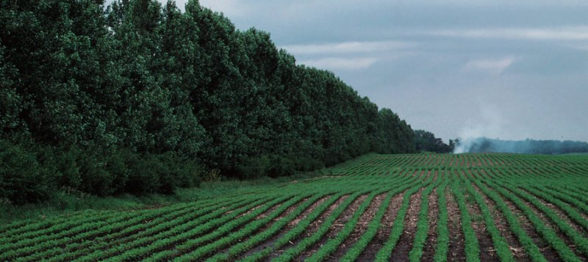
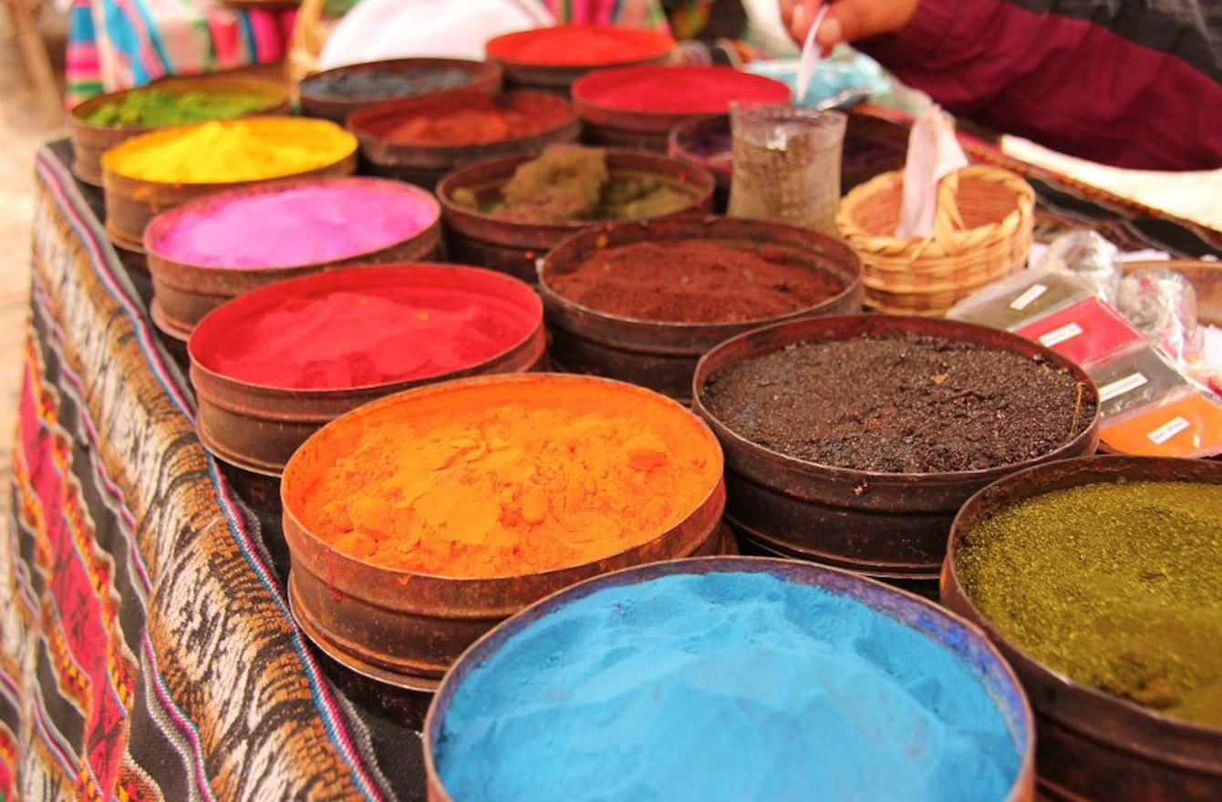
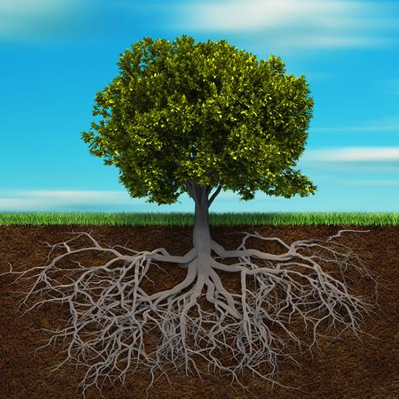
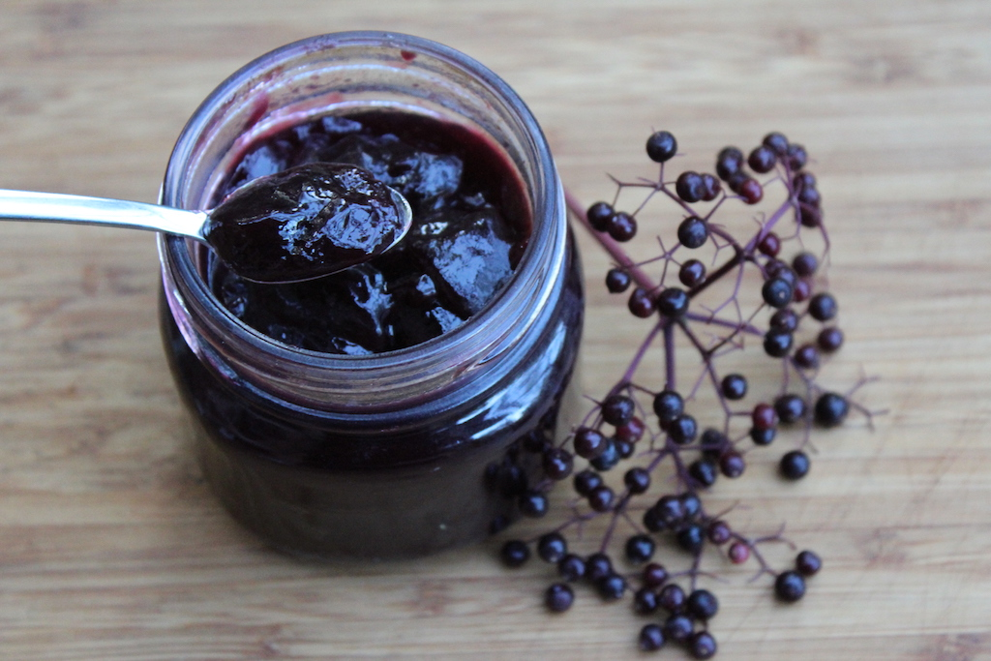
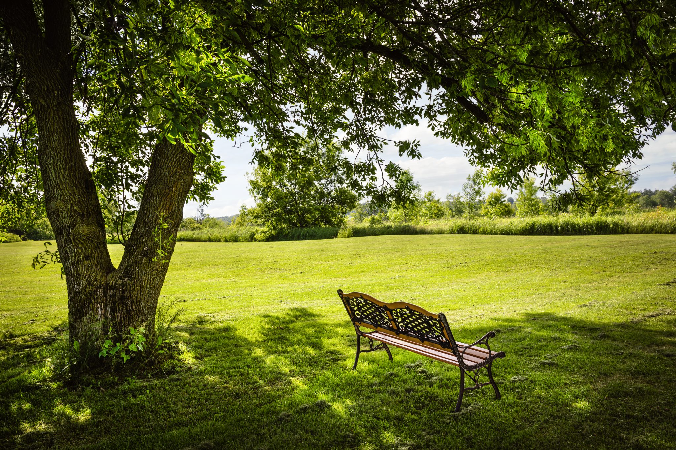
Why should we plant trees?
Notes:
Discussed in earlier slide: fruit, medicine, reducing heating/cooling costs, air quality benefits, habitat
This slide: local food (elderberry jam), protecting ag from wind, shade for people, dyes/pigments, elevation of soil health - aeration, stability

Slide 16
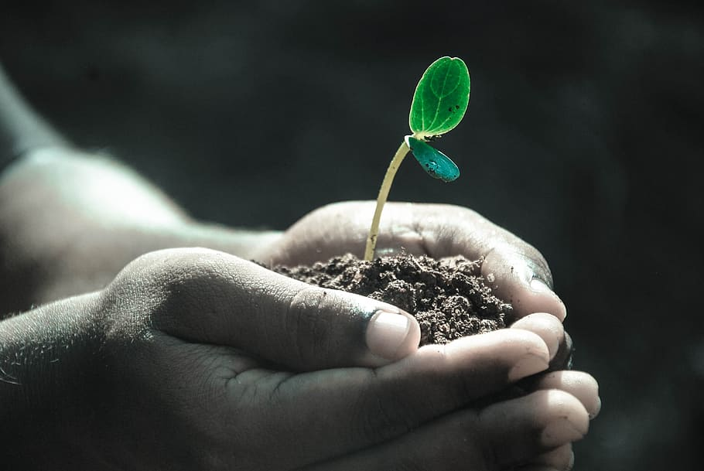
How will you care for your tree?
Notes:
Distribute tree profiles and care worksheets

Slide 17
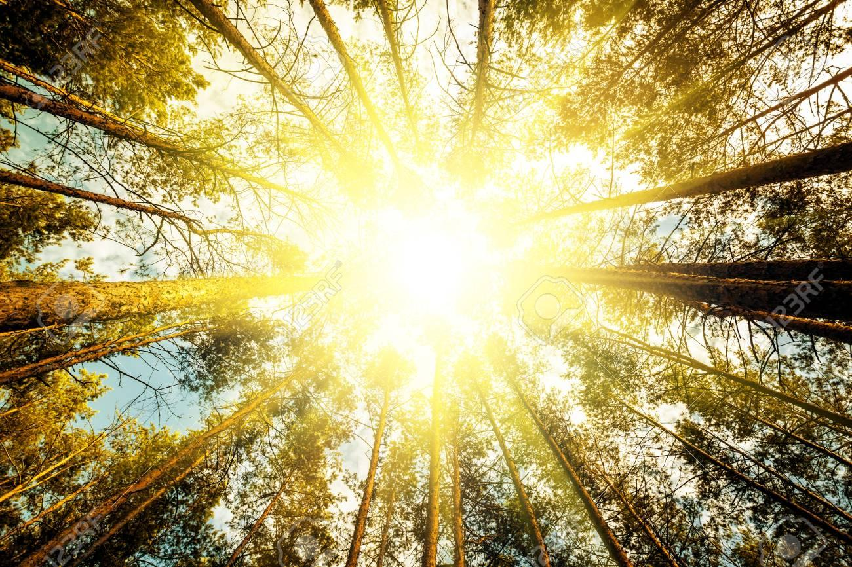
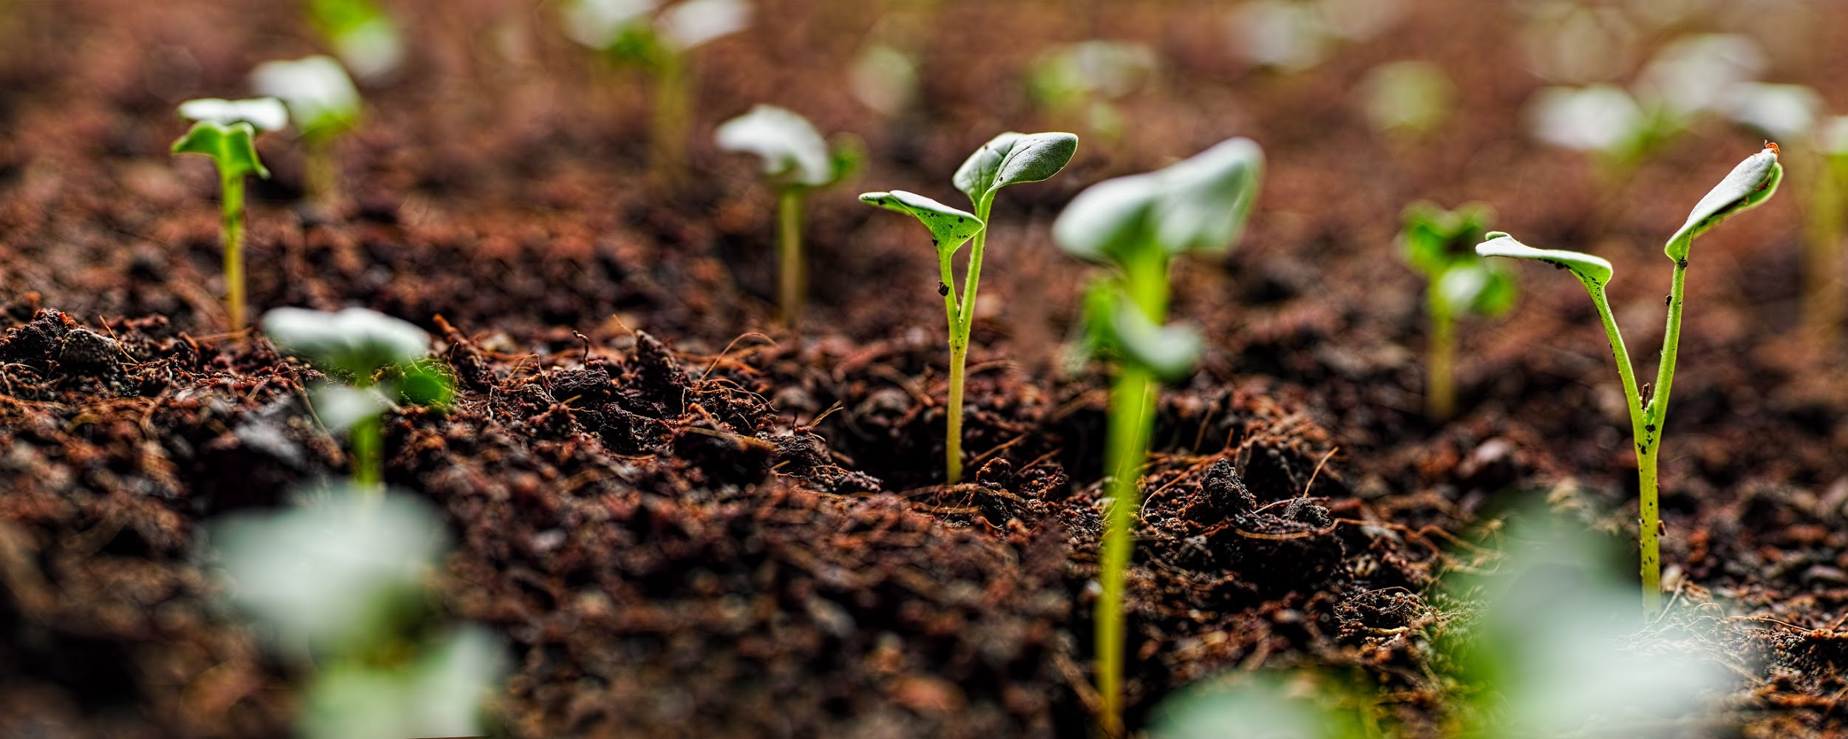
Wrap it up!
Water
To survive, trees need:
B. Sunlight
C. Healthy soil
D. All of these
D. All of these
Notes:
Start with photos and have students guess the seeds.

Slide 18

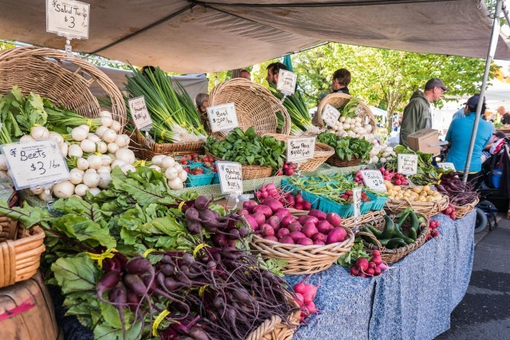

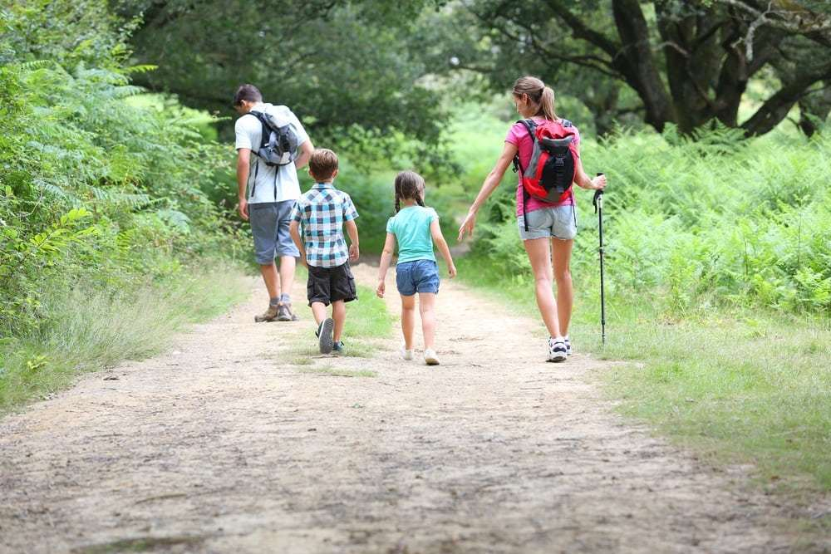
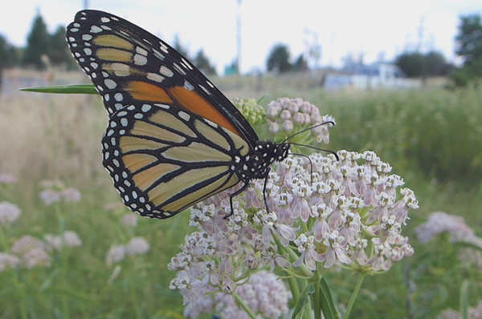
Wrap it up!
What else can we do for Earth Day?
Notes:
Reduce waste by donating clothes you no longer need
Save water
Get outside!
Plant pollinator habitat
Eat locally
Other ideas

Slide 19
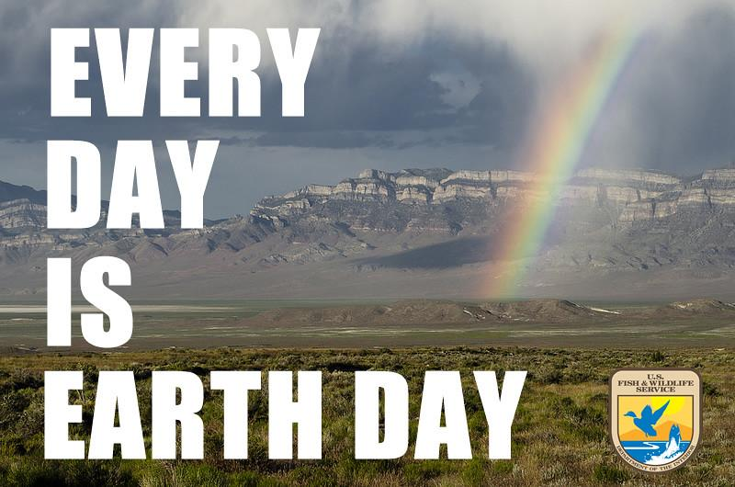
redlands.edu/trees
Notes:
Thank you to students
redlands.edu/trees demo at end, time permitting: map, resources, activities

