Slide 1
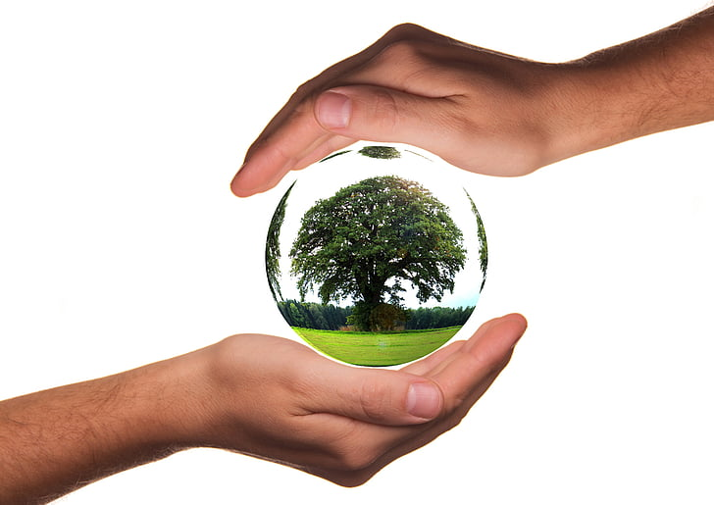






Earth Day 2020: Trees, Please!

Slide 2
Redlands Unified School District is the school District that your school is in!
U of R is a private institution of higher education in Redlands
Environmental Systems Research Institute (ESRI)
Creator of Geographic Information Systems (GIS), software that collects and analyzes data in a geographical context
“The Science of Where”
IERCD is a local government agency that provides a range of services in habitat conservation, and education to residents in the Inland Empire.
Redlands is the City your school is in! City staffers work hard to make sure Redlands is a great place to live, work, and study.

Slide 3


What is Earth Day?
Why do we celebrate?
Notes:
Ask questions to gather students’ current knowledge.

Slide 4
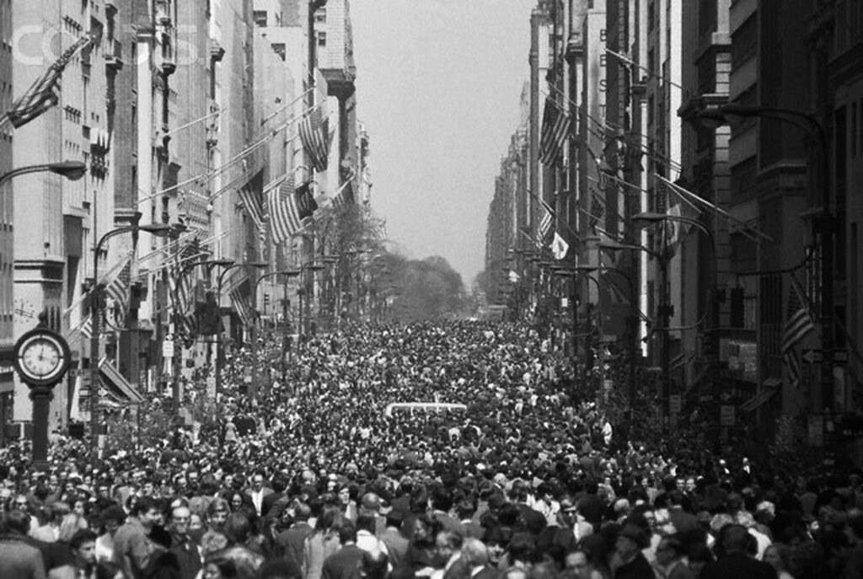
The first Earth Day occurred on April 22nd, 1970. On this day 20 Million Americans organized to demand a healthier, more sustainable environment.

Slide 5

Since 1970, one billion people have celebrated Earth Day in more than 190 countries across the world!

Slide 6

For Earth Day 2020 students in Redlands Unified School District will receive something that...

Slide 7

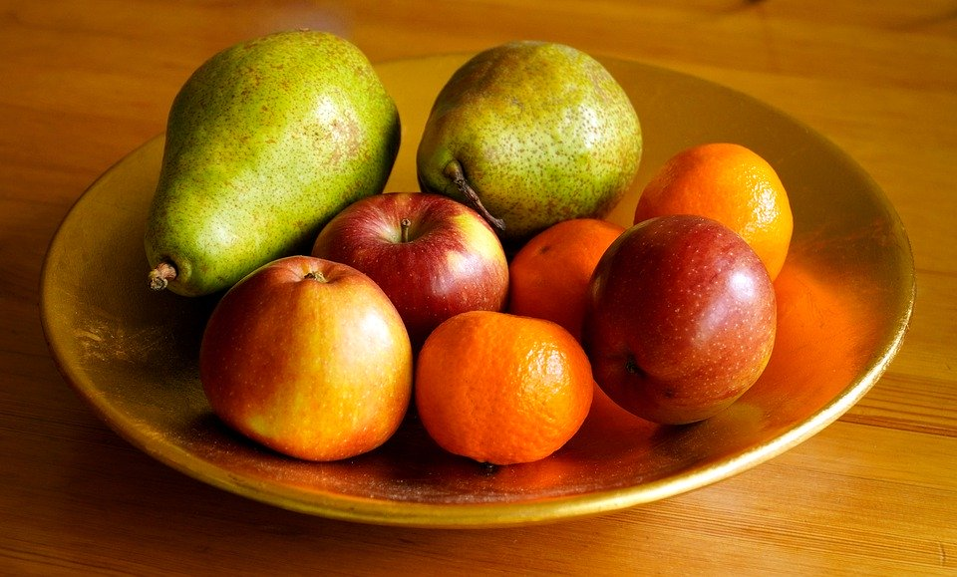

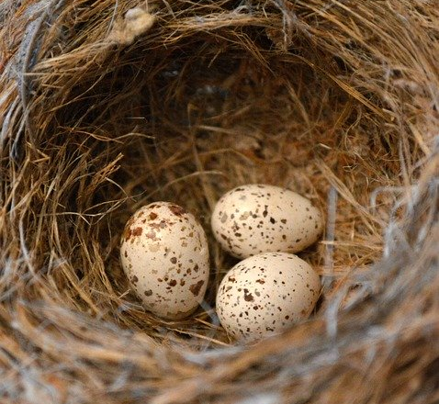
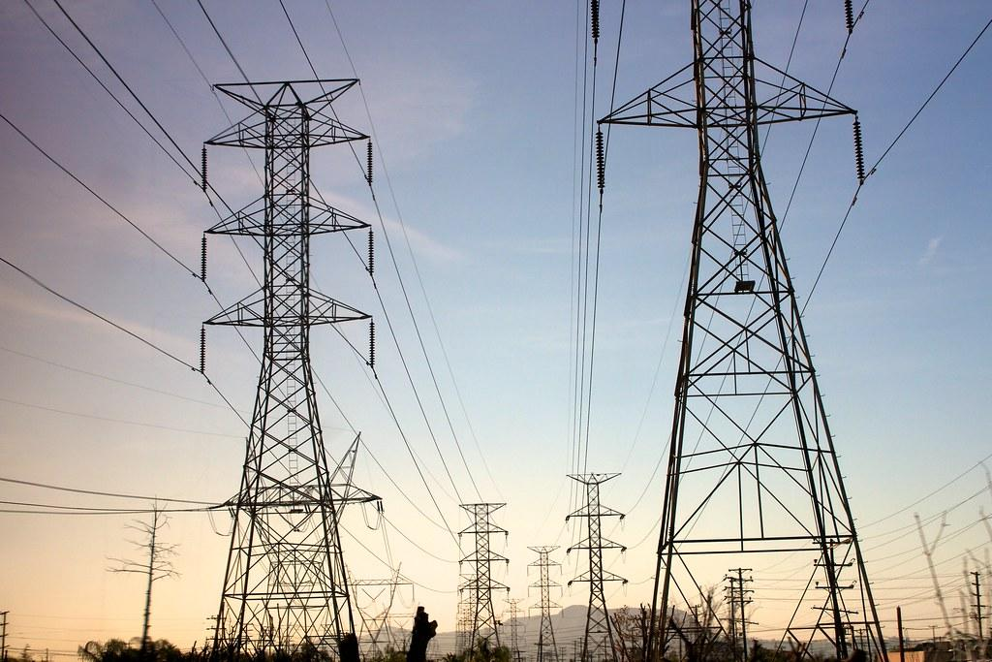
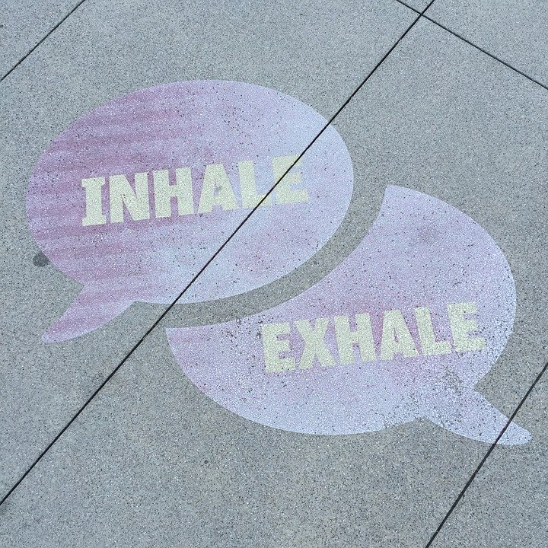
Is used in making medicine
Provides habitat
Gives us food
Produces oxygen and reduces smog
Saves electricity needed for heating and cooling

Slide 8

A tree for every student in RUSD!

Slide 9
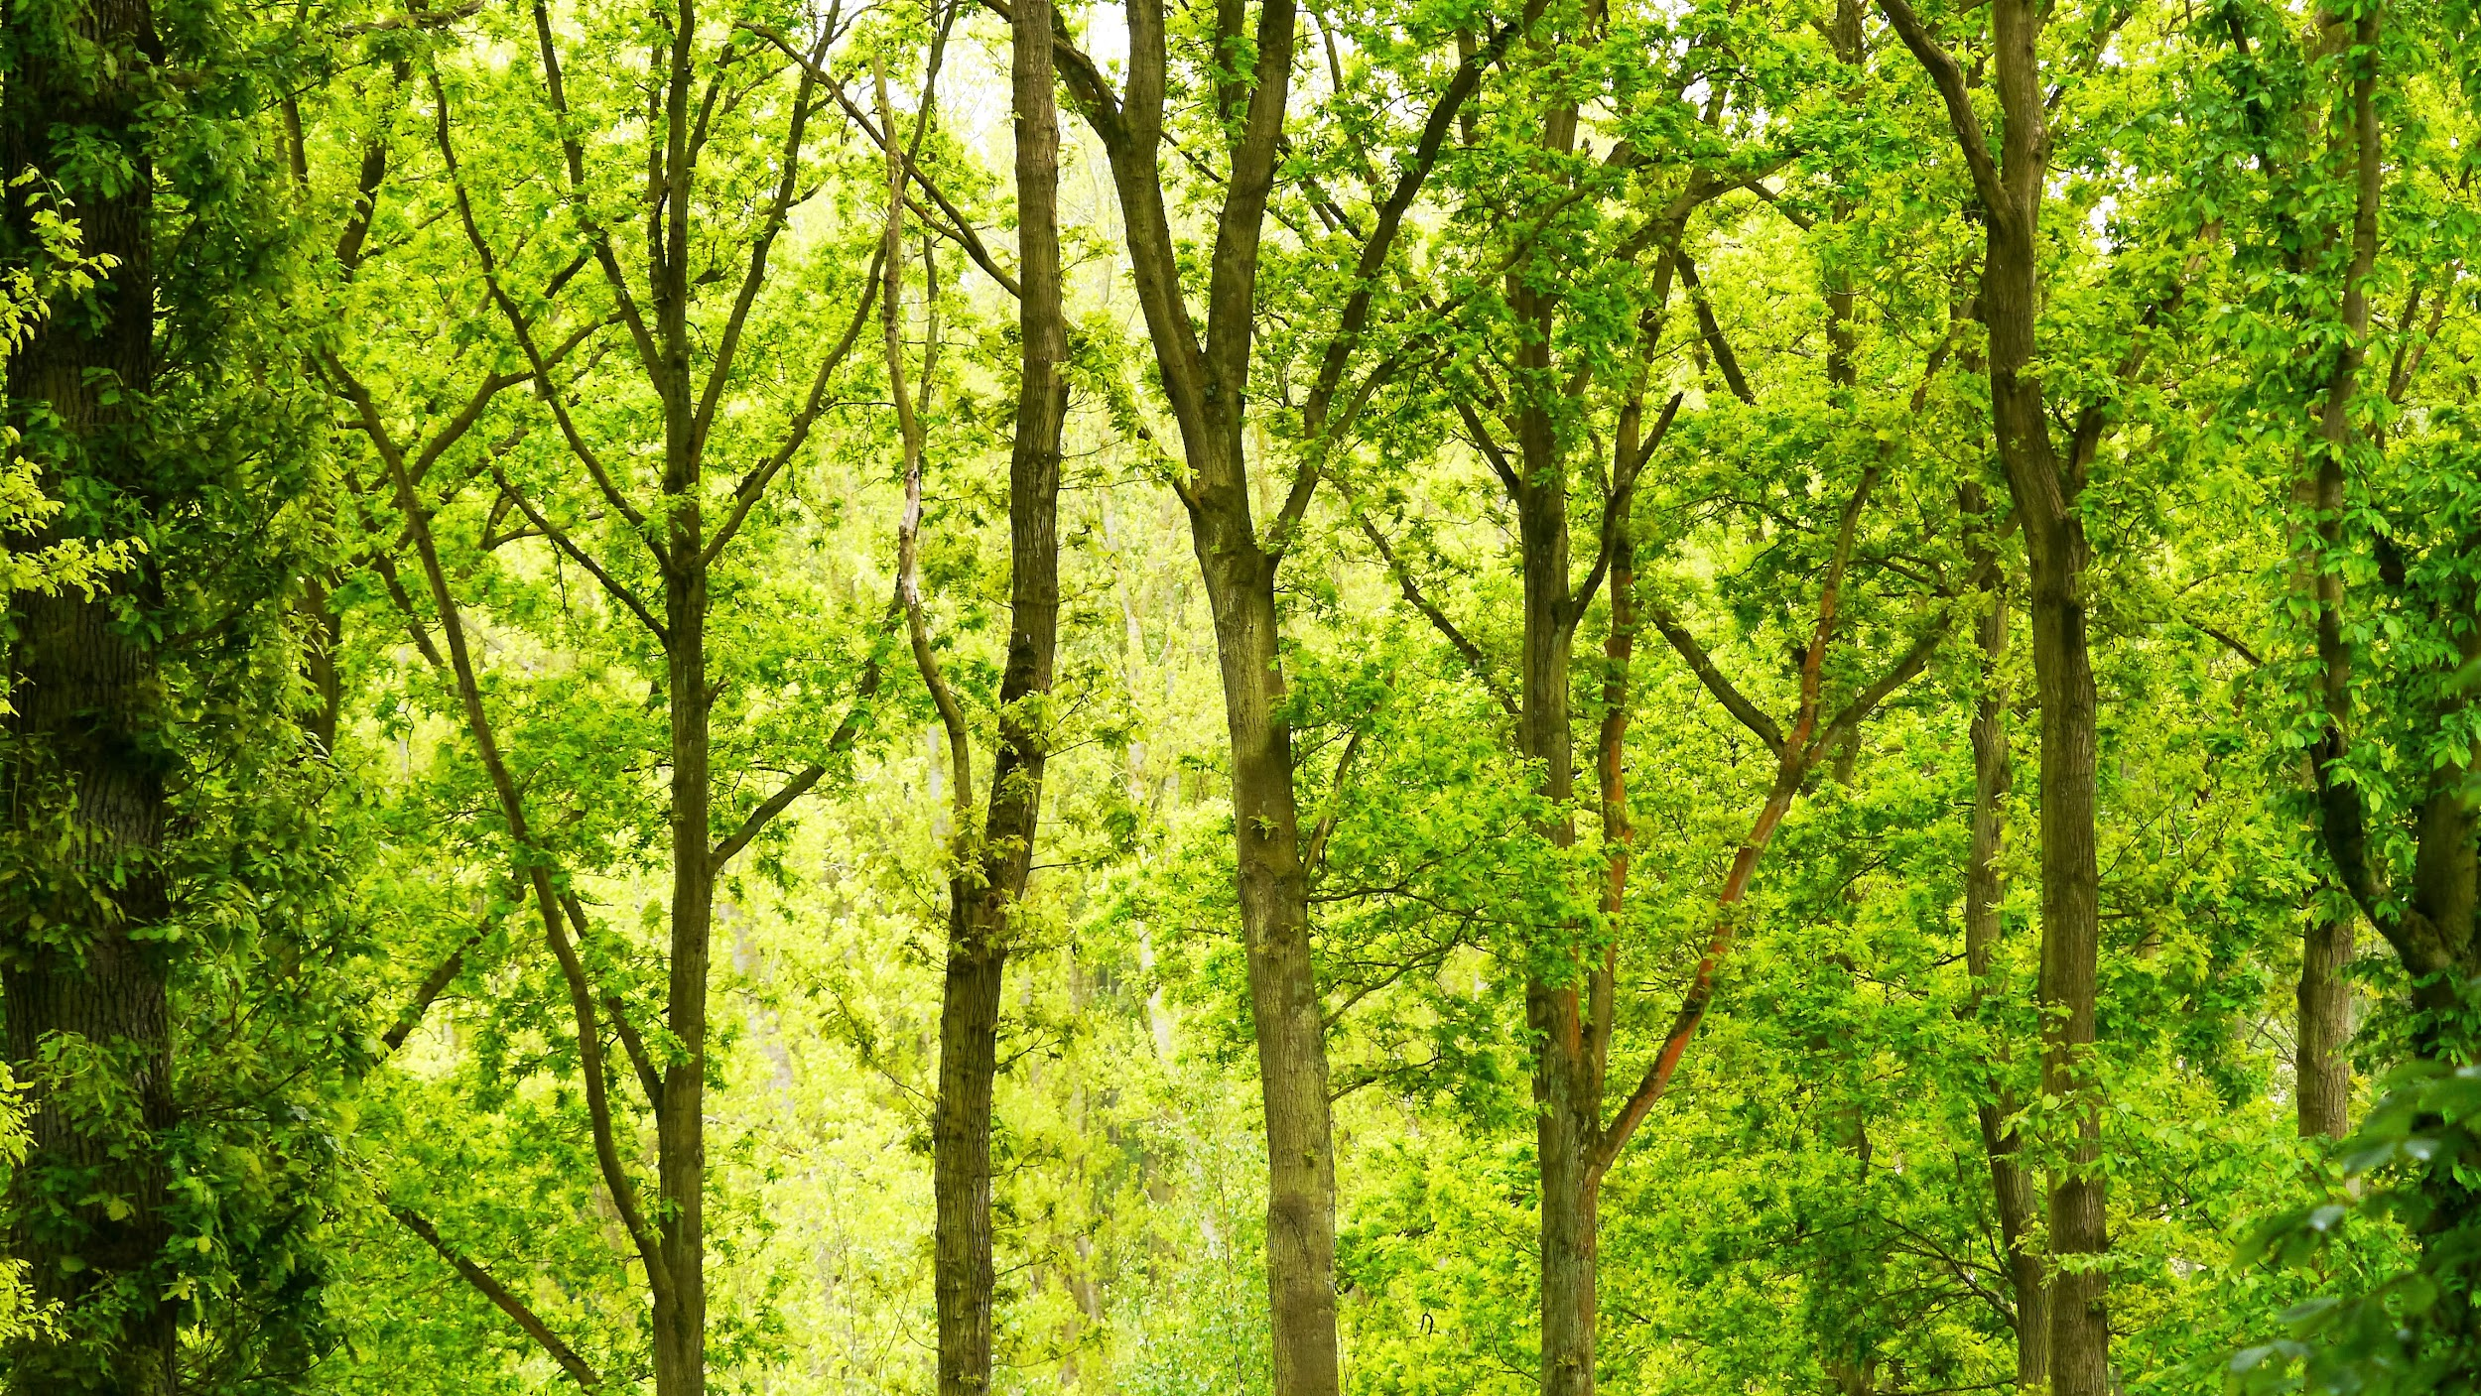
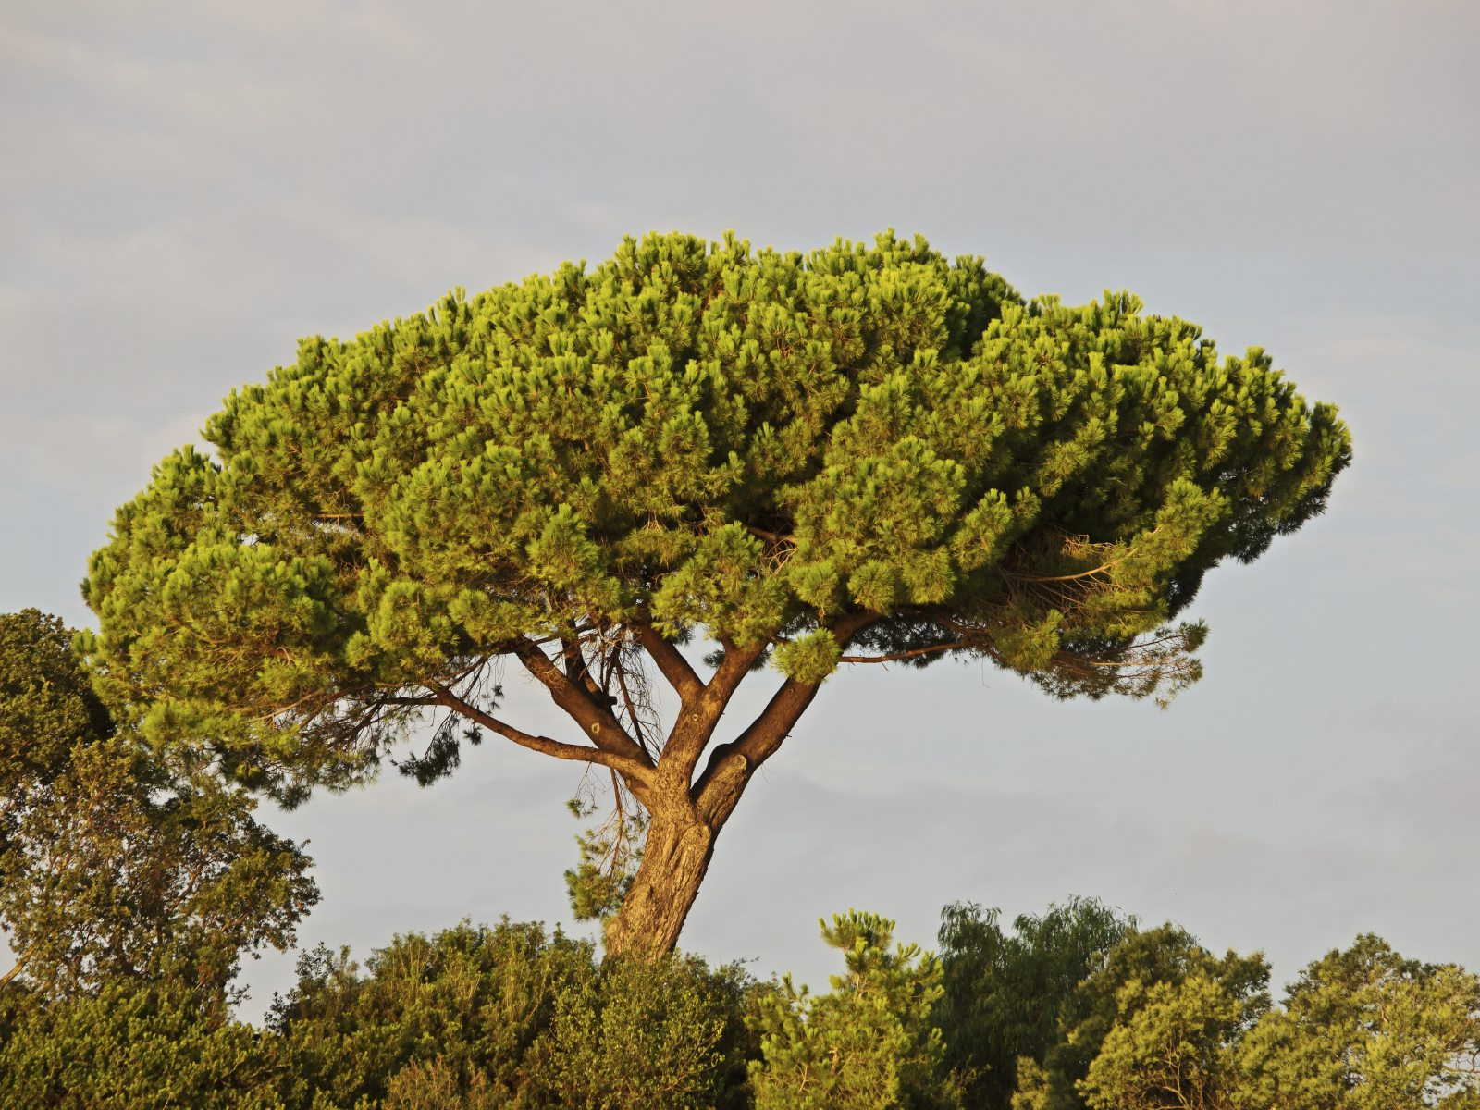
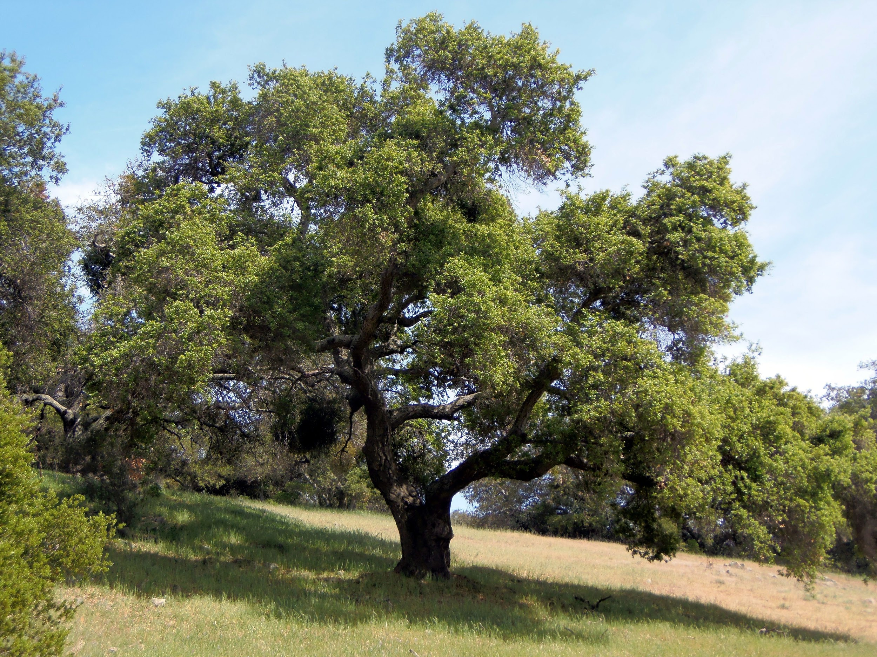
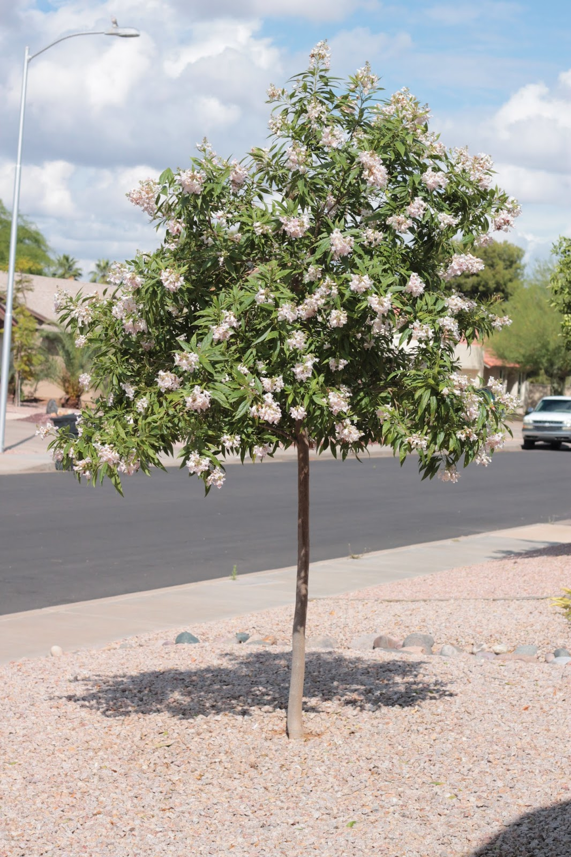
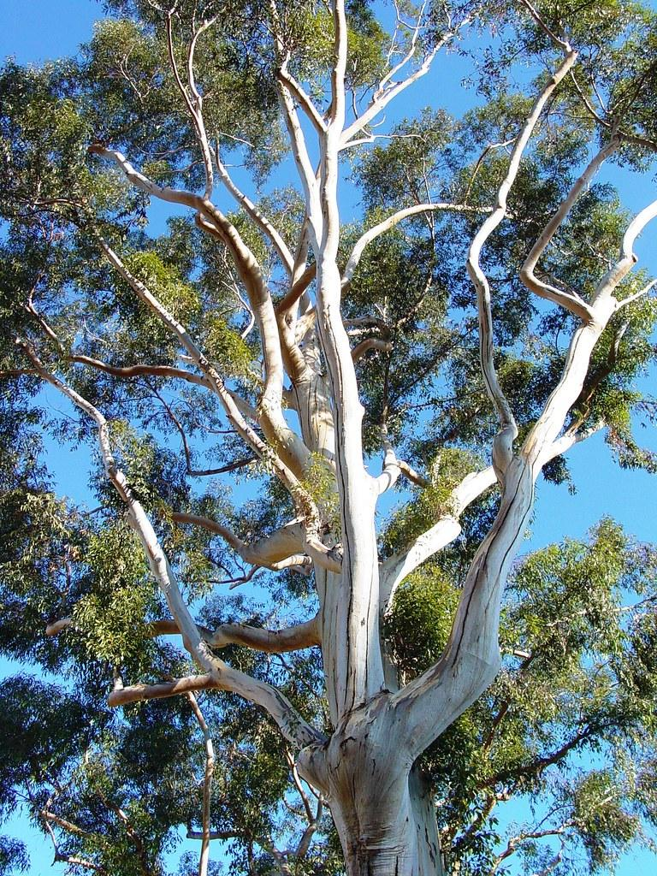
You will receive one of these four trees...
Stone Pine
Coast Live Oak
Chitalpa
Eucalyptus
Notes:
Show pictures and ask students to guess trees

Slide 10
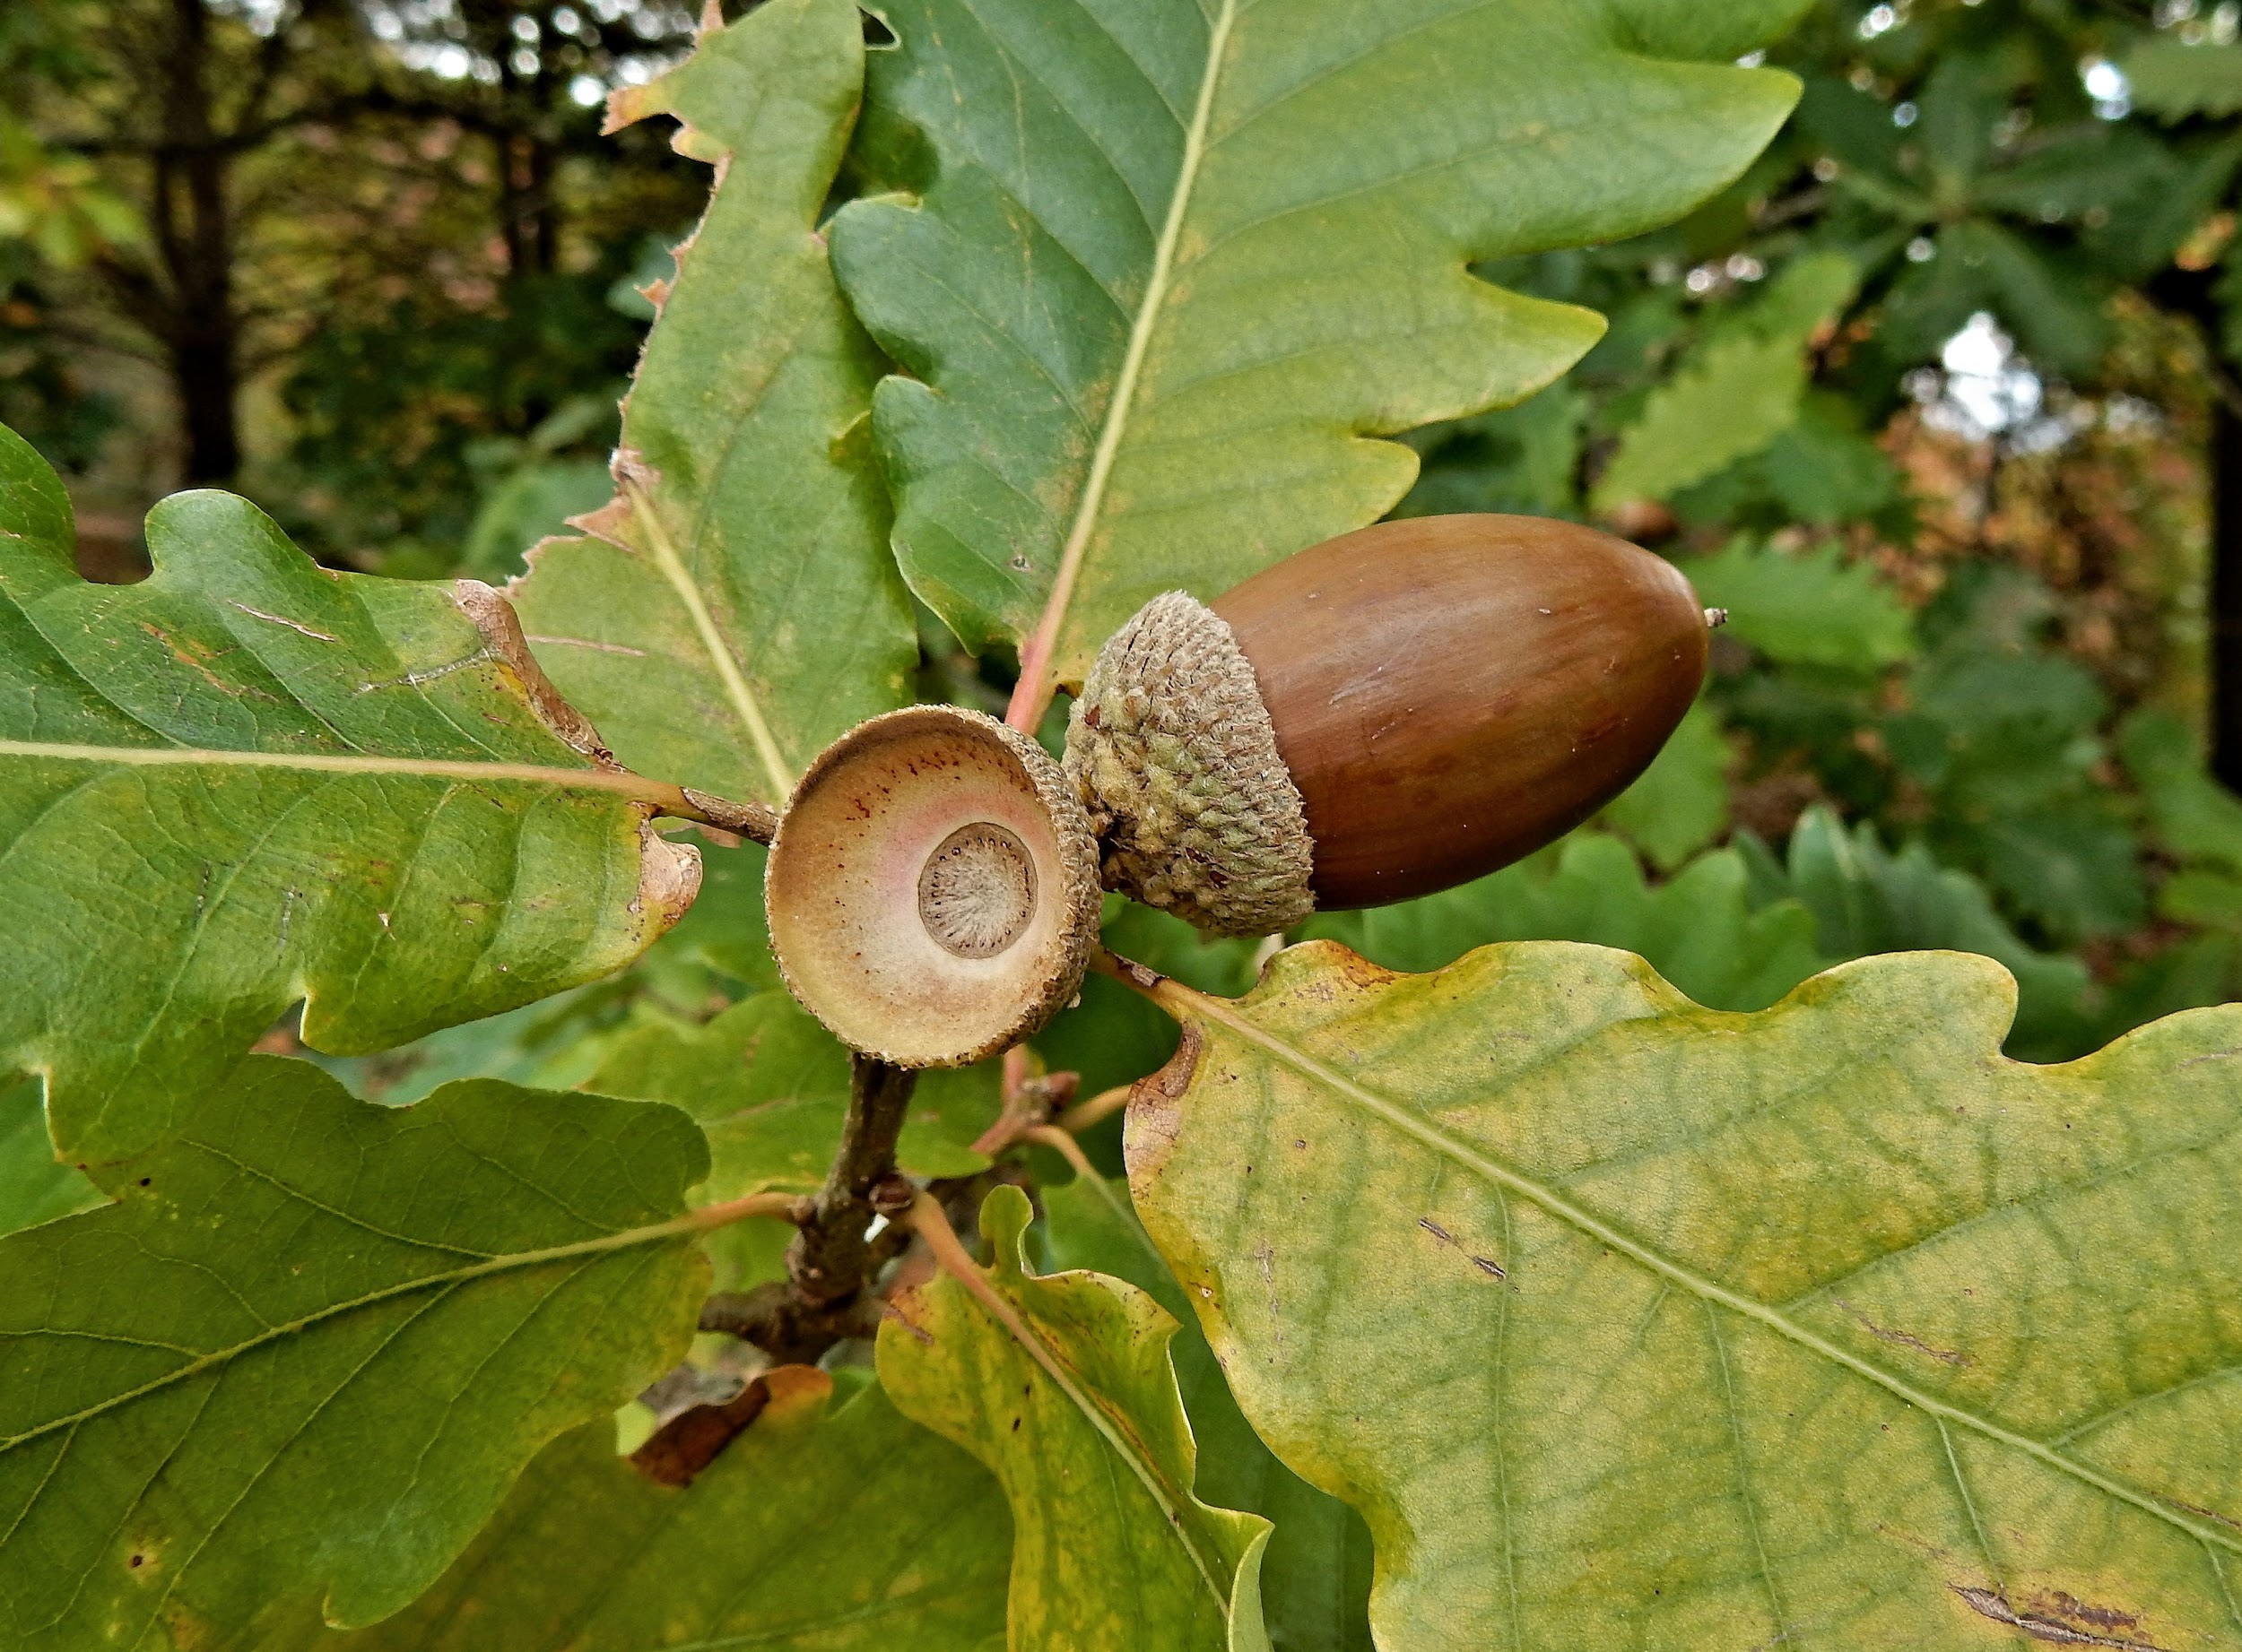
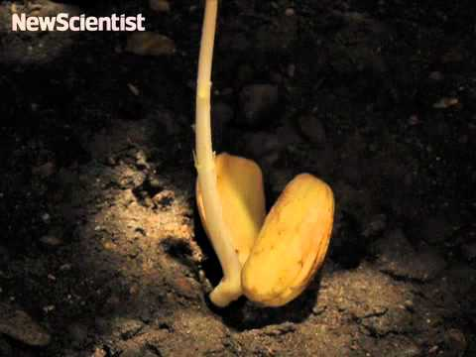

Notes:
Phenomena: What do you think is happening in this video? What do you notice?

Slide 11
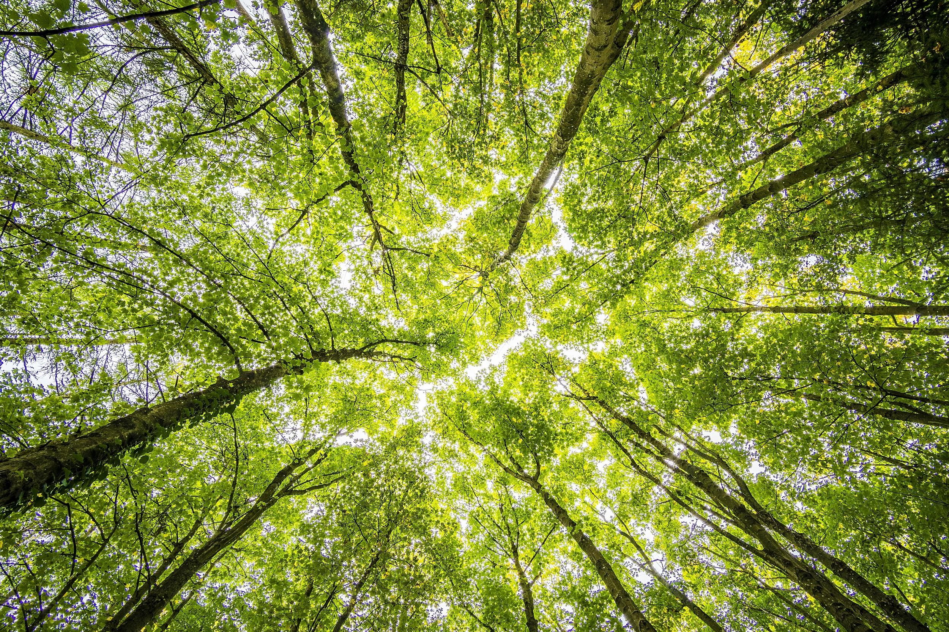
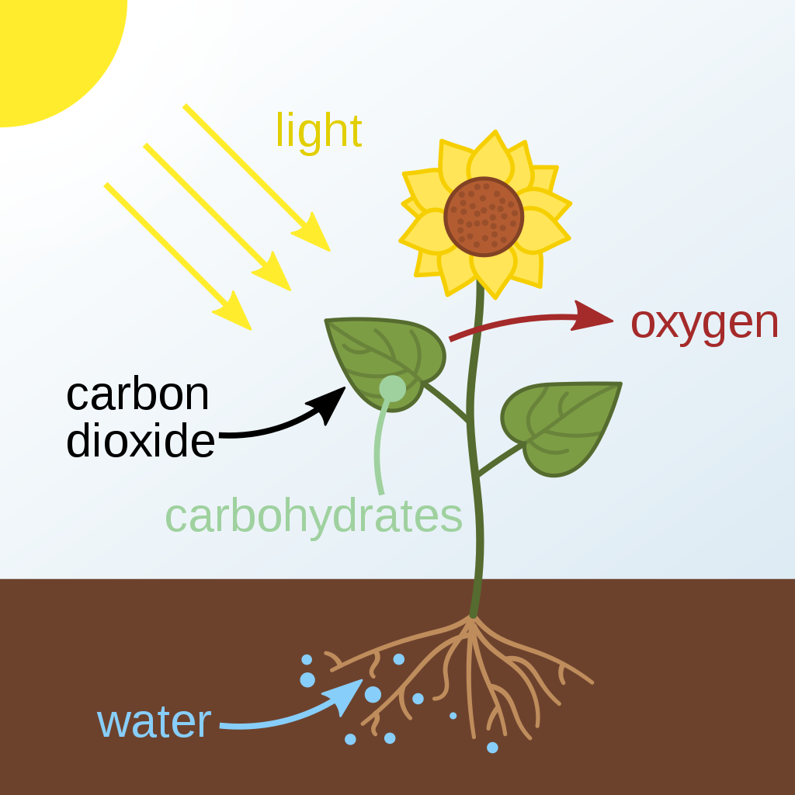


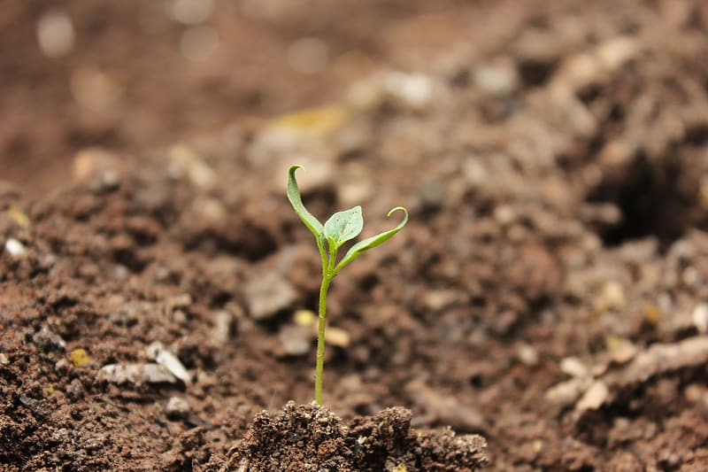

What does a tree need to survive?
MS-LS1-6. From Molecules to Organisms: Structures and Processes
Construct a scientific explanation based on evidence for the role of photosynthesis in the cycling of matter and flow of energy into and out of organisms.
Notes:
Ask question, then populate as students provide answers.

Slide 12
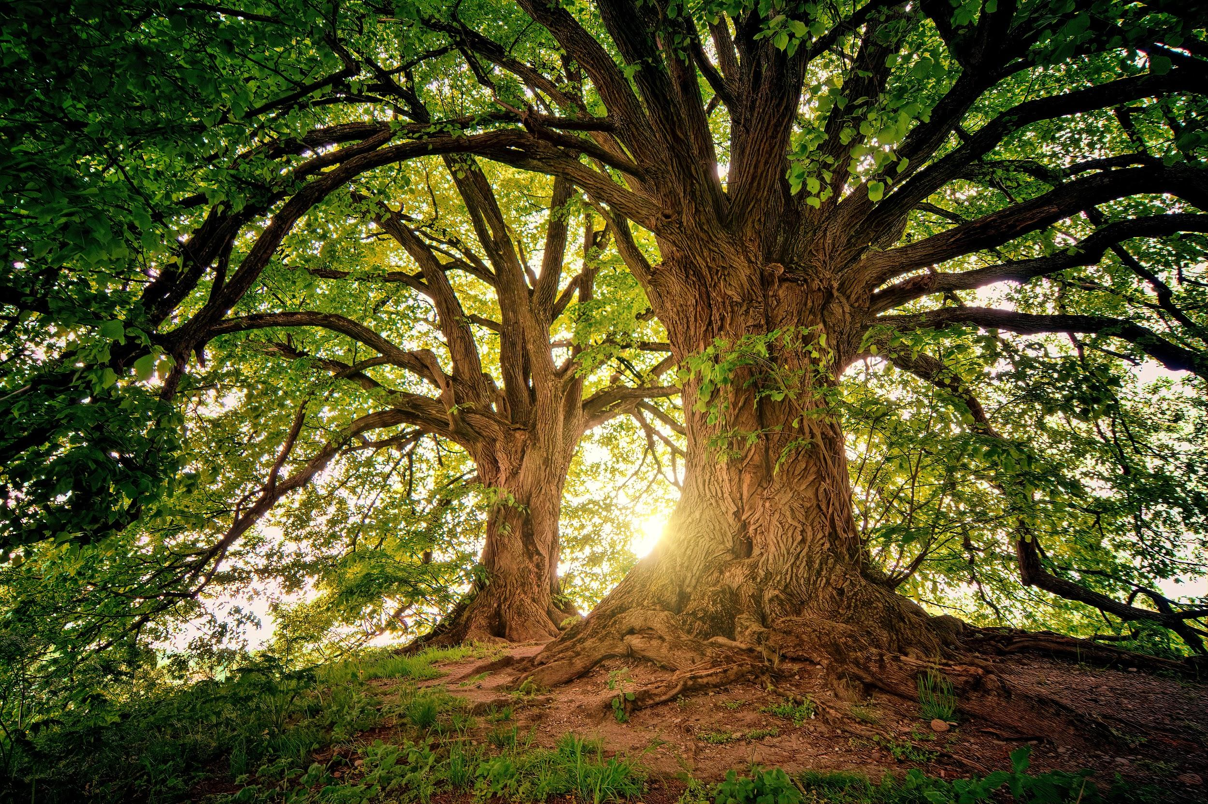
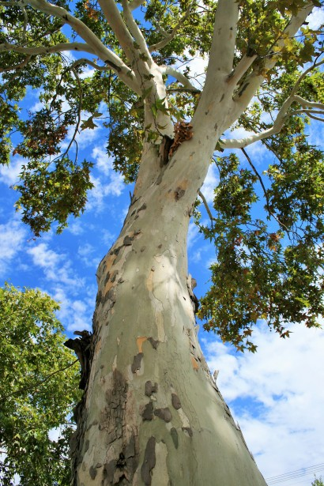
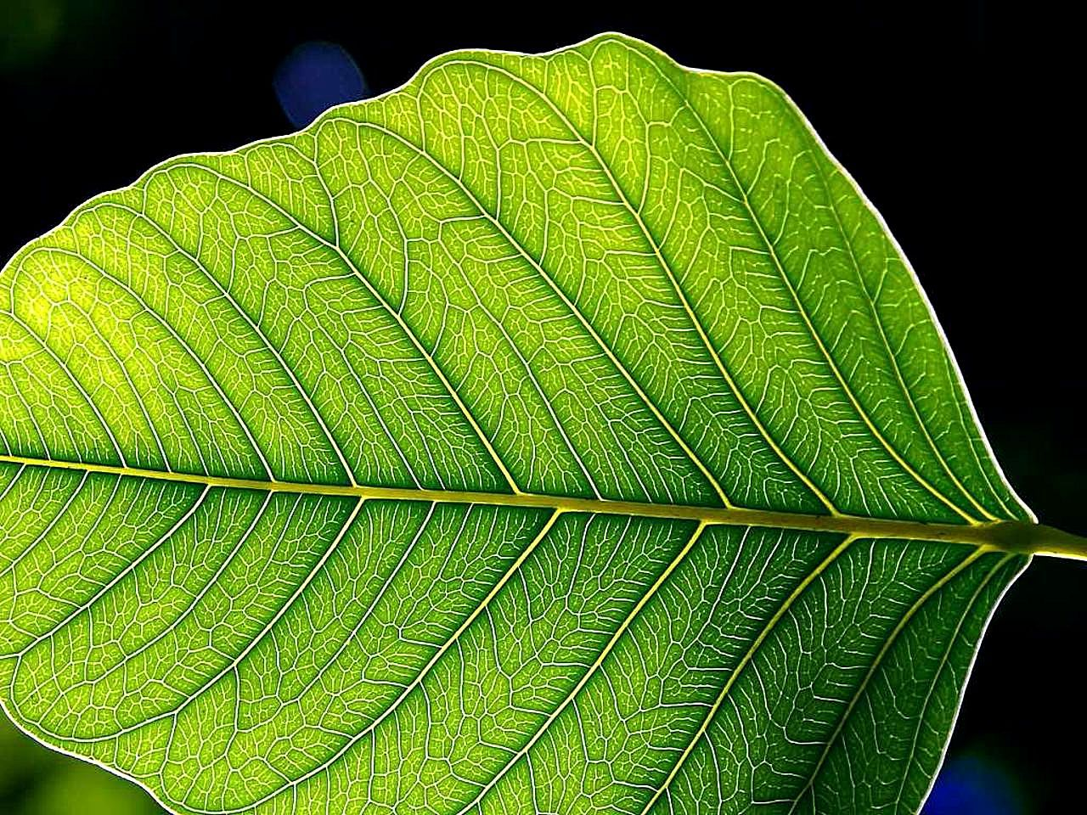
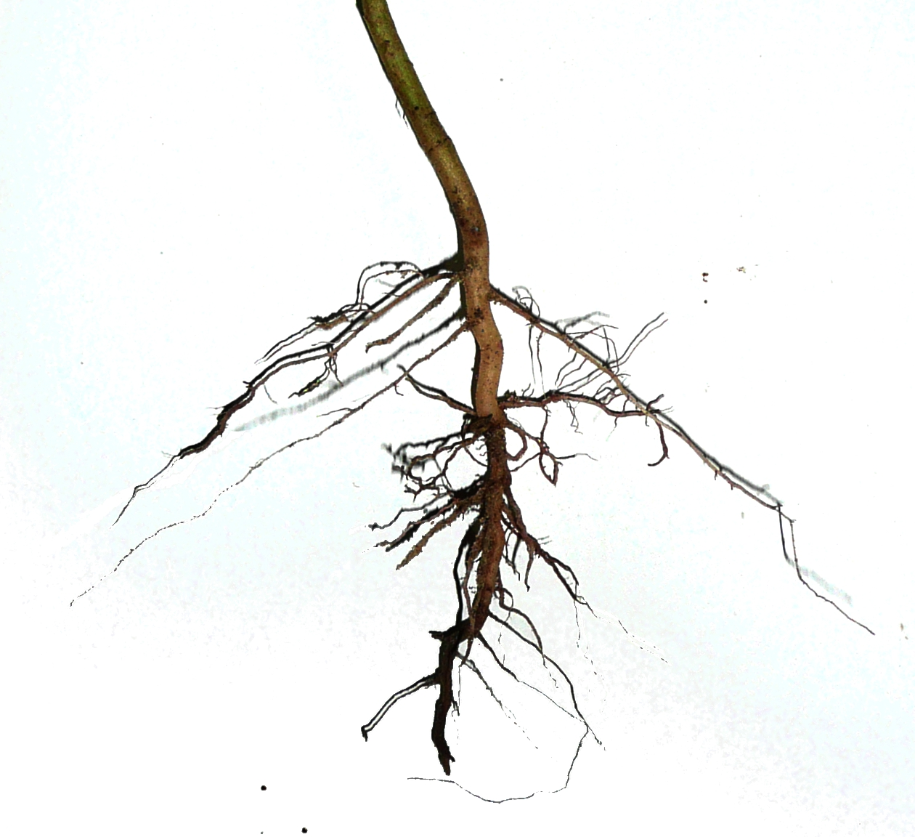
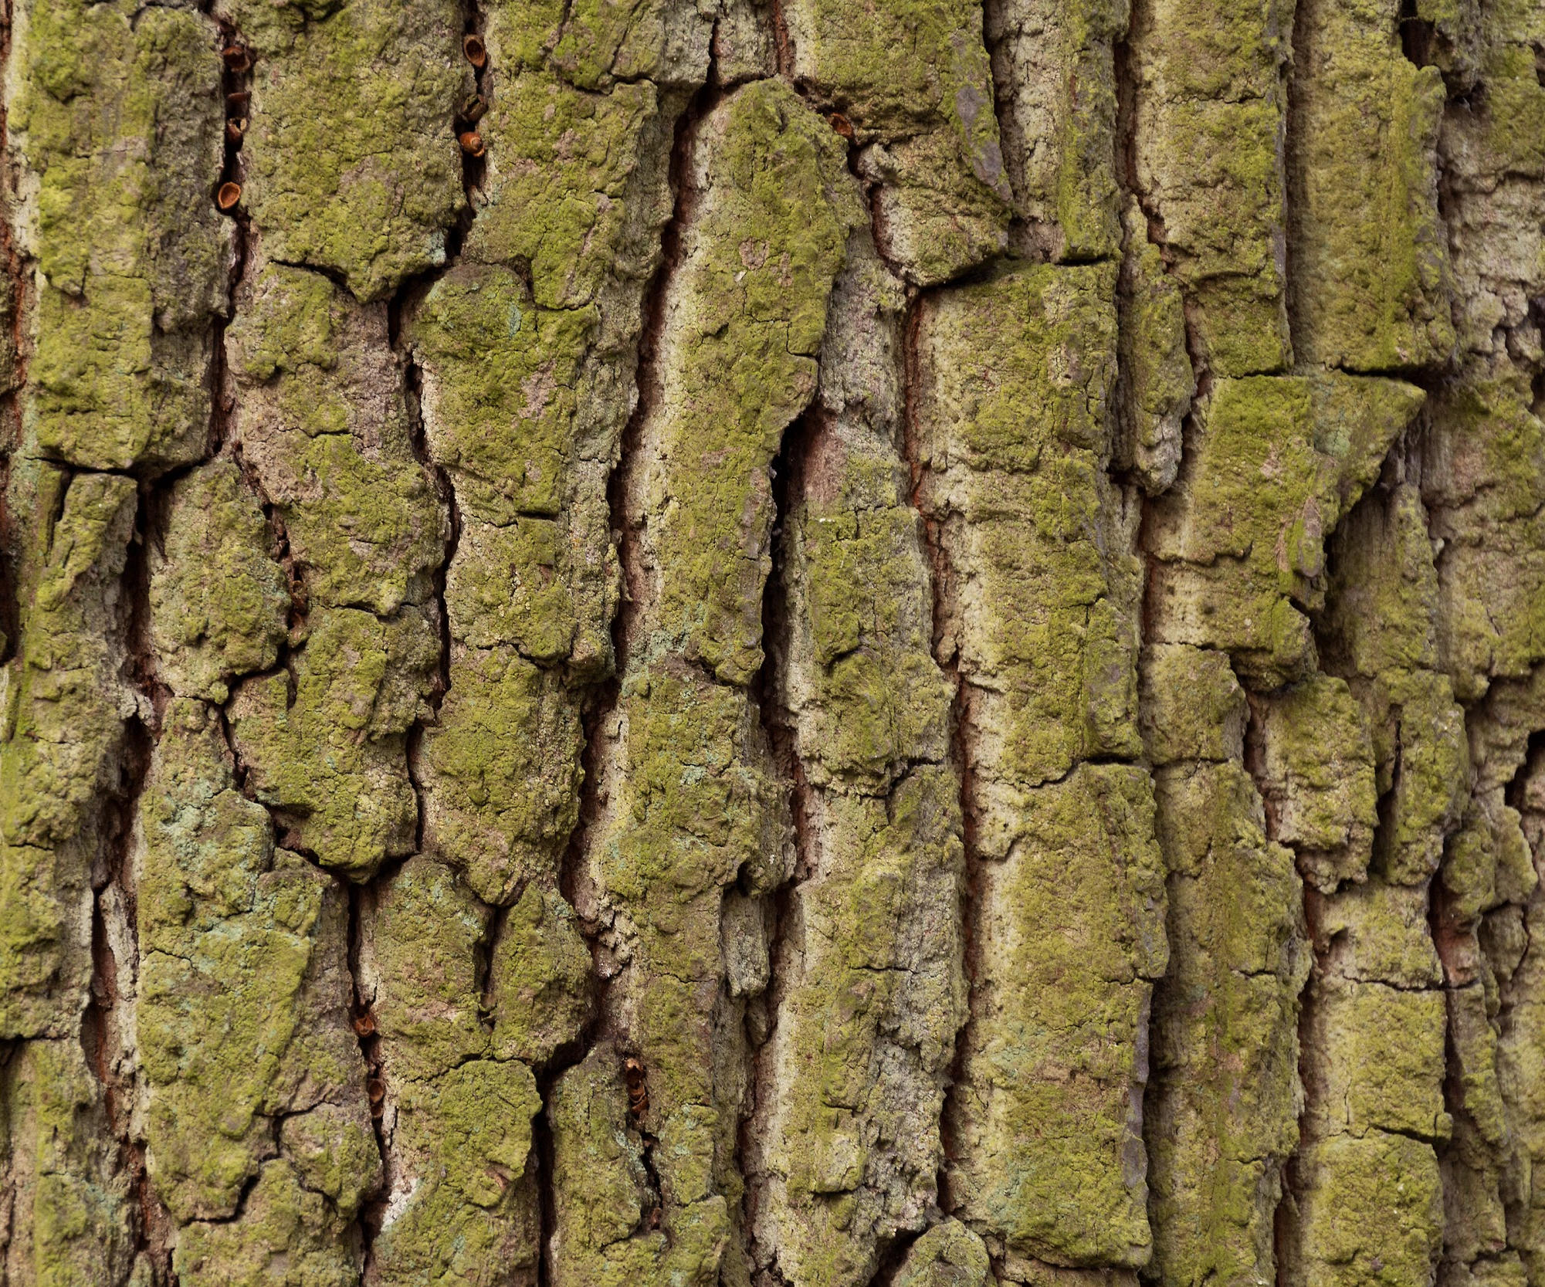
Do you know the different parts of a tree and what they do to help the tree?
The trunk provides structure. It carries water and minerals up from the roots to the leaves and carries sugar down to the roots.
Leaves use sun to make food for the tree
Roots absorb water and nutrients from the soil, store sugar, and anchor the tree.
Bark protects the tree from insects, disease, weather, and fire.
Notes:
Start with questions and images. Ask individual students to name an item and then explain how it helps the tree. Once all have been covered, then show purposes and review.

Slide 13

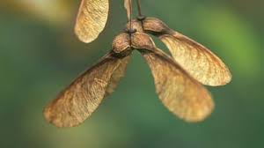
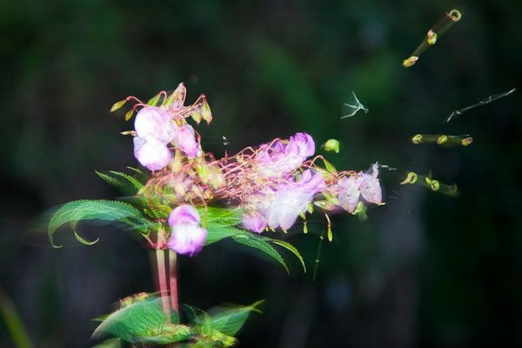

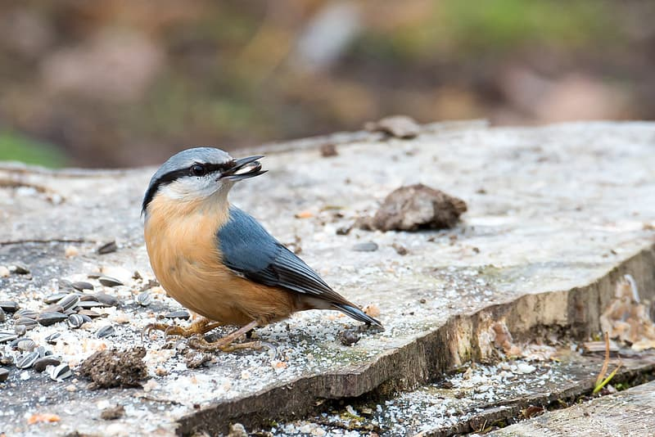
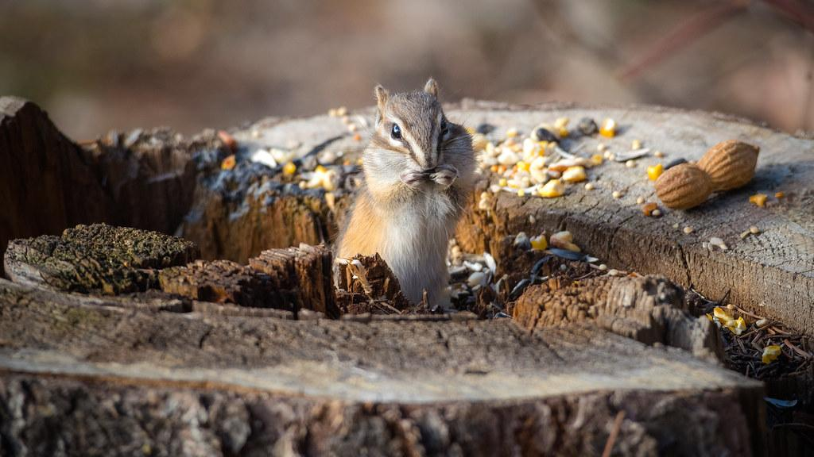
How can seeds be dispersed?
Water
Seed shape
Seed explosion!
Wind
Animals
Notes:
Seed observation and what it tells us about the way it might be dispersed:
Wind
Water
Animals - consumption, exterior transport
Gravity

Slide 14
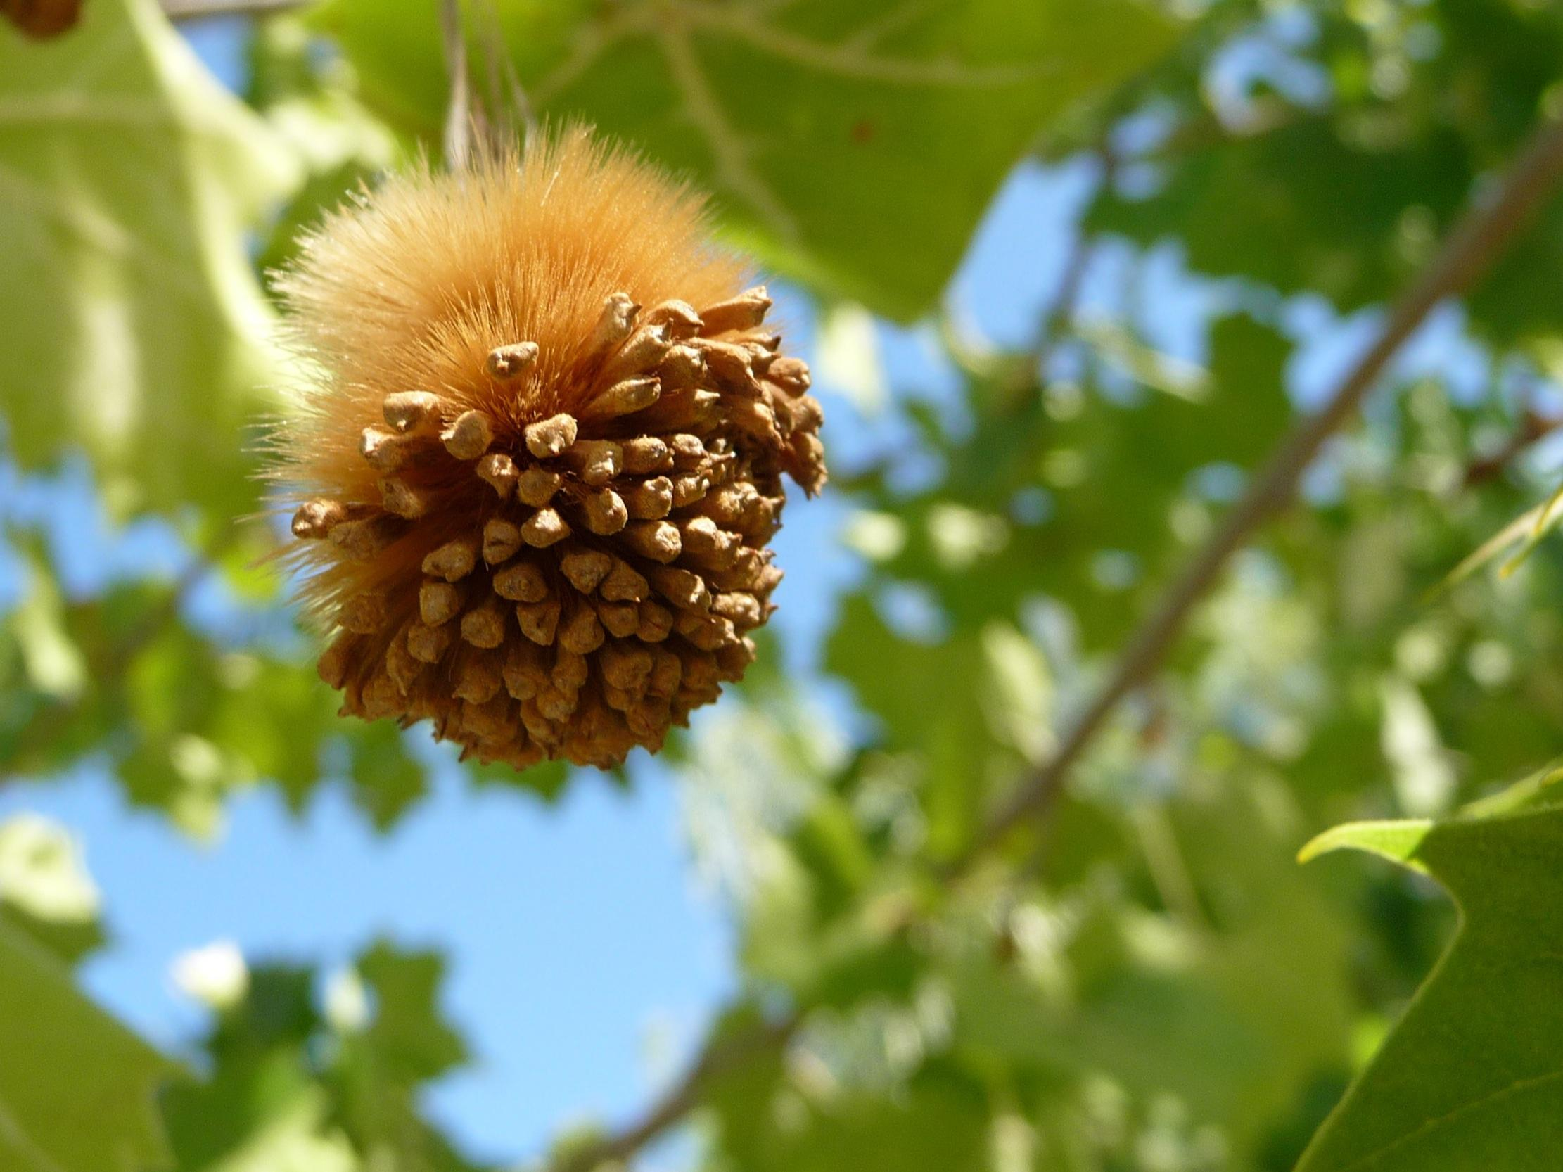
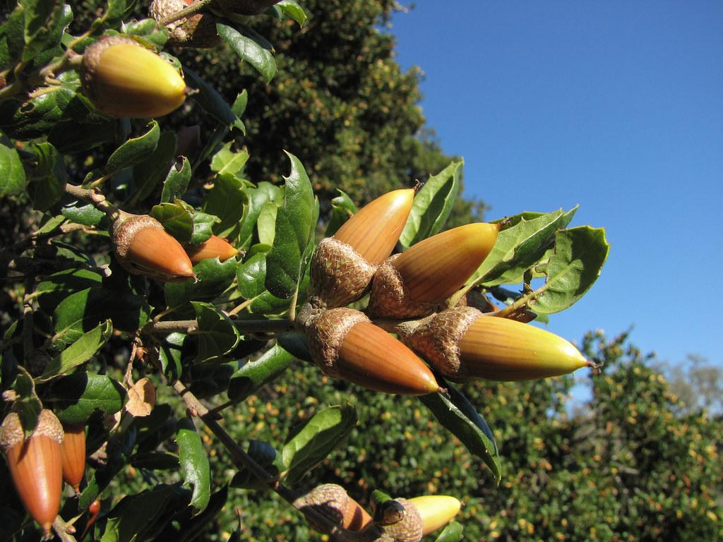
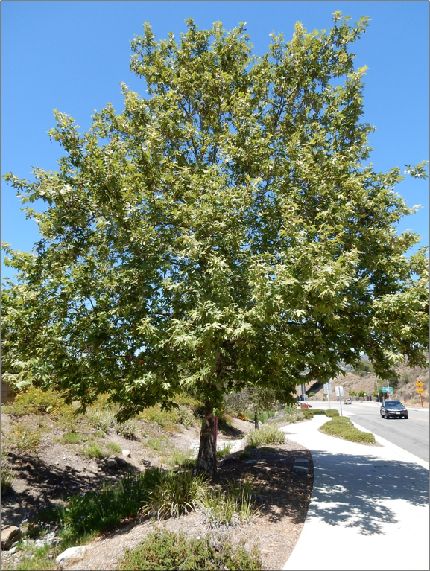
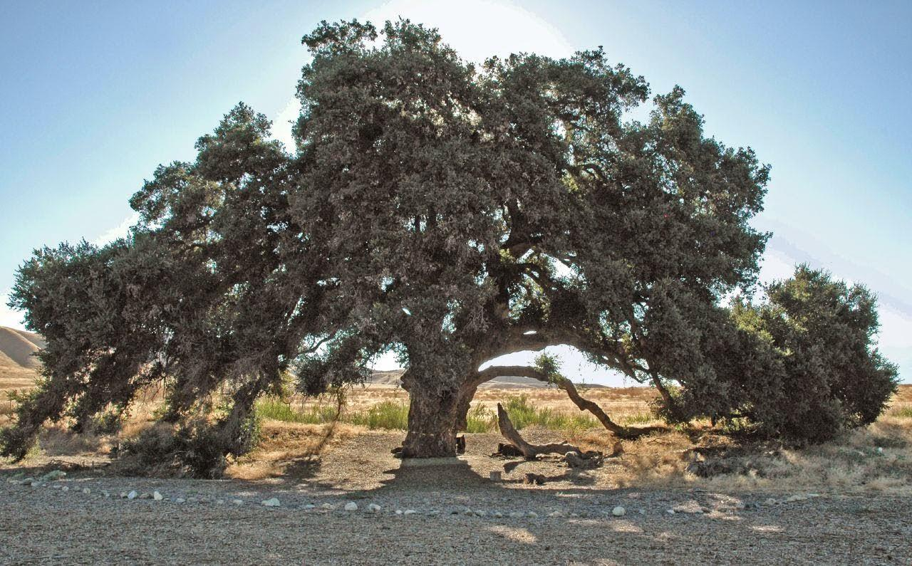
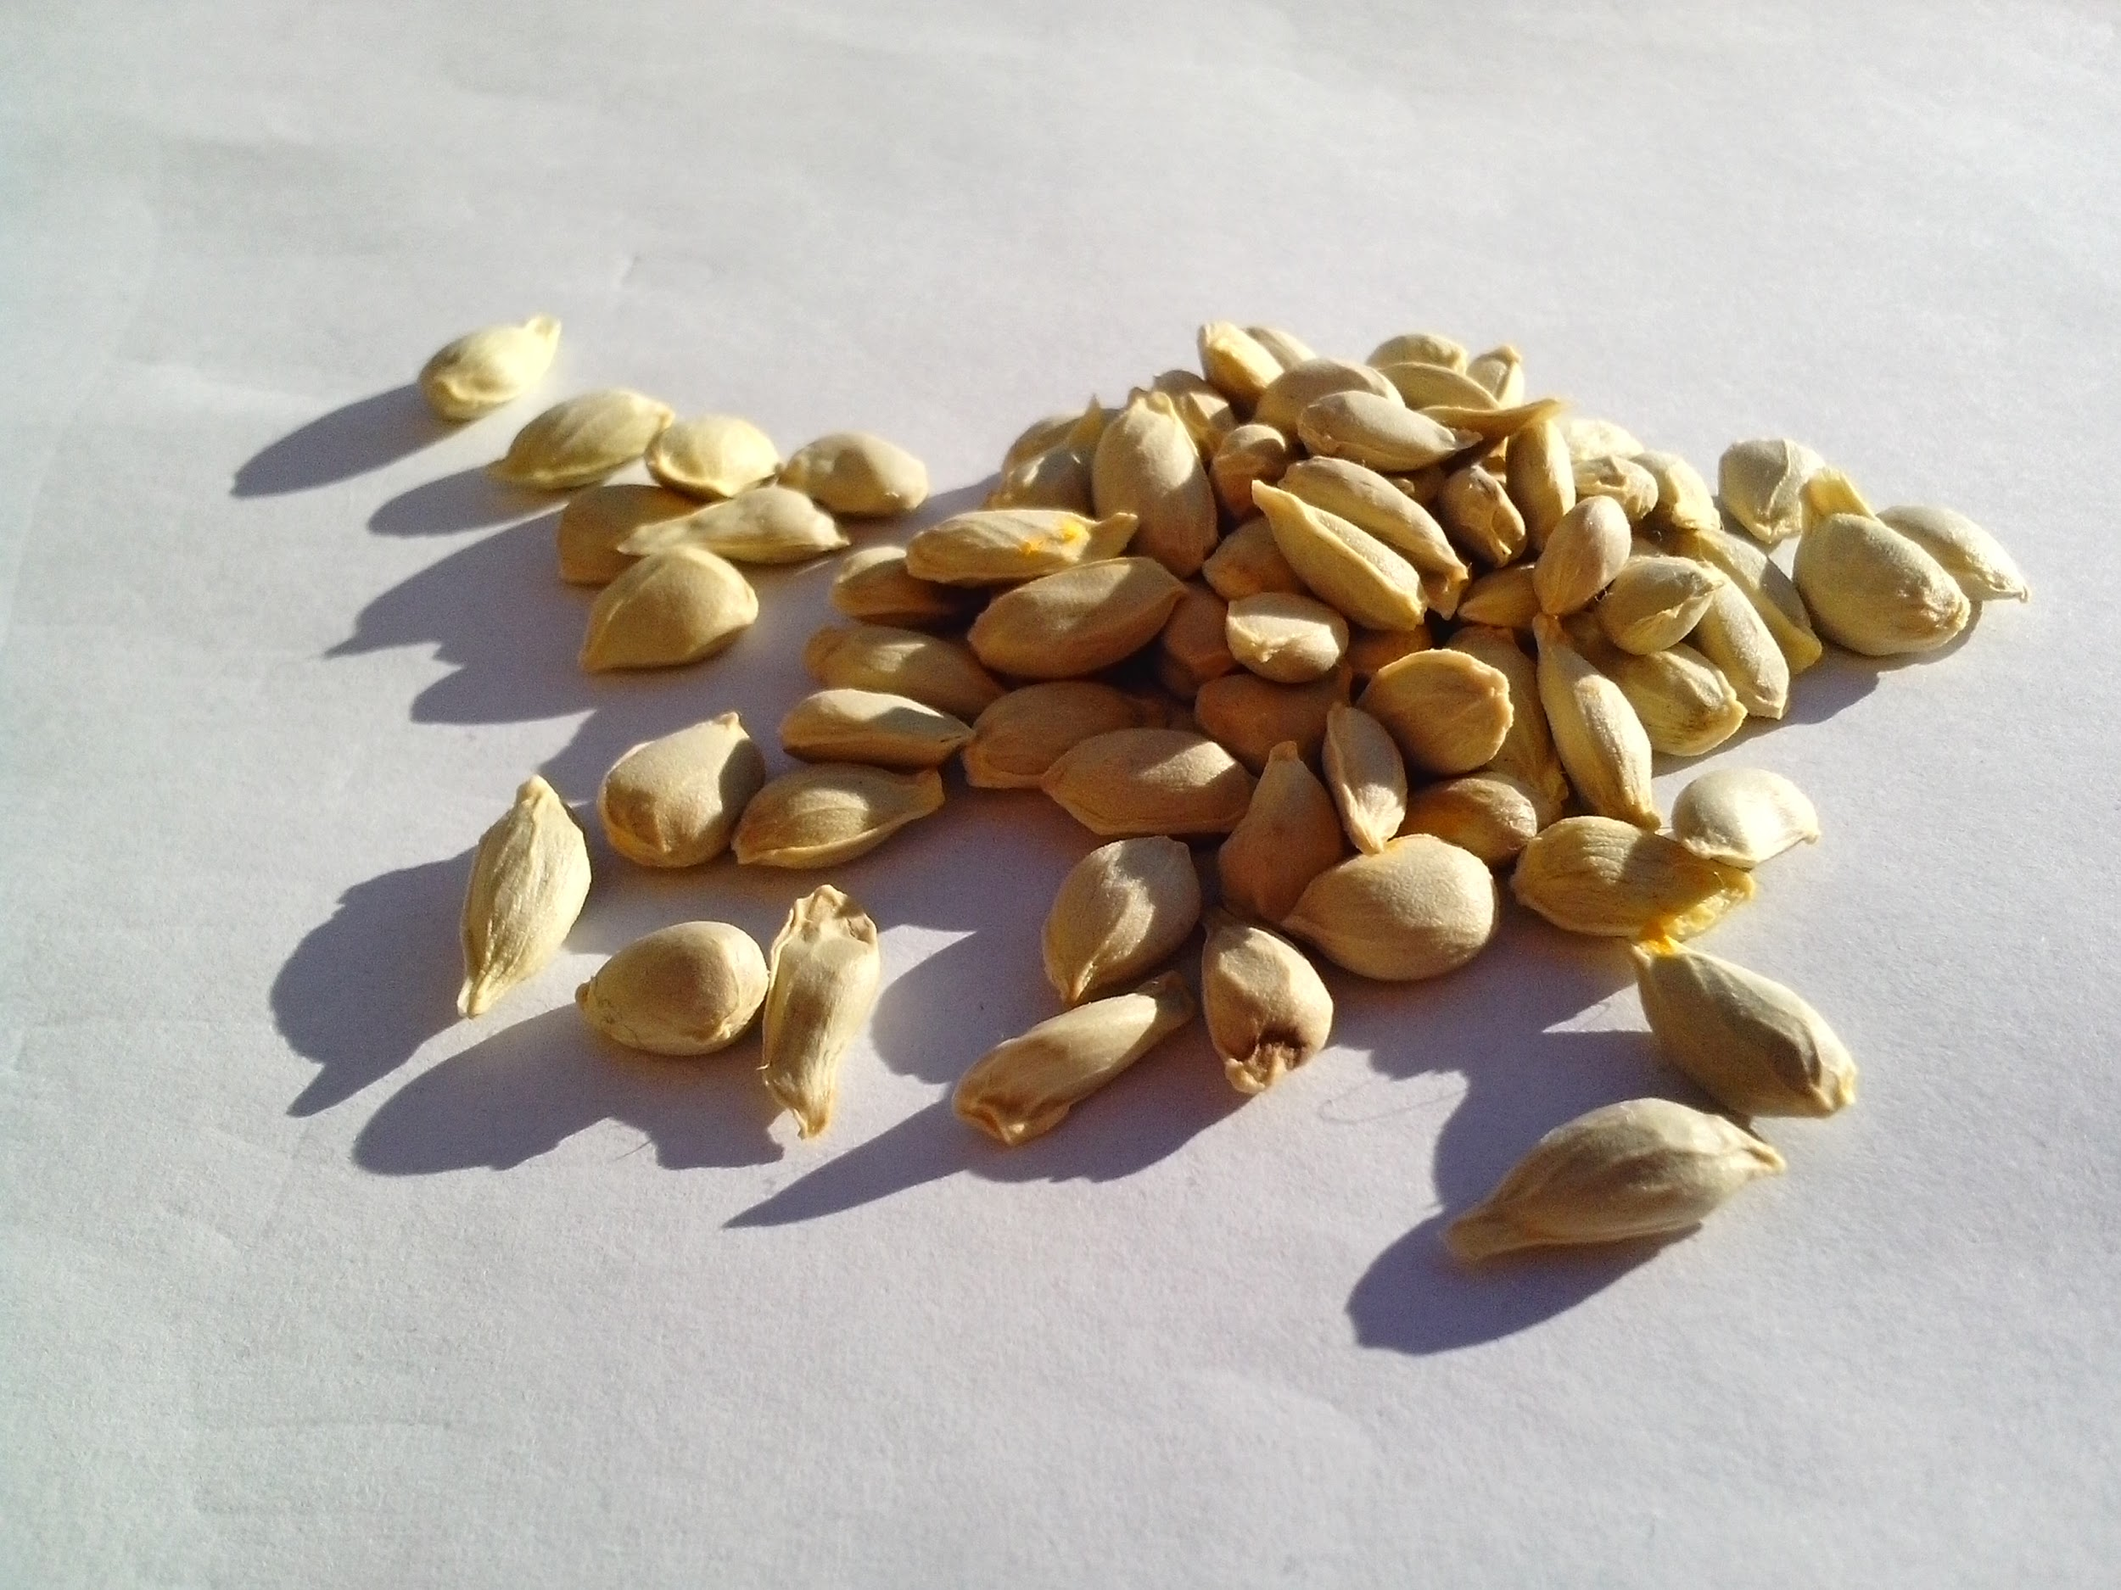
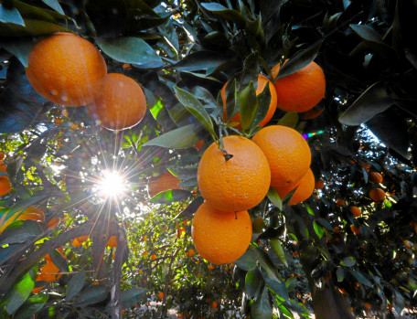
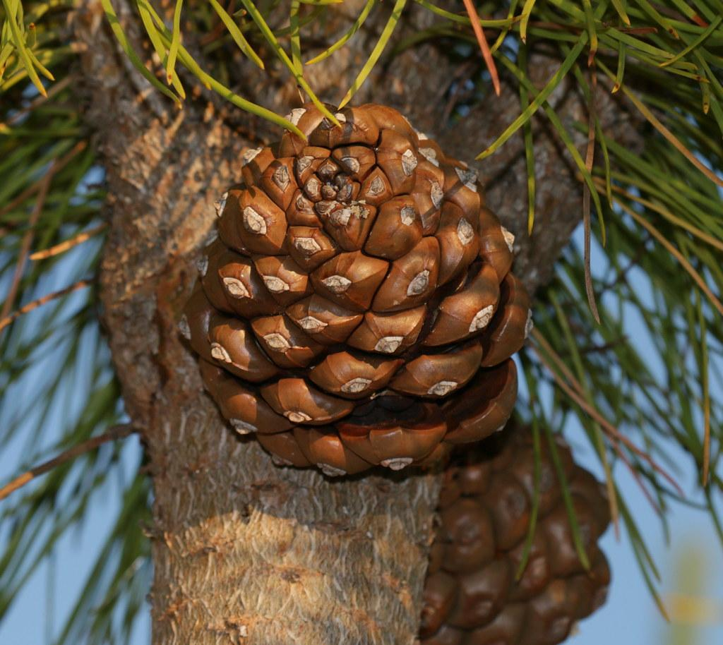
Let’s see what you know!
Orange
Sycamore
Coast live oak
Stone Pine
Notes:
Seed guessing/ID as trees appear

Slide 15
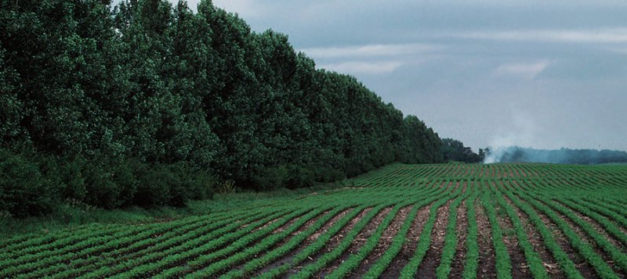
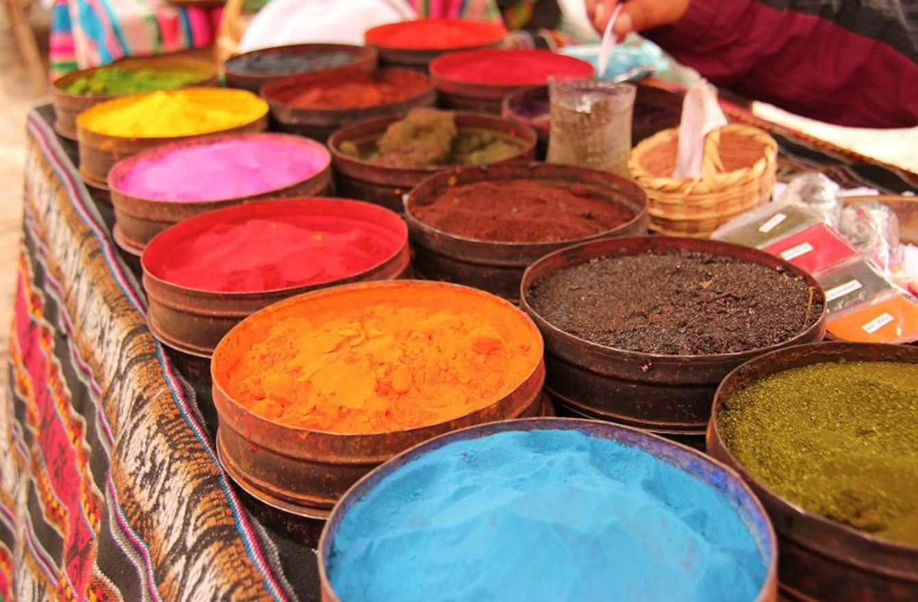
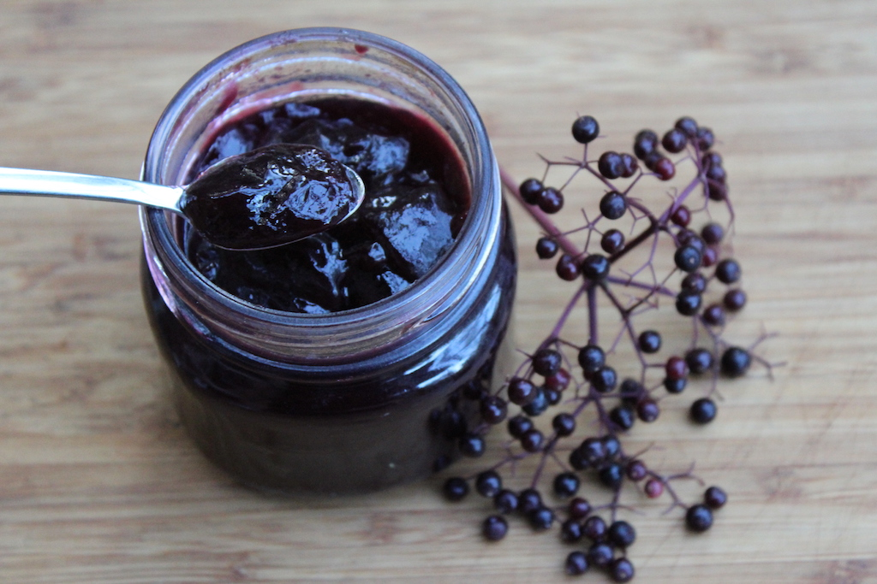
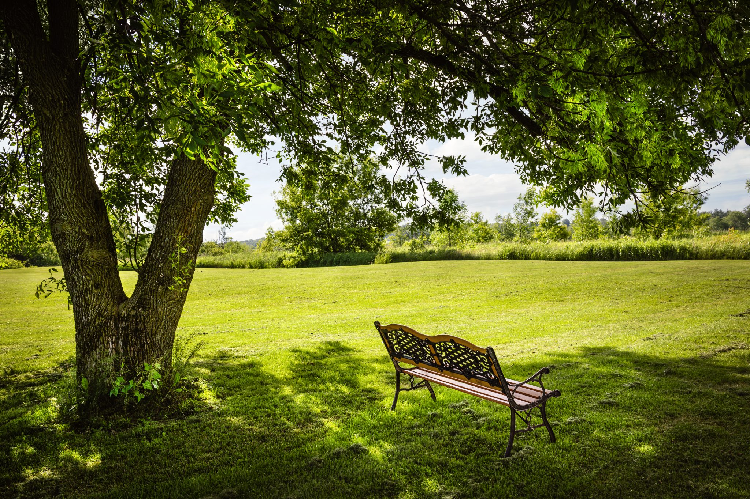
Why should we plant trees?
Notes:
Discussed in earlier slide: fruit, medicine, reducing heating/cooling costs, air quality benefits, habitat
This slide: local food (elderberry jam), protecting ag from wind, shade for people, dyes/pigments, elevation of soil health - aeration, stability

Slide 16
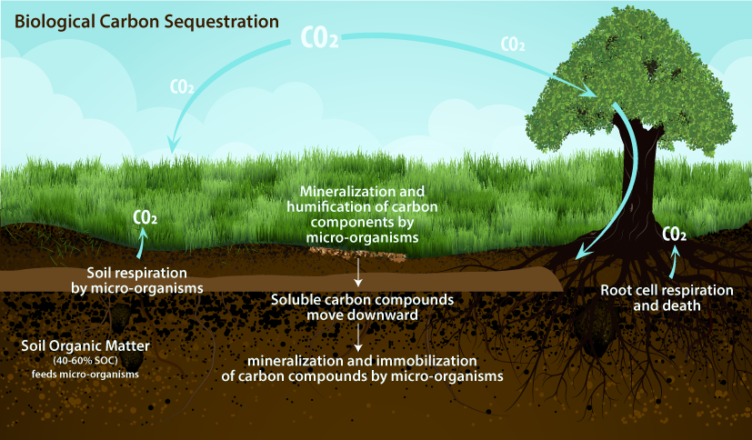

Slide 17
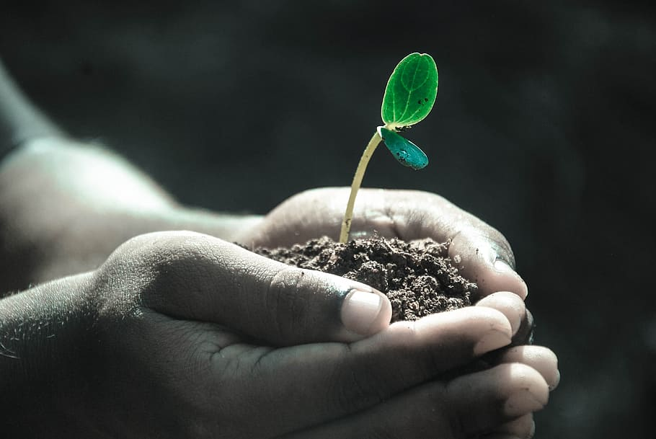
How will you care for your tree?
Notes:
Distribute tree profiles and care worksheets

Slide 18

Wrap it up!
Name a way in which seeds can be dispersed.
Notes:
Start with photos and have students guess the seeds.

Slide 19

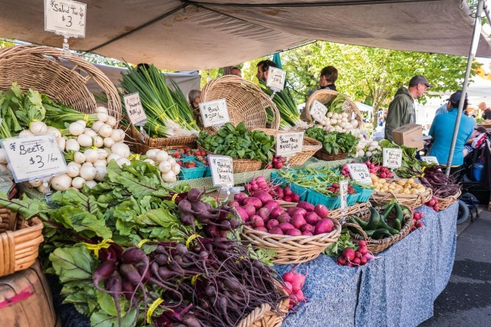

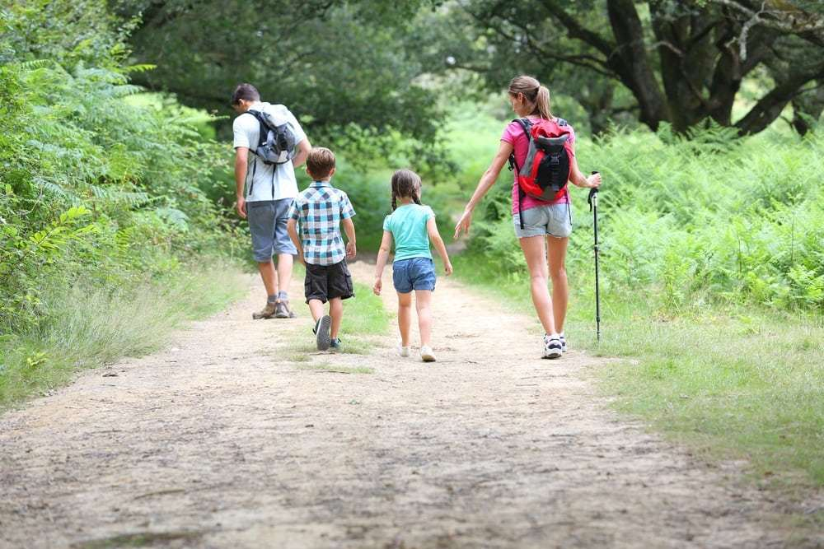
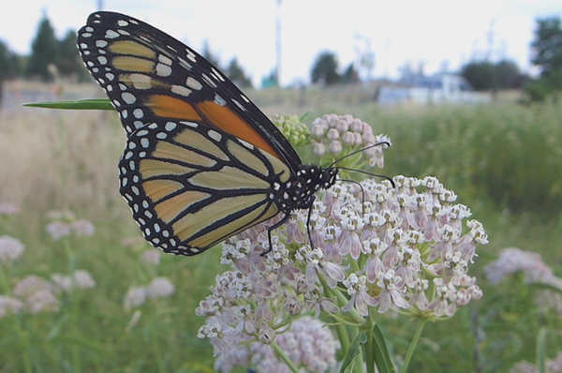
Wrap it up!
What else can we do for Earth Day?
Notes:
Reduce waste by donating clothes you no longer need
Save water
Get outside!
Plant pollinator habitat
Eat locally
Other ideas

Slide 20
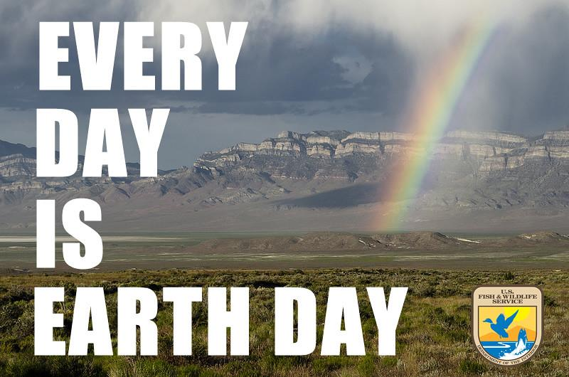
redlands.edu/trees
Notes:
Thank you to students
redlands.edu/trees demo at end, time permitting: map, resources, activities

