Slide 1
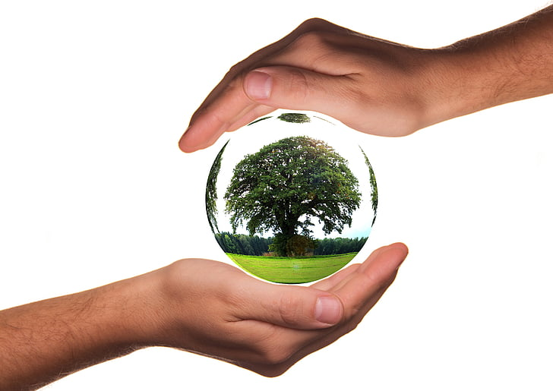






Earth Day 2020: Trees, Please!

Slide 2
Redlands Unified School District is the school District that your school is in!
The University of Redlands is a place where students go to study after high school
Esri makes maps to help people understand how our world works and how to make it even better
IERCD is an organization working to protect open space, help native plants and animals, and educate kids and adults on how to be stewards of our environment
Your school is in the City of Redlands and State of California

Slide 3
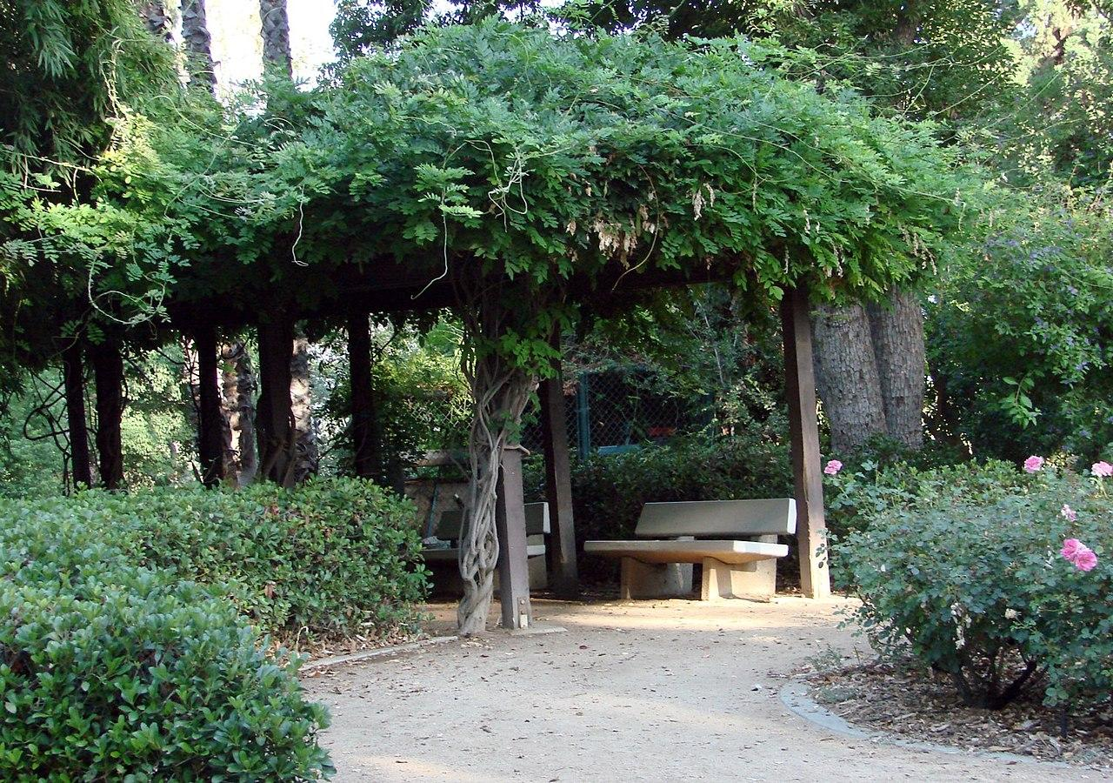

Tree Stretch
Be a seed and plant yourself in the ground.
Grow tall into the sky.
Stretch out your branches and wiggle your leaves (fingers).
Sway in the wind and drop some seeds!

Slide 4


What is Earth Day?
Why do we celebrate?
Notes:
Ask questions to gather students’ current knowledge; if students need prompting, teacher may suggest:
Why we need Earth Day:
To take care of animals
Protect open spaces
Make sure we have clean air and water for all life on earth - people included
To reduce use of plastic and other materials harmful to our environment, recycle materials as much as possible, and to properly dispose of non-recyclable trash
Why we celebrate:
1. We need to remember Earth is something we need to take care of - our planet and everything on it for the sake of all life
2. Having an annual Earth Day reminds us to do something for the planet - pick up trash, plant a tree, walk instead of drive, share toys with friends rather than buy something new

Slide 5
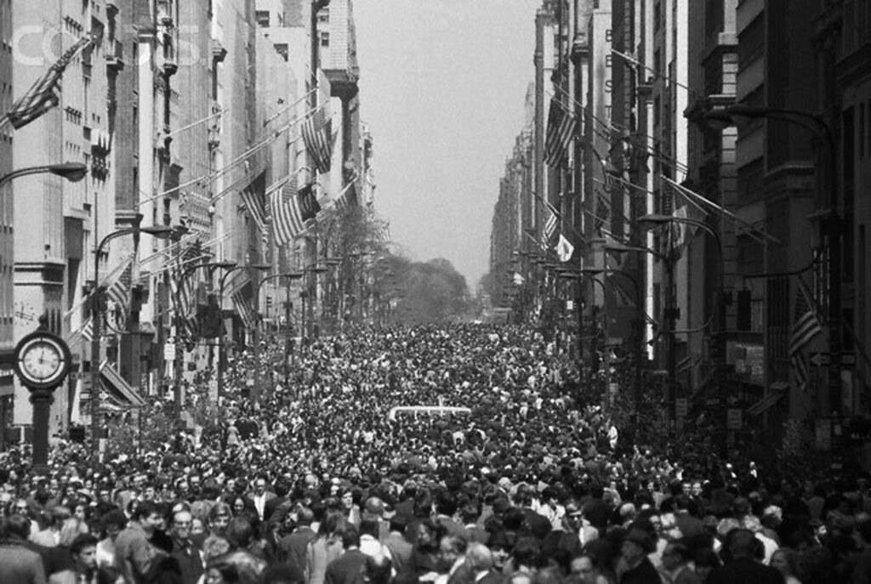
The first Earth Day was fifty years ago! On this day in April of 1970,
20 million Americans organized to demand a healthier, more sustainable environment.
Notes:
Page notes:
Earth Day started out as a celebration in the United States, but over time moved to countries all around the world!
All countries on Earth need to work together to make sure we take care of our planet.

Slide 6

Since 1970, one billion people have celebrated Earth Day in more than 190 countries across the world!
Notes:
Page notes:
Teacher may prompt students to share some of the ways they’ve previously celebrated Earth Day, or suggest ways they may celebrate Earth Day 2020
Attending a celebration with family
Saving water - shorter showers, asking an adult to fix leaky faucets, turning off the water to brush teeth
Getting outside - enjoying nature and taking care of it by staying on the trail during hikes, picking up all trash, and leaving plants as they are for everyone to enjoy

Slide 7

For Earth Day 2020 students in Redlands Unified School District will receive something that...

Slide 8

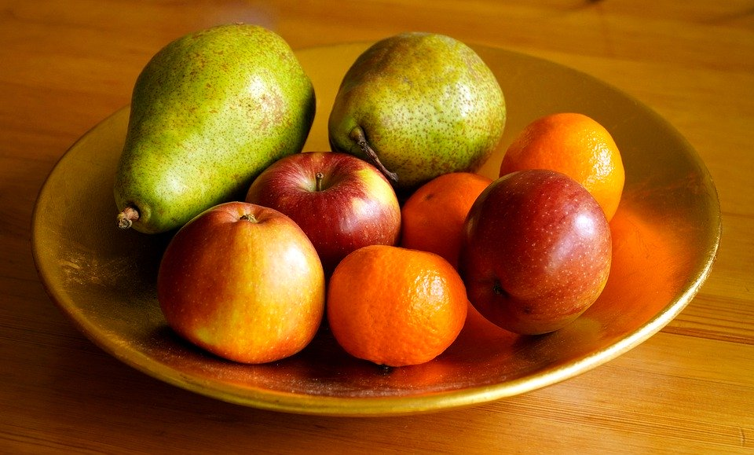
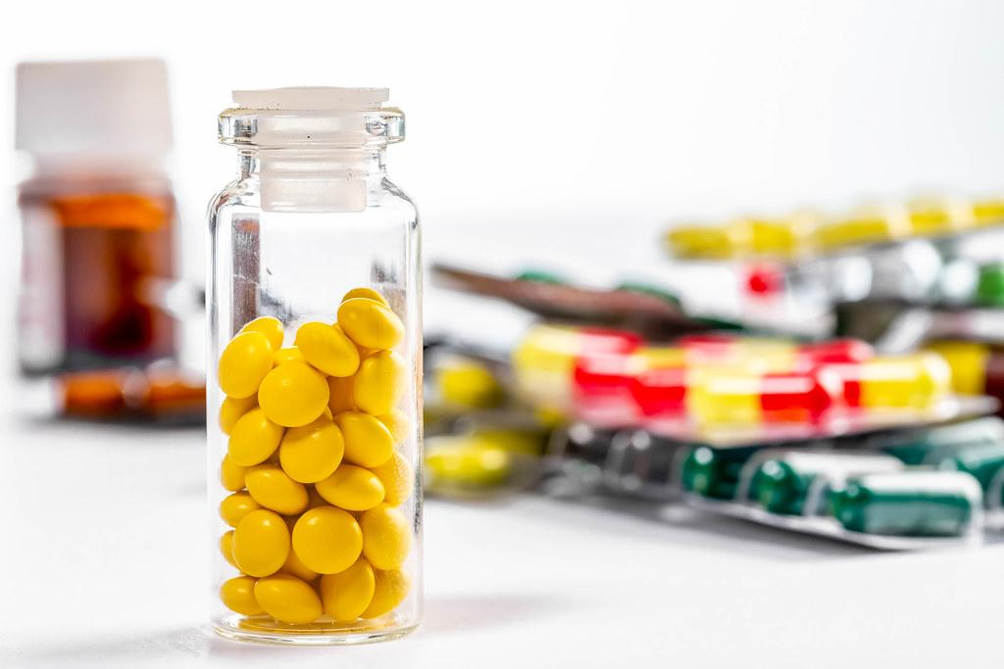
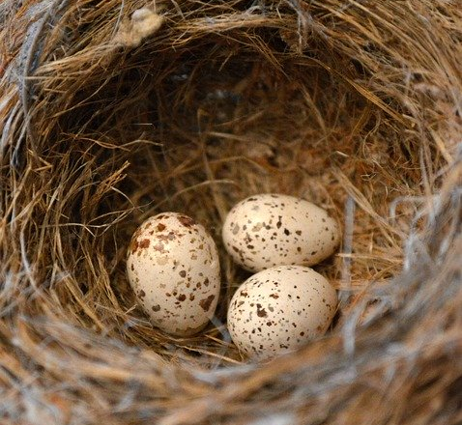
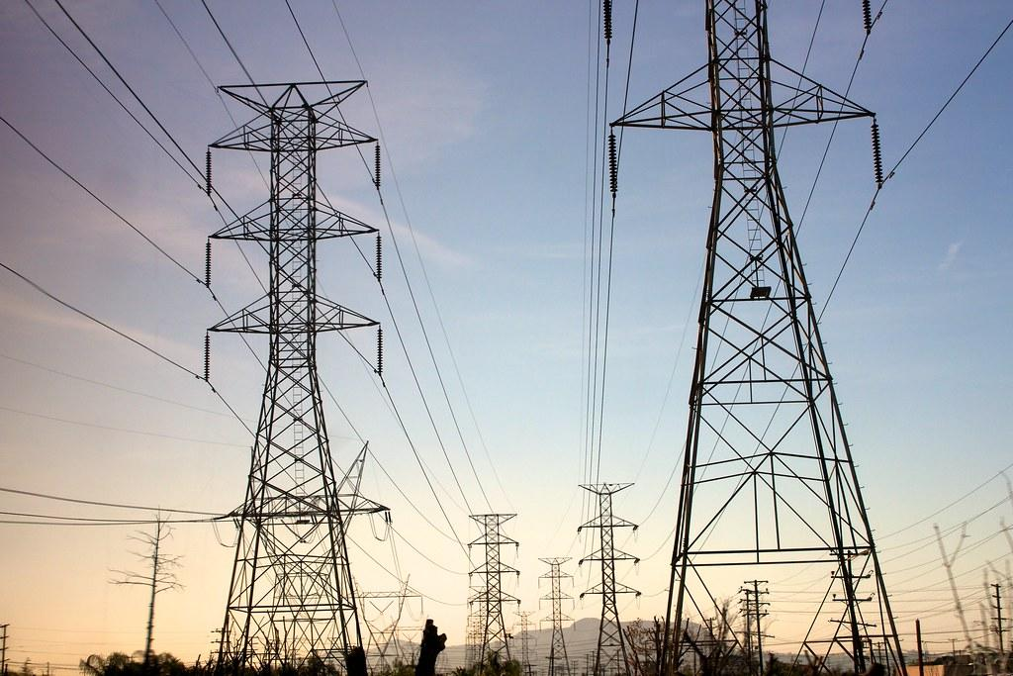
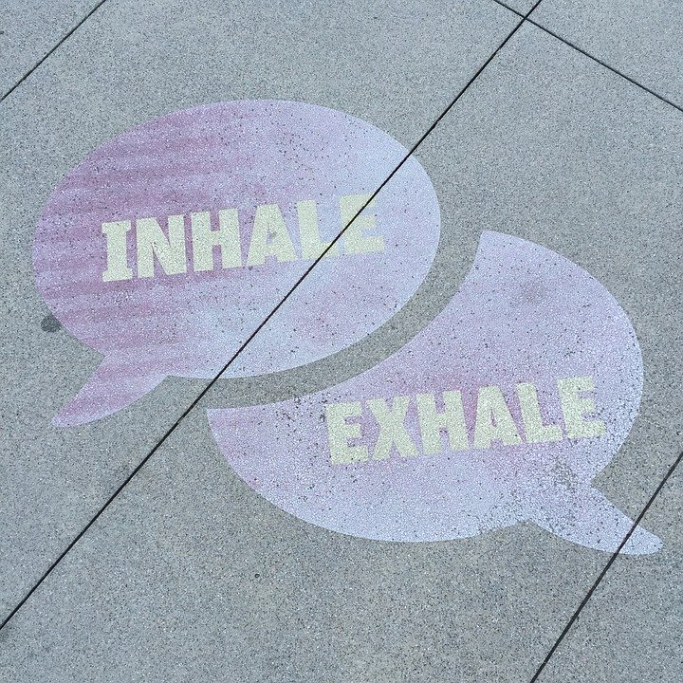
Is used in making medicine
Provides habitat
Gives us food
Produces oxygen and reduces smog
Saves electricity needed for heating and cooling
Notes:
Teacher may provide additional clues and/or ask students to guess the give-away

Slide 9

A tree for every student in RUSD!
Notes:
Page notes:
Teacher may ask if students were right or not in guessing the give-away.
If students were correct, how did they know trees were the give-away? What clue/clues on the previous slide indicated they would take a tree home?

Slide 10
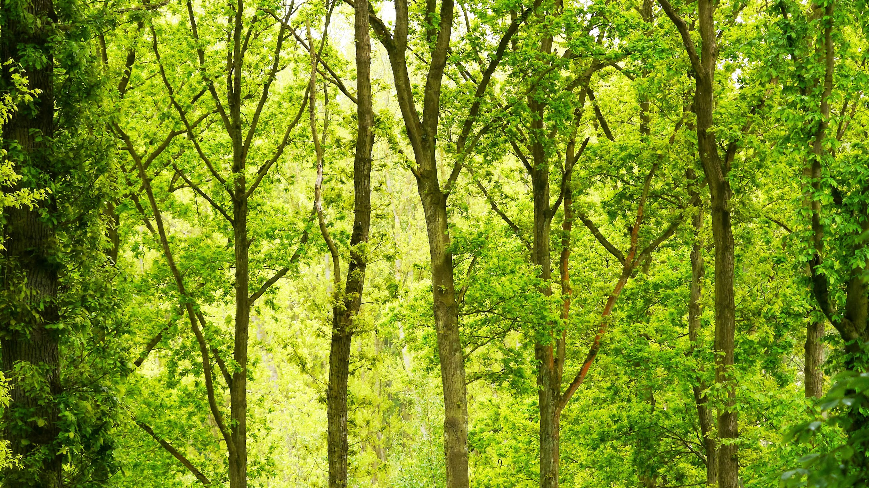
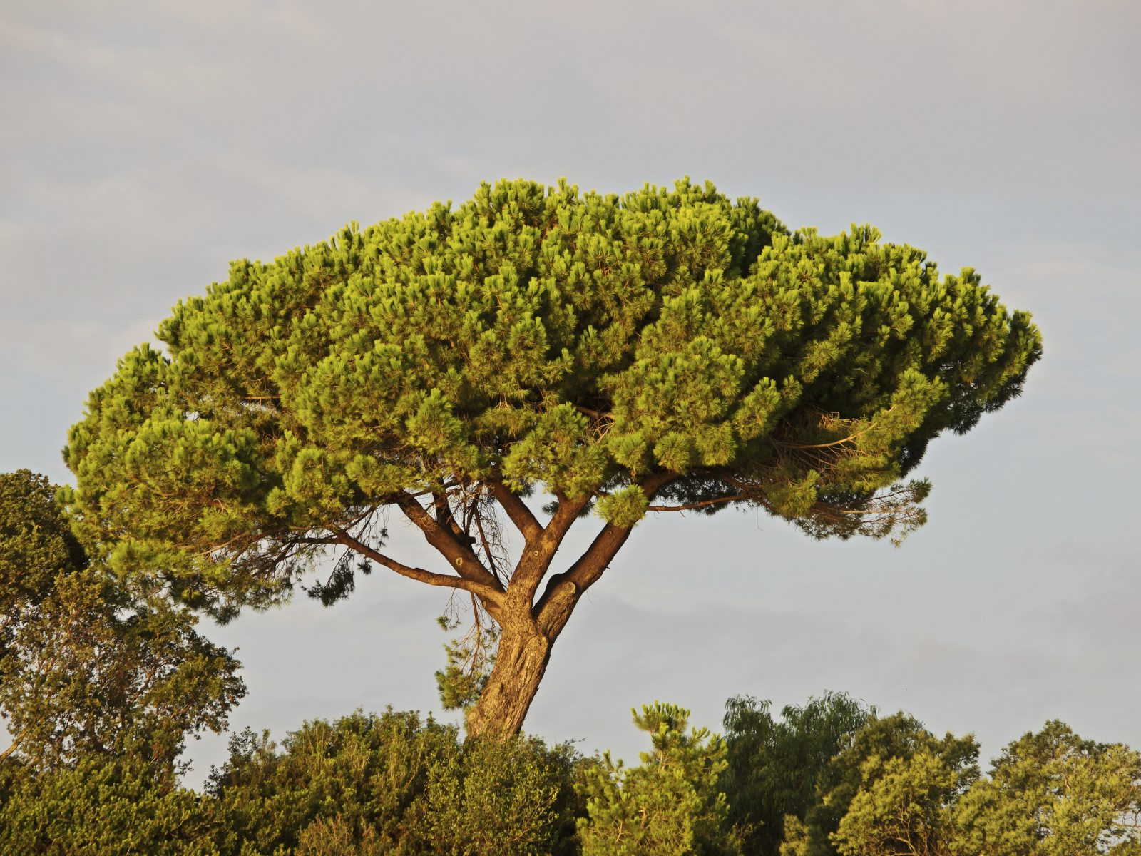
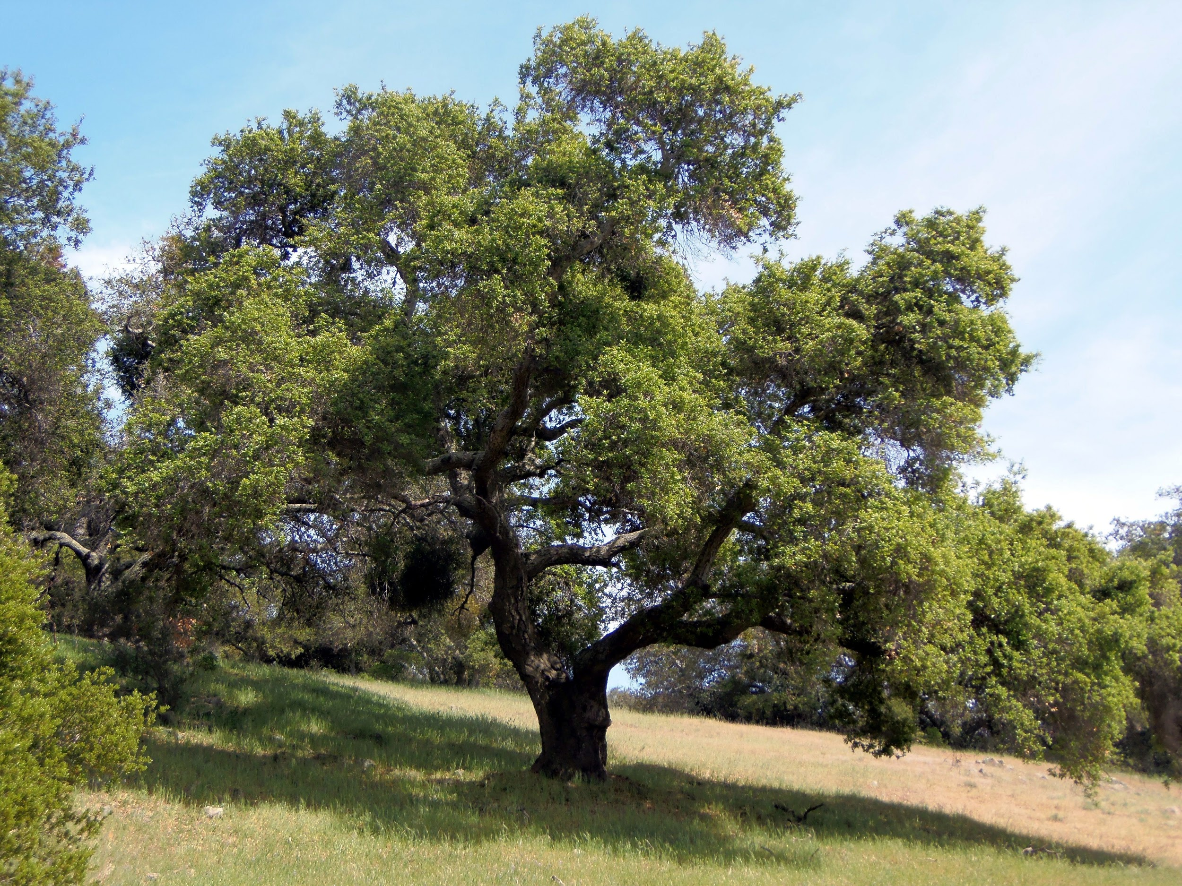
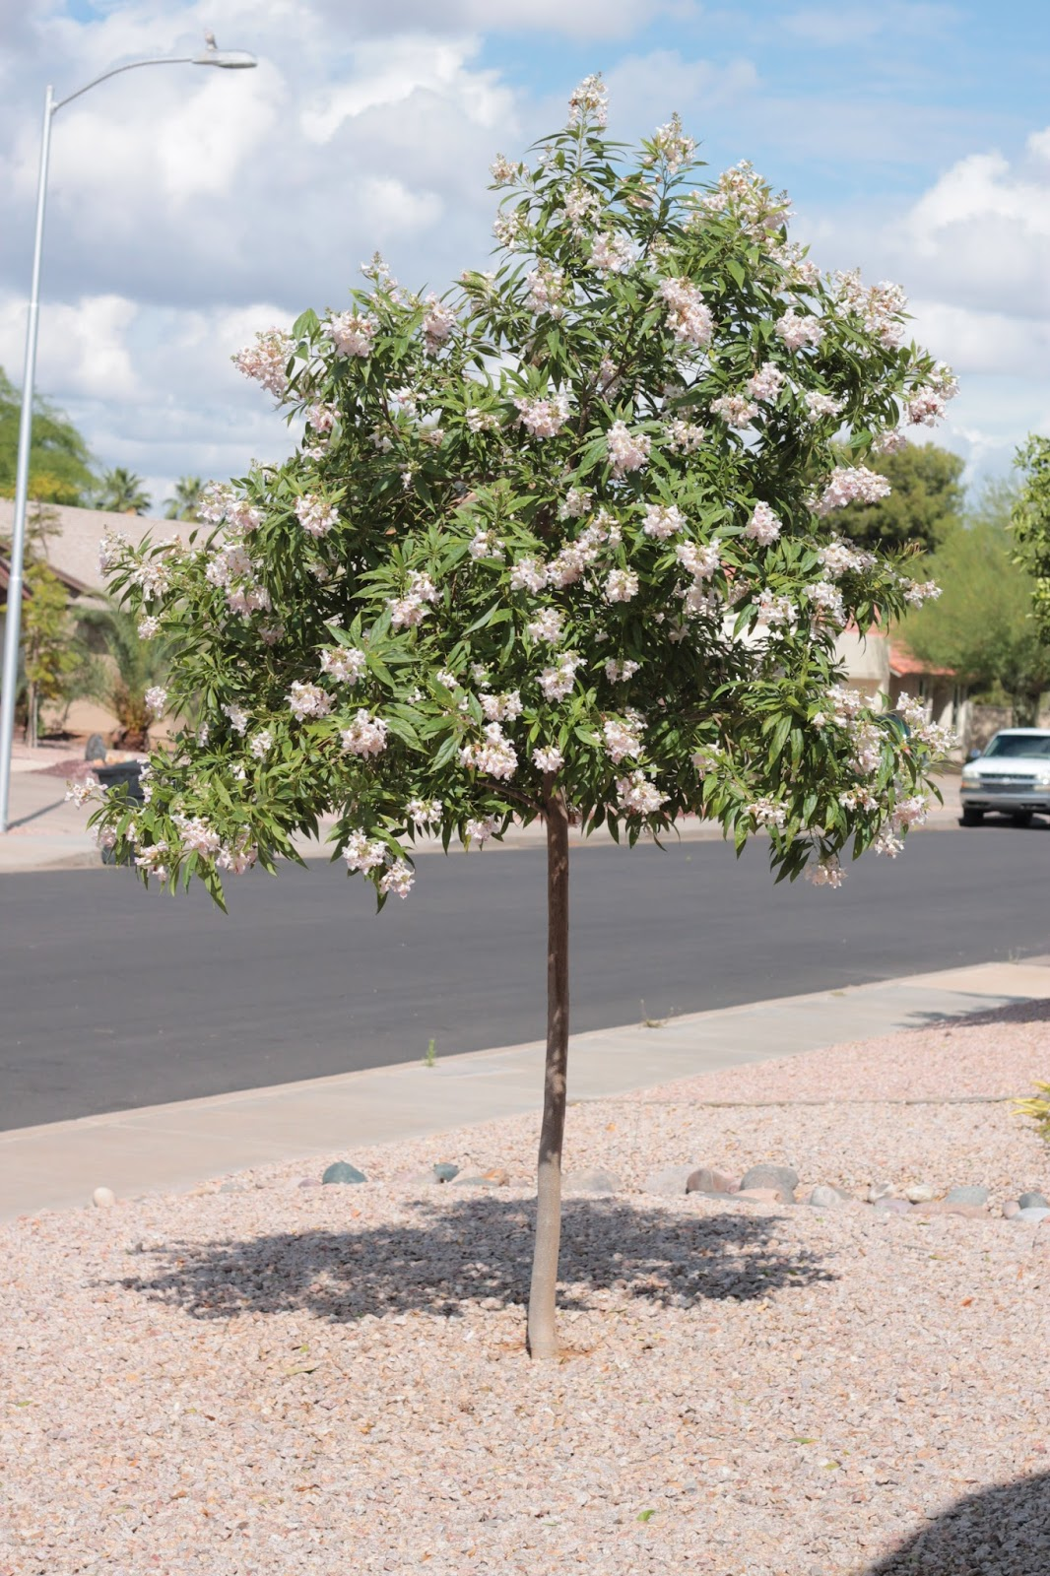
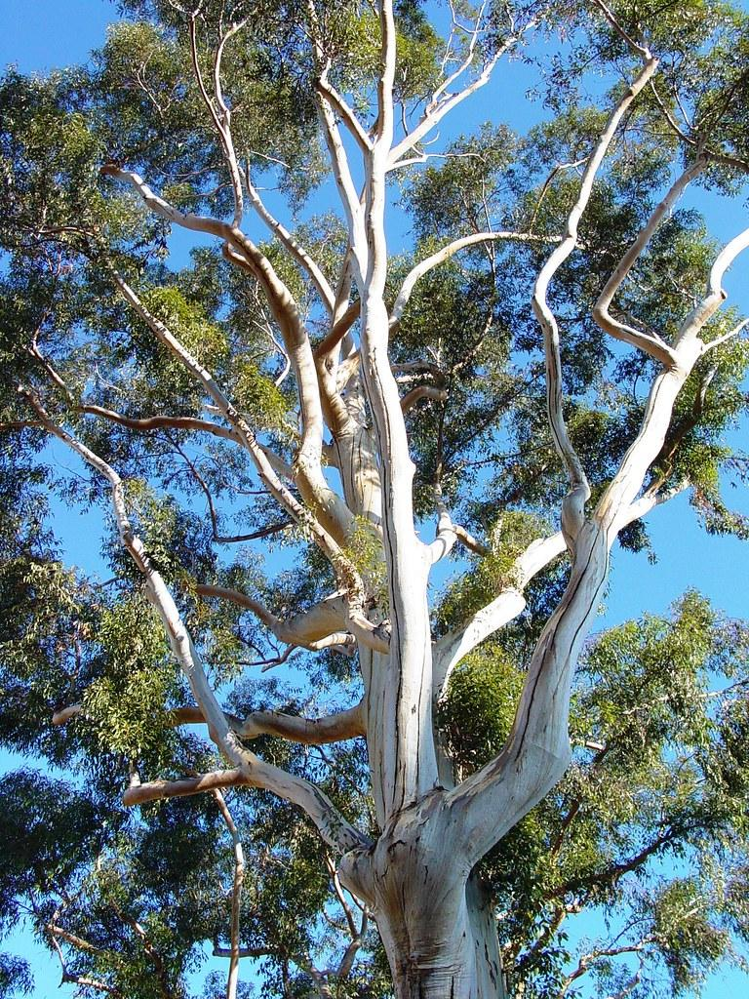
You will receive one of these four trees...
Stone Pine
Coast Live Oak
Chitalpa
Eucalyptus
Notes:
Show pictures and ask students to guess trees

Slide 11
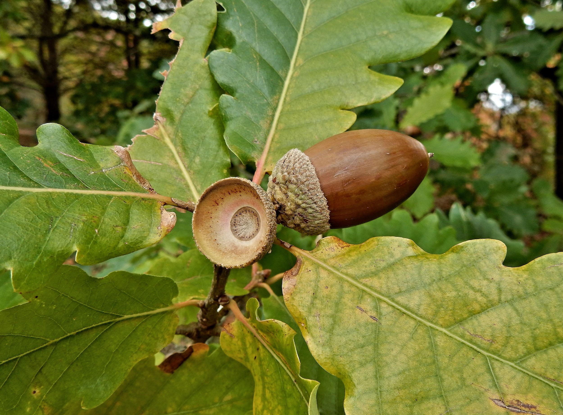
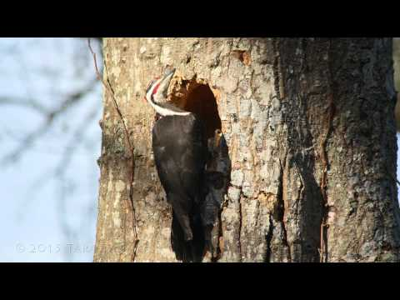

K-ESS2-2 - Construct an argument supported by evidence for how plants and animals (including humans) can change the environment to meet their needs.
Notes:
Phenomena: What do you think is happening in this video? What do you notice?

Slide 12
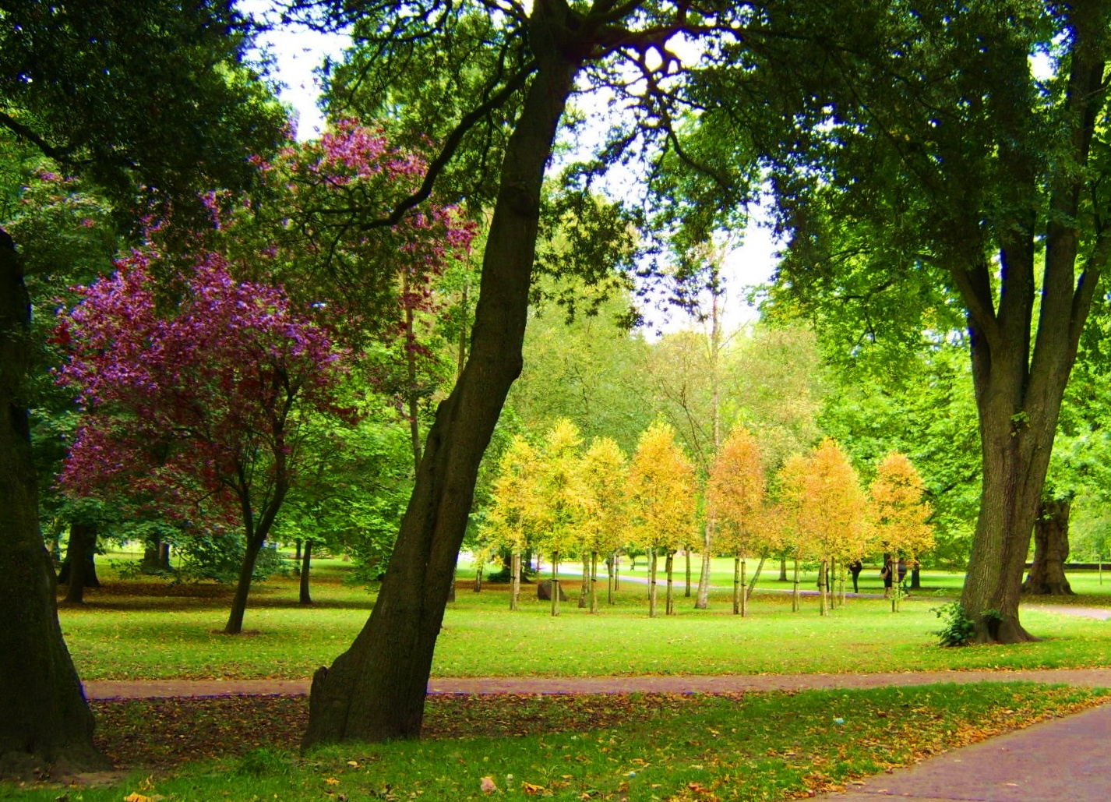



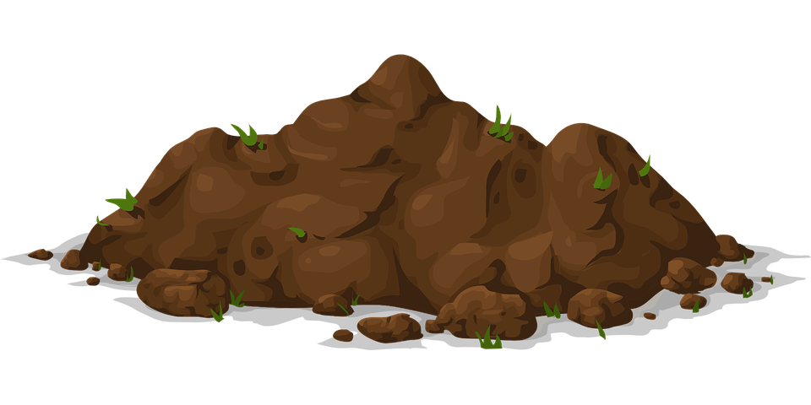
What does a tree need to survive?

Slide 13
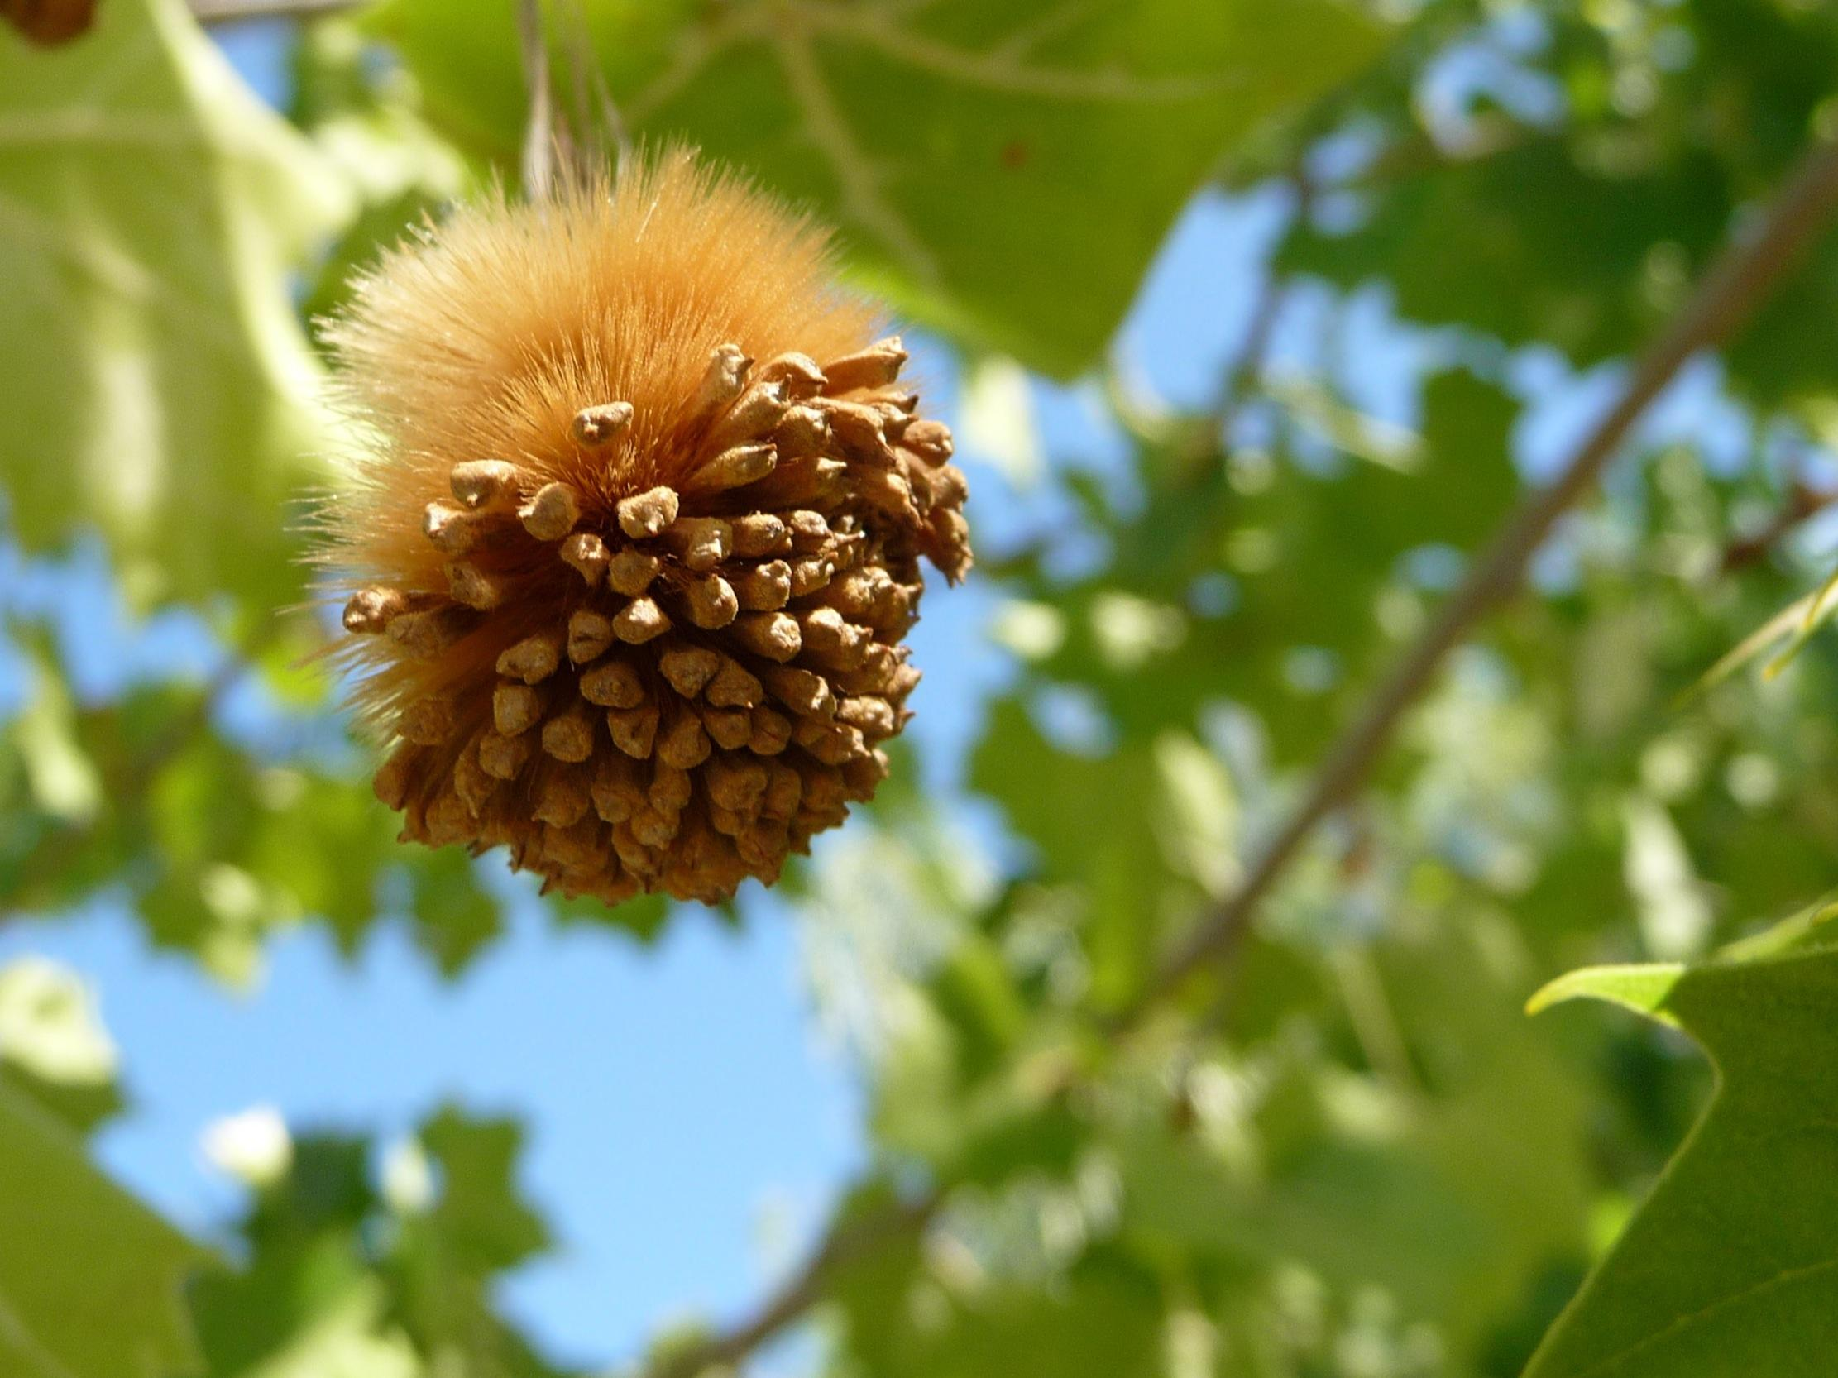
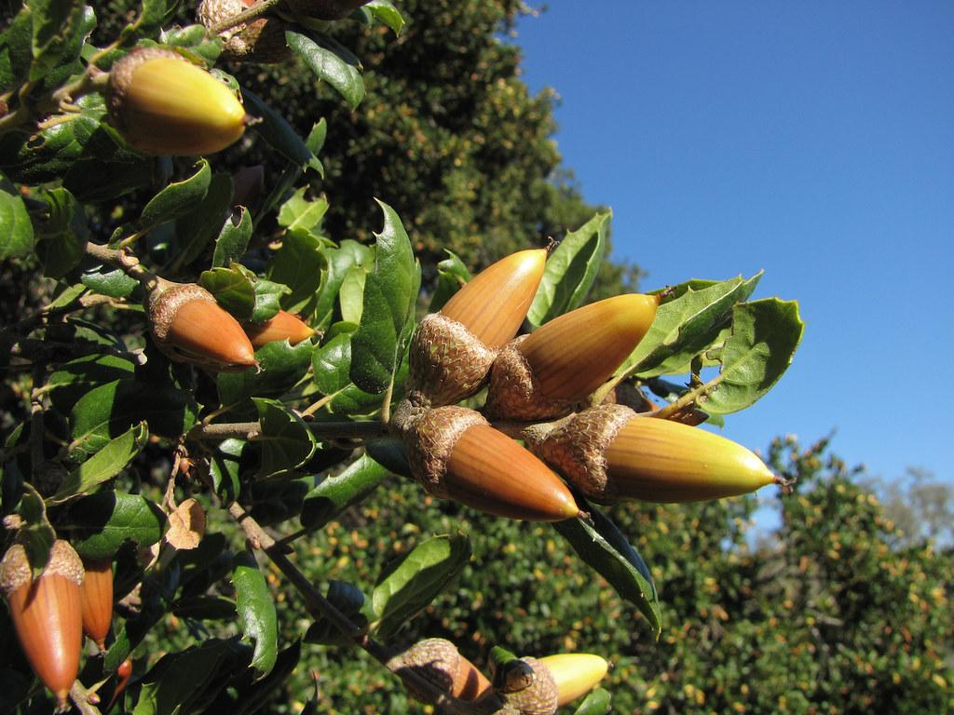
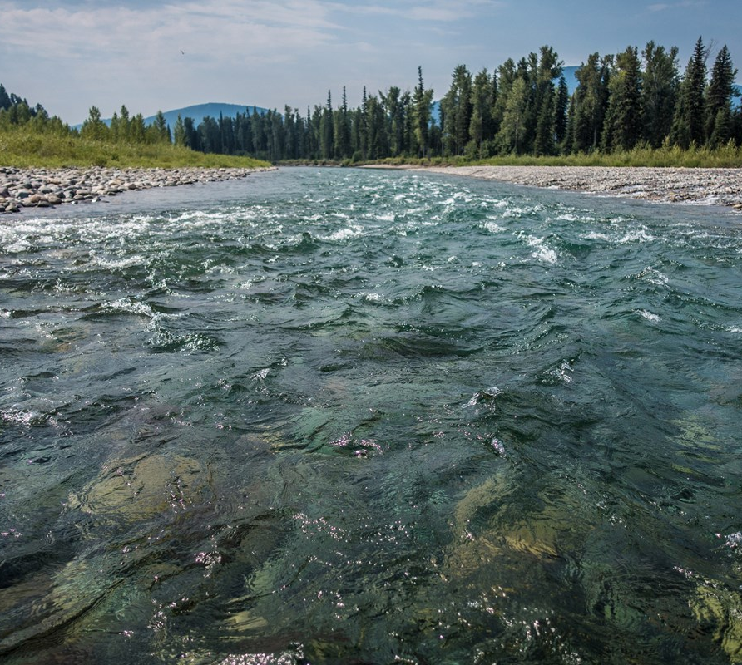
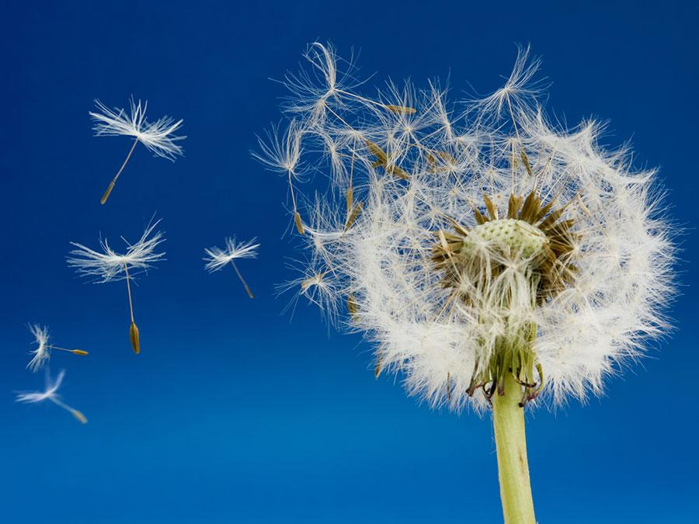
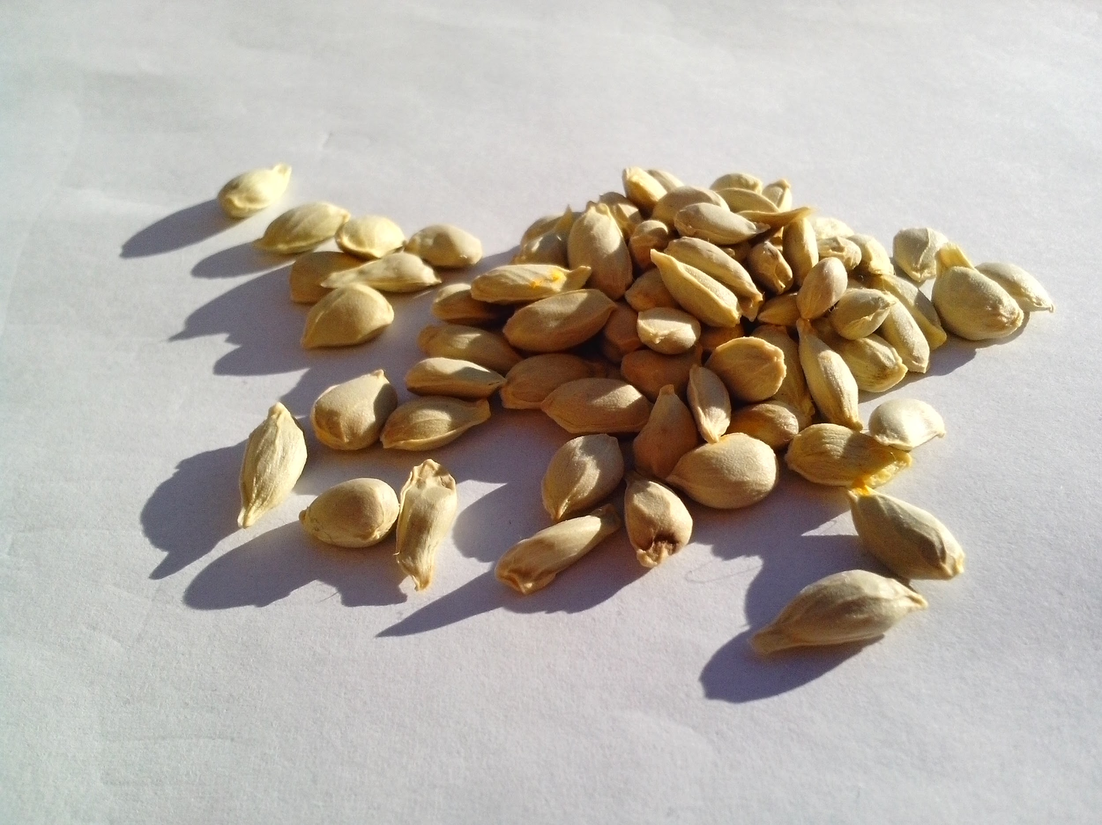
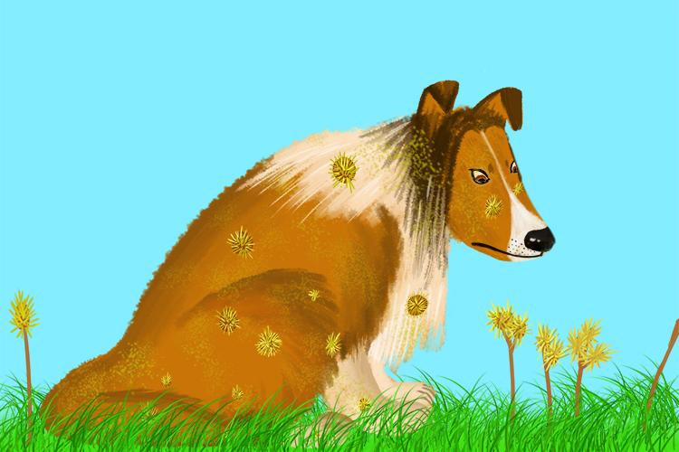
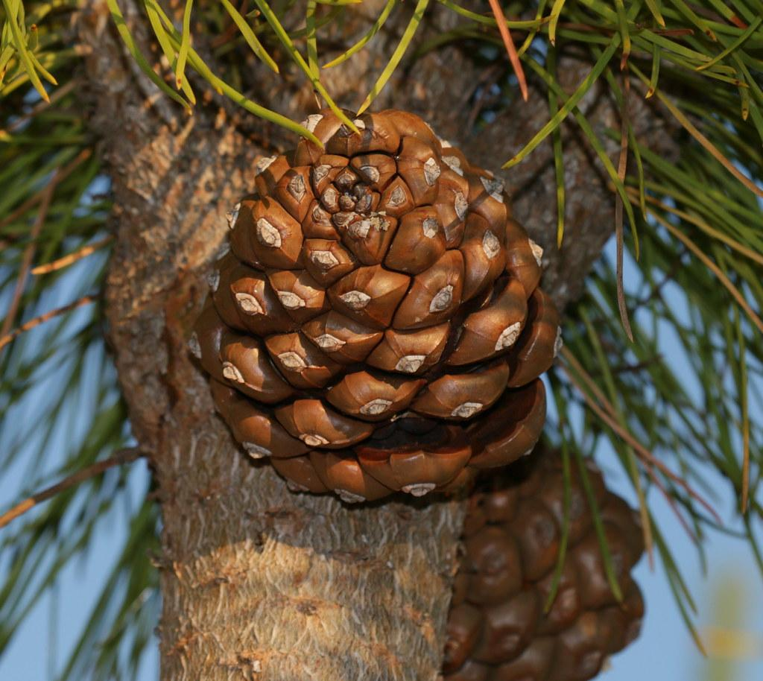
Let’s see what you know!
Water
Wind
Animals
Notes:
Seed observation and what it tells us about the way it might be dispersed:
Wind
Water
Animals - consumption, exterior transport
Gravity

Slide 14
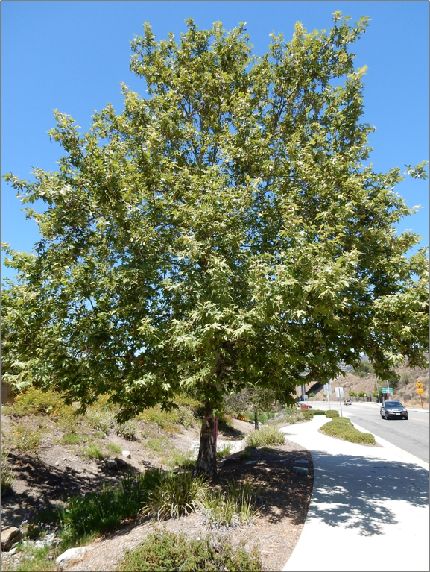
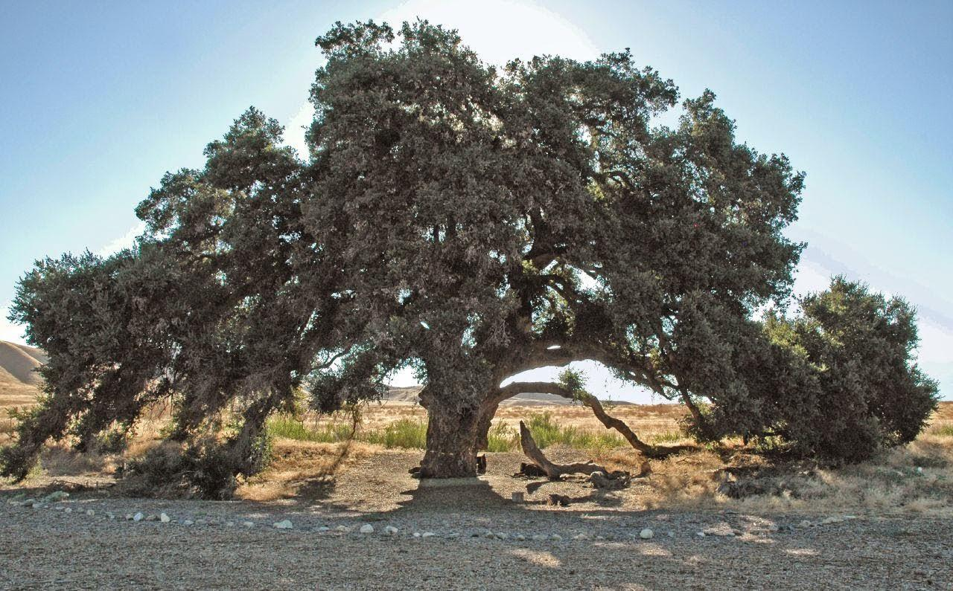
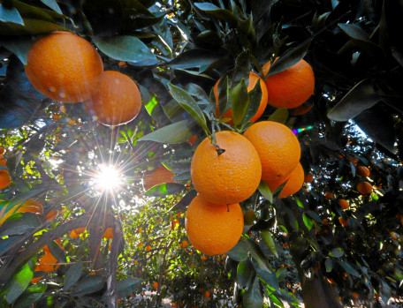
Let’s see what you know!
Orange
Sycamore
Coast live oak
Stone Pine
Notes:
Seed guessing/ID as trees appear

Slide 15
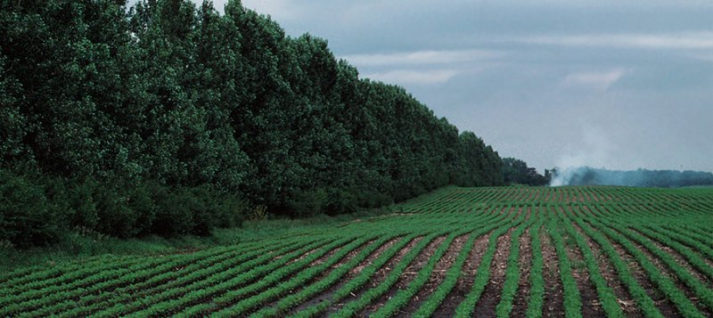
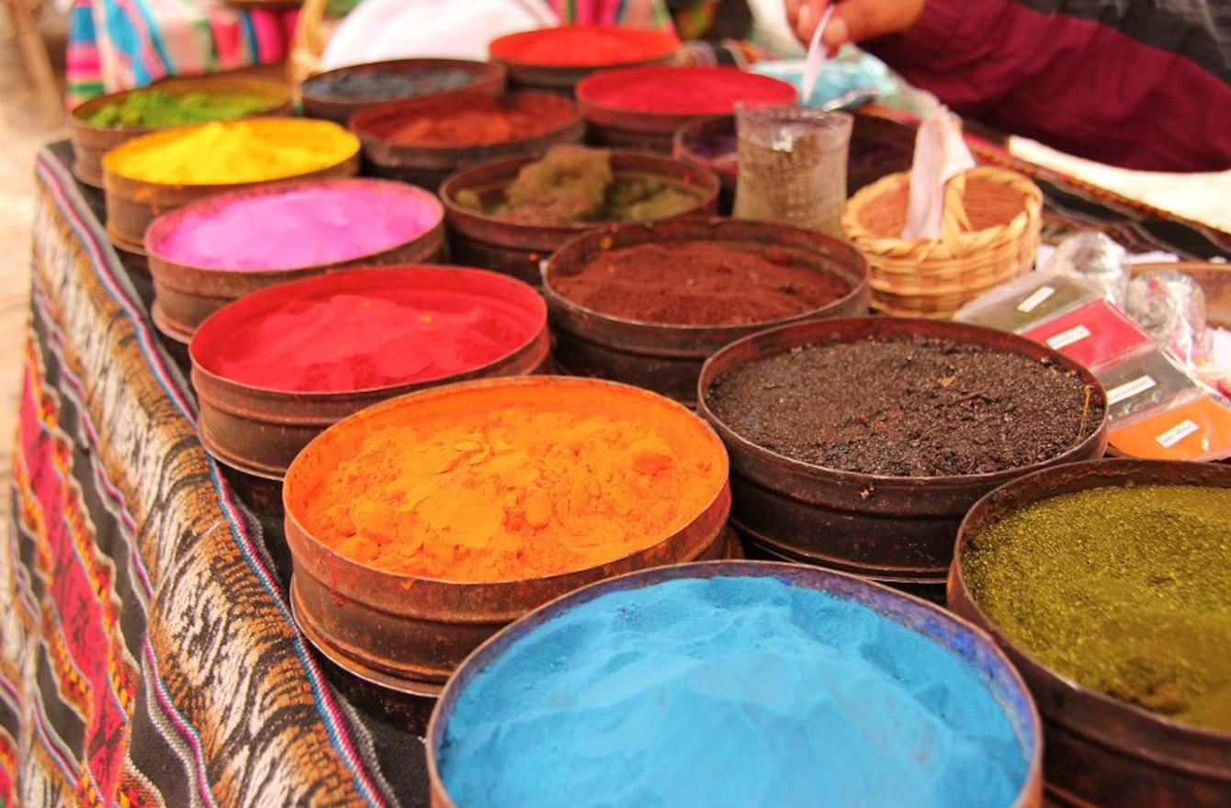
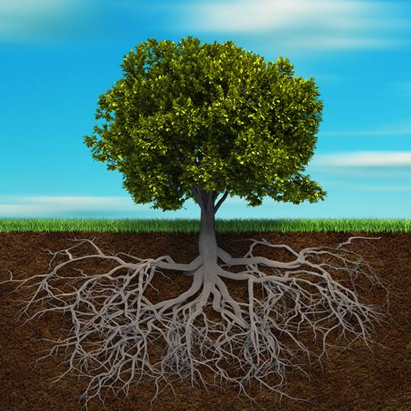
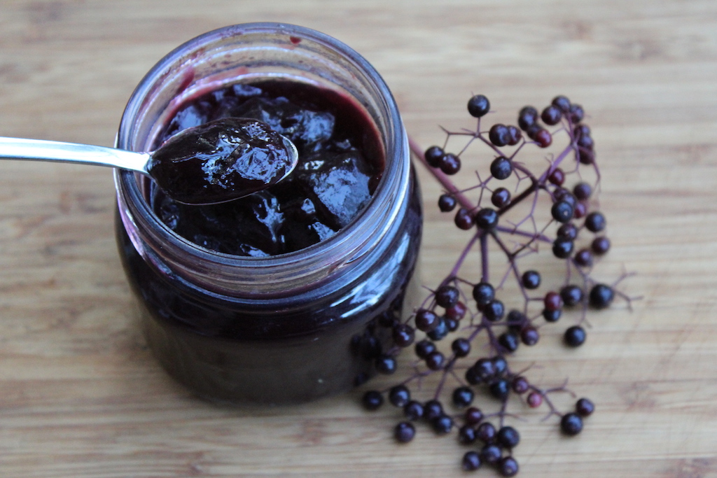
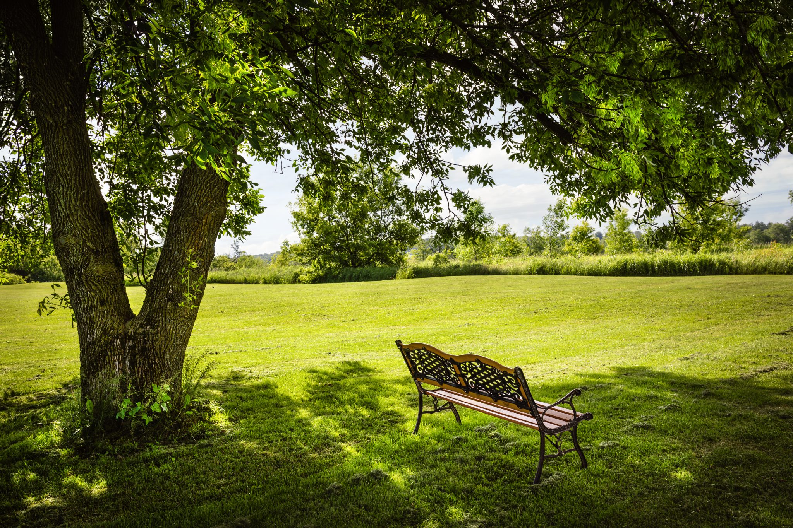
Why should we plant trees?
Notes:
Discussed in earlier slide: fruit, medicine, reducing heating/cooling costs, air quality benefits, habitat
This slide: local food (elderberry jam), protecting ag from wind, shade for people, dyes/pigments, elevation of soil health - aeration, stability

Slide 16
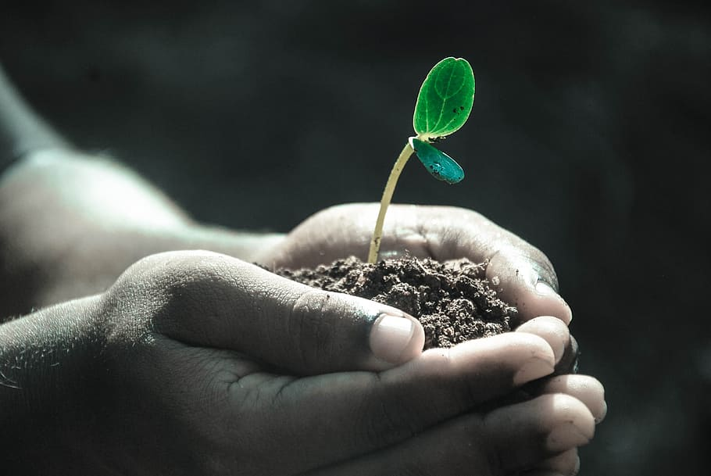
How will you care for your tree?
Notes:
Distribute tree profiles and care worksheets

Slide 17

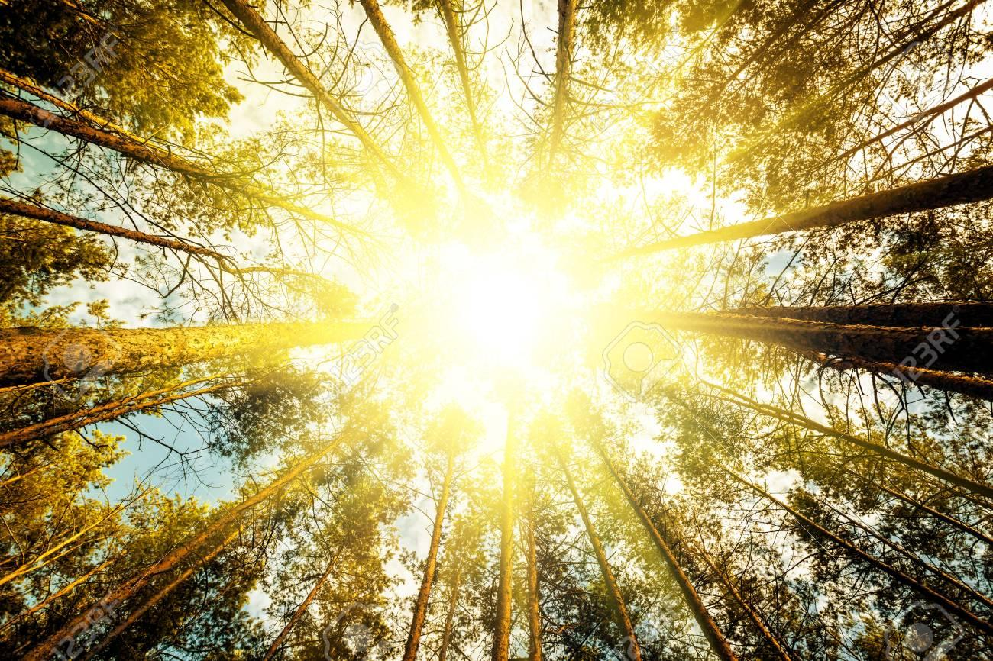
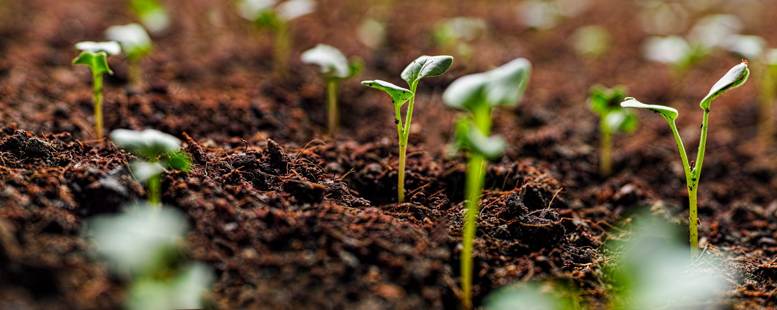
Wrap it up!
Water
To survive, trees need:
B. Sunlight
C. Healthy soil
D. All of these
D. All of these
Notes:
Start with photos and have students guess the seeds.

Slide 18

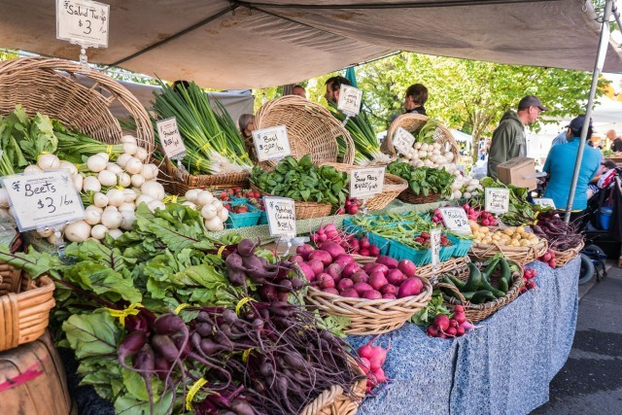

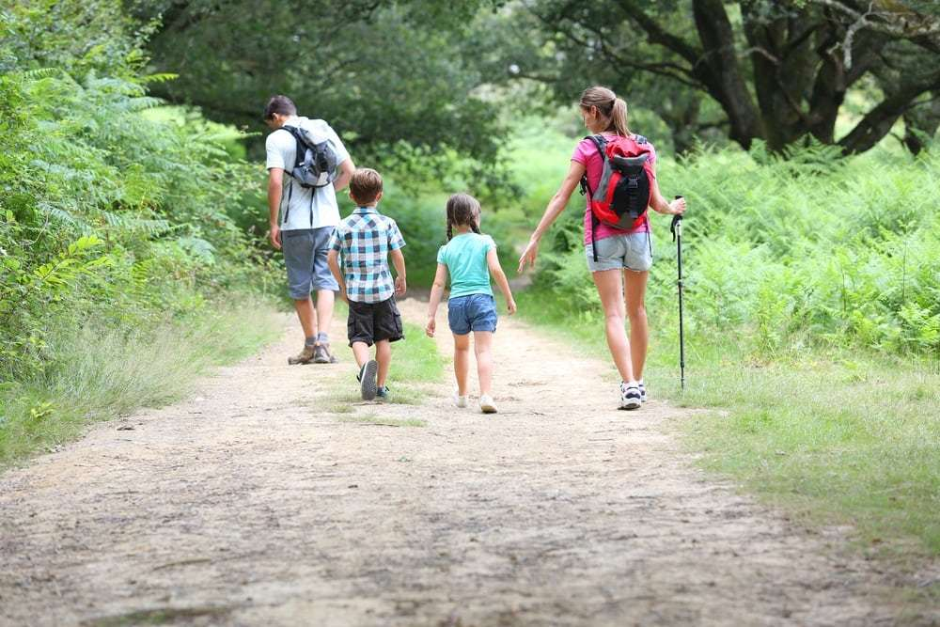
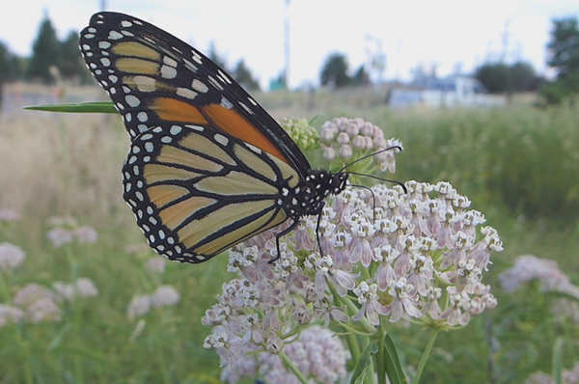
Wrap it up!
What else can we do for Earth Day?
Notes:
Reduce waste by donating clothes you no longer need
Save water
Get outside!
Plant pollinator habitat
Eat locally
Other ideas

Slide 19
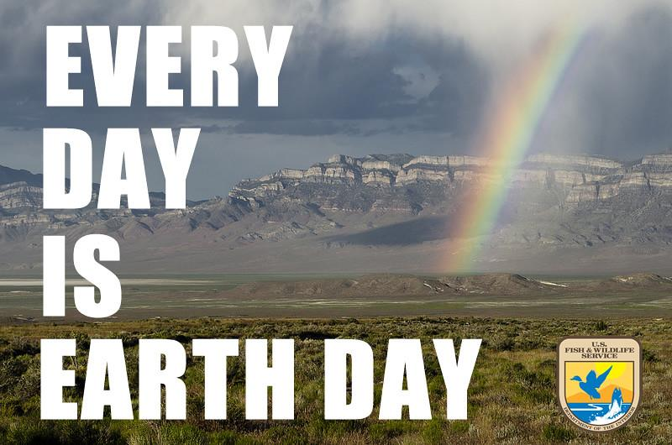
redlands.edu/trees
Notes:
Thank you to students
redlands.edu/trees demo at end, time permitting: map, resources, activities

