Slide 1



EMERGENCY PROCEDURES ACTIVE SHOOTER
UNIVERSITY OF REDLANDS PUBLIC SAFETY DEPARTMENT
Andy Flores, Interim Chief
Tony Gorrell, Interim Assistant Chief

Slide 2
DEPARTMENT OF PUBLIC SAFETY
Introductions
24/7 Operation.
  Experienced dispatchers and officers always available.
Contact Public Safety at 909-748-8888.
Officers will document incidents and crimes occurring on all campuses:
  Crimes.
  Injuries.
  Accidents.
  Any incidents impacting the normal operations of the campus.

Slide 3
Emergency Preparedness Update
Card Reader Project
  2nd phase – additional cameras
Building Addresses
Earthquake scenarios
  Emergency supplies
  Emergency Communications
PSAFE Bike Team
PSAFE website

Slide 4

IN CASE OF AN EMERGENCY
If there is an urgent medical need, violence or crime in progress:
  DIAL 911.
After dialing 911, notify Public Safety at 909-748-8888 when convenient.
If possible have someone direct emergency personnel to location.

Slide 5

MEDICAL EMERGENCIES
Immediately call 911 and Public Safety (x8888). Give your name, describe the nature and severity of the problem, and provide the location of the victim.
Do not panic. Assess the situation. Look for medical ID and question witnesses.
Ask the victim, “Are You Okay?, “What’s Wrong?, and “How Can I Help?”
Keep the victim still and comfortable. DO NOT MOVE THE VICTIM, unless there is a life-threatening situation.
Check breathing. If not breathing, give CPR, if trained to do so. Use an AED if one becomes available.
Control serious bleeding by placing direct pressure on the wound.
Continue to assist the victim until help arrives.
Give all information to the police or medical personnel.
Immediately report all injuries to supervisors or faculty.

Slide 6
CLERY ACT
Enacted in 1990.
Mandates University crime reporting guidelines and dissemination of information.
Daily Crime and Fire Logs.
Timely Warnings.
Annual Security Report is posted online at: http://www.redlands.edu/public-safety/annual-security-and-fire-safety-report/

Slide 7

EMERGENCY ALERTS
UR Bulldog Alert.
Communications service used to quickly send emergency alerts via email, voice and text messages.
  Alertus – available in near future.
All University of Redlands students, faculty, and staff are automatically enrolled in UR Bulldog Alert.
  Check your profile.
In the event of a major disaster, call the emergency status information line at 909-335-5299 or 877-687-8300 or go on-line http://www.emergency-redlands.com

Slide 8
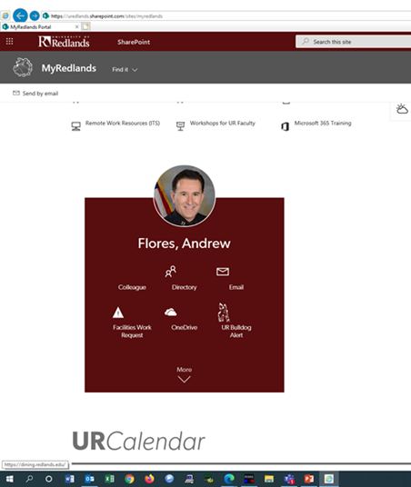
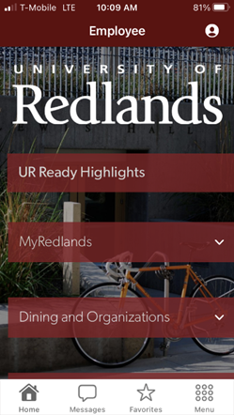
BULLDOG ALERTS
My Redlands or Redlands App

Slide 9
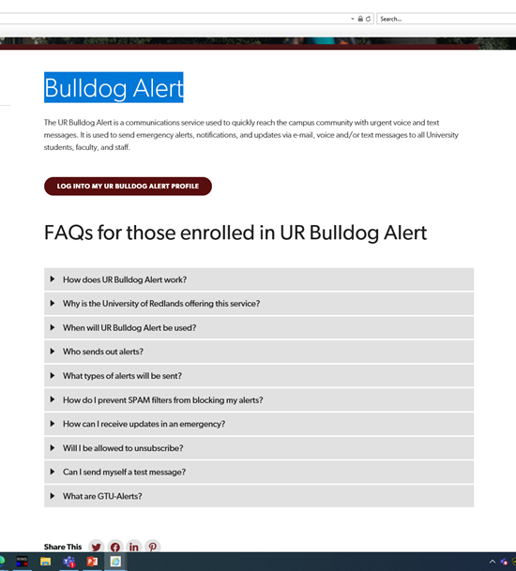
Bulldog Alert
Click “Log into my
UR Bulldog Alert Profile

Slide 10
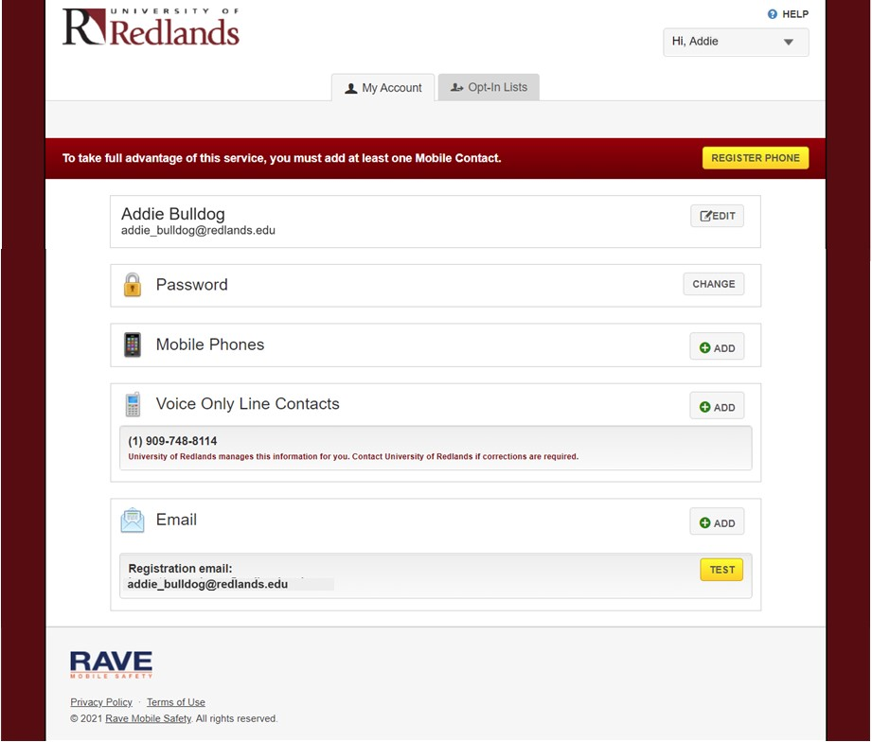
Bulldog Alert
Personalize
You can add up to three
Additional phones /two
email addresses your profile

Slide 11
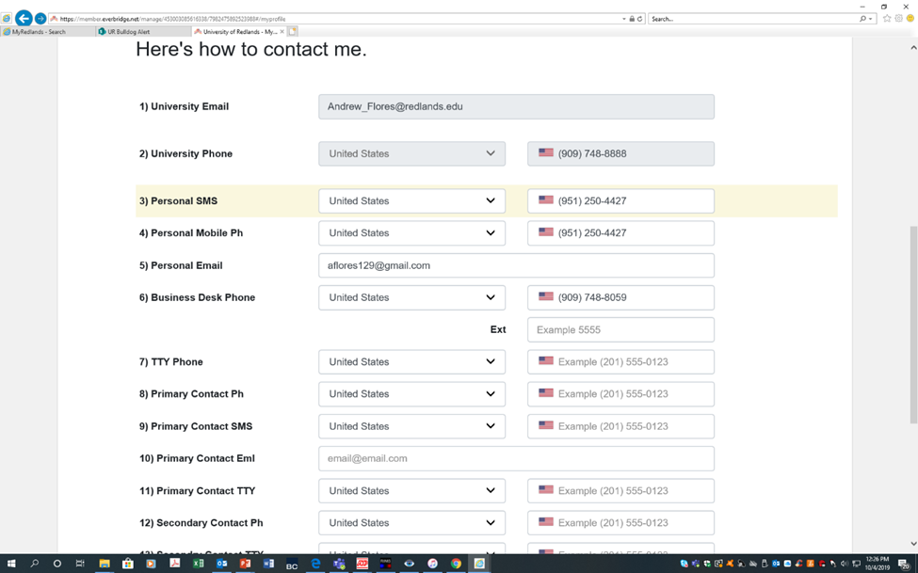
BULLDOG ALERT PROFILE

Slide 12
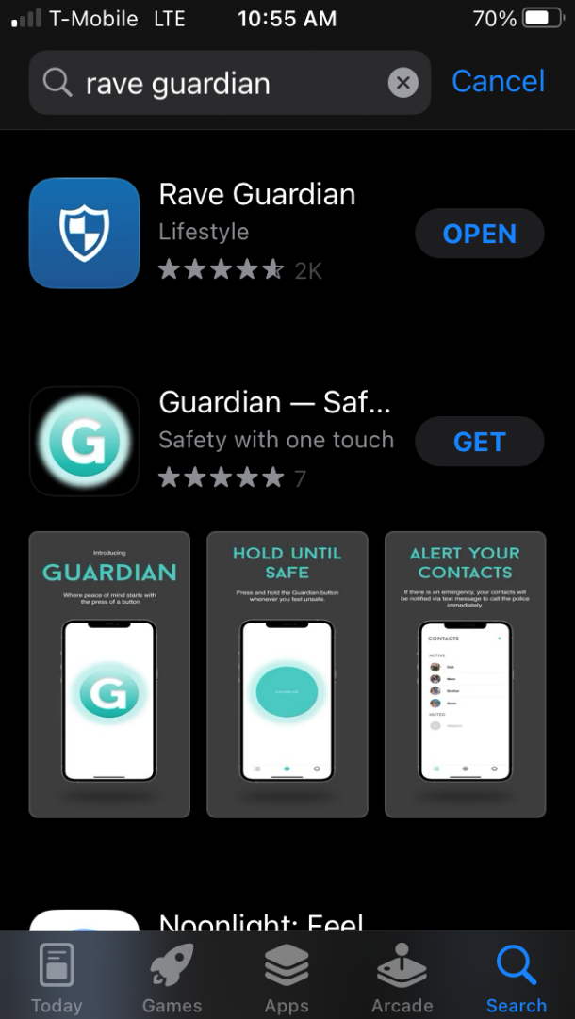
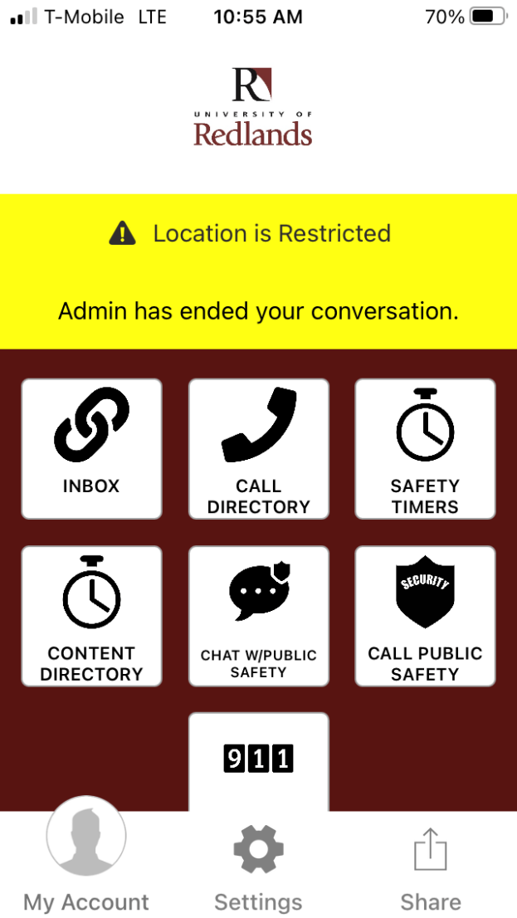
RAVE GUARDIAN

Slide 13
Edwards Street Shooting
Thursday, February 16, 2023
2:46 pm – UOR employees reported shots heard north of Ted Runner.
PD notified, PSAFE Officers immediately responded to the Athletic Fields to warn staff/students in the area.
RPD Deputy Chief called PSAFE Chief Flores and verified two people struck by gunfire on Edwards Street.
Chief Flores immediately notified Michelle Rogers and both agreed that although not an immediate threat to campus a Bulldog alert should go out as a precaution as information is obtained.
Bulldog alert sent to Shelter in Place and wait for further information
RPD notified Chief Flores scene was stable and suspects no longer in the area
3:39 pm - “All Clear” Bulldog alert sent
Total time of incident was 53 minutes

Slide 14


Shelter in Place vs. Lockdown

Slide 15

SEE SOMETHING, SAY SOMETHING
If you see suspicious activity on campus, report it.
Examples of suspicious activity.
Be aware of your surroundings.
Take note of the nearest exits when visiting facilities.
Have a plan.

Slide 16
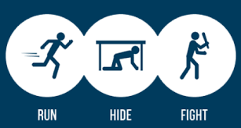
ACTIVE SHOOTER

Slide 17

3 PHASE TRAINING
1. Pre-Attack
2. During Attack
3. Post- Attack

Slide 18
PHASE 1: PREVENTION
SEE SOMETHING SAY SOMETHING
  The police or PSAFE will not know about a potentially unsafe condition unless you report it!
  Don’t rationalize or assume the condition is normal
    “It’s probably nothing, I don’t need to report it”
LEAKAGE
  Many active shooters let others know what they plan to do, but it does not get reported. “Oh he’s not really serious”
  Many active shooters post this information on social media.
    Screenshot the information
    Capture the user ID information
    Report to Police or PSAFE
    Do not immediately report to the social media platform because they may delete the account. The police will contact social media
    Save the info on a flash drive if possible

Slide 19
PHASE 1: PRE-ATTACK / PREPARE
MINDSET
  It can happen.
  Tell yourself you will survive and help others if needed.
BE PREPARED
  AWARENESS.
  Take notice of surroundings .
  Be aware of unusual behaviors, unattended objects, unexplained odors, or vehicles traveling at abnormal speeds or patterns.

Slide 20

PHASE 1: PRE-ATTACK / PREPARE
HAVE A PLAN
  Take note of emergency exits.
  Ensure you can barricade doors if needed.
  Be aware of cover and concealment if needed.
  WHAT IF?

Slide 21
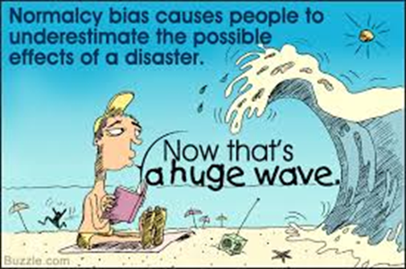
NORMALCY BIAS
People with normalcy bias have difficulties reacting to something they have never experienced before.
They also tend to interpret warnings in the most optimistic way.
3 phases of response: Denial, Deliberation (plan?), Decisive Moment.
70% of people display normalcy bias during a disaster.
Examples:
  Evacuation warnings, Hurricane, Fire, Floods etc.
  Hurricane Katrina, Pompeii, etc.

Slide 22
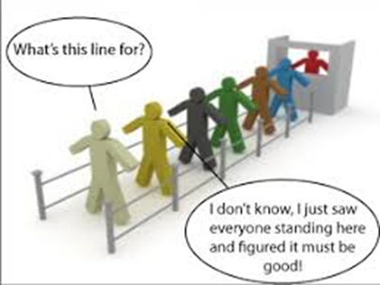
SOCIAL PROOF
Social Proof: a psychological and social phenomenon where people assume the actions of others in an attempt to reflect correct behavior in a given situation.
Example: Shots heard in the area, everyone looks at each other to see their reaction. If no one does anything, they assume this is proper behavior.
Don’t be a victim to the “herd mentality”. Take Action!

Slide 23
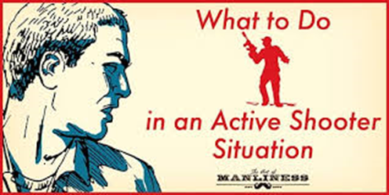
ACTIVE SHOOTER
Most Active Shooter situations are unpredictable and evolve quickly.
Immediate deployment of law enforcement is required to stop the shooting and mitigate harm to victims.
Often over in 10 to 15 minutes. Individuals must be prepared both mentally and physically to deal with an active shooter situation.

Slide 24

Phase 2: How to respond when an Active Shooter is in your vicinity.
RUN
  Have an escape route in mind.
  Evacuate regardless of whether others agree.
  Leave your belongings behind.
  Help others escape; if possible.
  Prevent others from entering unsafe area.
  Keep hands visible and follow instructions of officers.
  Do not attempt to move wounded people.

Slide 25

How to respond when an Active Shooter is in your vicinity.
HIDE
  If evacuation is not possible, find place to hide where shooter is unlikely to find you.
  Be out of the shooters view.
  Provide protection (cover and concealment) from shots fired.
  Try not to trap yourself or restrict options for movement.

Slide 26

How to respond when an Active Shooter is in your vicinity.
FIGHT
  As a last resort and only when your life is in imminent danger, attempt to disrupt and/or incapacitate the active shooter by;
  Acting as aggressively as possible.
  Throwing items and improvising weapons.
  Yelling.
  Commit to your actions.

Slide 27

How to respond to officers
Usually teams of 4 or 5 - Uniforms vary.
May use pepper spray or gas.
Officers may shout commands.
Remain calm / hands visible and free of objects.
Avoid quick movements / pointing / yelling.
Proceed to location they direct you to.

Slide 28
Active Shooter UOR (7:42 mins)
https://www.redlands.edu/publicsafety/emergency-procedures2/active-shooter/

Slide 29

Phase 3: POST ATTACK
Many lives are lost due to uncontrolled bleeding injuries.
Research has shown that bystanders, with little or no medical training, can become heroic lifesavers.

Slide 30

POST ATTACK
Recommend attending a “Stop the Bleed” training session or similar “hands-on” training.
The human adult has about 5 liters of blood in the body.
Losing ½ of your blood causes irreversible damage.
Applying direct pressure can often times save lives.
Applying a tourniquet results in an 87% chance of survival if applied before shock sets in.

Slide 31

POST ATTACK
SITUATIONAL AWARENESS
  Are you safe?
  Can you treat yourself?
  Can you treat others?
WHO DO WE TREAT IN MULTIPLE VICTIM INCIDENT?
  Your decision.
  If breathing or moving – Treat.
  If not – Move on.

Slide 32
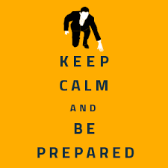
CLOSING
Prepare
Plan
Be Alert
Report suspicious behavior, objects, incidents
Attend First AID / CPR / Stop the Bleed training.

Slide 33

QUESTIONS?

